Slide 1

PiLog’s Data Quality and Governance Solution powered by AI
Accelerated Transformation with SAP & PiLog
PiLog
Manual, Unstandardized Practices
Digitized, Industry Best Practices
Data Quality Fuels AI Excellence

Slide 2
Table of Content
PiLog’s Data Quality and Governance Suite – Powered by AI (Requested by Smitha)
Solution Overview
Business Case
Go To Market – 2025 & 2026
PiLog DQG Suite – Price Catalogue
Customer Success Stories & Business Value Management
Competitive Landscape – Solution Comparison Overview “PiLog Suite vs PG MDG EAM SolEx vs Prospecta MDO”
SAP Store Performance History
PiLog Data Quality & Governance Suite (PiLog Suite) – Solution Overview
Data Governance with AI Lens (Copilot)
Data Quality Management
iContent Foundry
Data Migration: Data Extraction, Transformation & Load
Spare Parts Interchangeability Records (iSPIR) & Financial Asset Register (iFAR)
Meta Data Optimizers (AI/ML Models)
Product Roadmap
Solution Context Overview
Industry Agnostic Standards, Policies, Procedures & Compliance; Use Cases for Asset & Supply Chain Data Management

Slide 3
PiLog’s Data Quality and Governance Suite – Powered by AI
SOLUTION OVERVIEW
Partner Solution and Description | PiLog Data Quality and Governance Suite PiLog’s data quality and governance suite is built on lean management principles, incorporating best industry practices, ISO standards, and AI-driven content. This suite provides comprehensive features, processes, and methodologies for effective data lifecycle management for core processes within ERP, CRM, CMMS systems. AI Powered PiLog’s Data Quality & Governance Suite has following solutions bundled as follows Data Governance (20+ Data objects with real-time integration with S4 on BTP) Data Quality (Data Cleansing, Classification, Categorization & Enrichment) iContent Foundry (Asset, Product & Services Taxonomy with EAM data repositories) Data Migration (Data Acquisition/Integration, Transformation & Migration to S4 on BTP) SAP MDG Add-on (Material & Service Master taxonomy with governance for SAP MDG)
SAP Integration & Interoperability | PiLog Data Quality and Governance Suite integrates with S/4HANA on-premise and private cloud editions through SAP Cloud Foundry on BTP (CPI middleware APIs). Open and Cloud connector Architecture with API endures future scalability and interoperability with SAP and non-SAP suites for RISE & GROW programs
Cloud Delivery and Data Processing | Deployment model – On-Cloud (SaaS), Private Cloud & On-Premise Data Centers – Hyperscalers (IaaS platform) Data Center countries – NA, EMEA, APJ Data Center hosting providers – AWS, MS Azure Data Privacy Policy & GDPR – Compliant with GDPR Avg time to Go-Live (days) – Deployment within 60 Days (Pending on total scope)

Slide 4
PiLog’s Data Quality and Governance Suite
Competitive and Risk Profile
Competing Solutions | Prometheus MDG - EAM, Prospecta MDO, Simple MDG on SAP Store
Competitive Advantage | AI-powered industry content blended into the solution for diverse deployment scenarios (SaaS, PCE, On-Prem) ~30 years of customer success recognized by Gartner, Forrester, and InfoTech Active in ISO and standards bodies with strong industry advisory expertise 50+ integrations available through BTP Cloud Foundry for SAP Landscape A value-driven portfolio of products that helps customers continually measure value, optimize costs, and improve return on investment For scalability, continuous Investment in AI-powered tools, accelerators, processes, methods, and standards
Risk | PiLog sees no potential risks or threats. With a 360-degree partnership with SAP on Data Quality and Governance suite, we aim to improve market share and customer success across the globe
Endorsed APP Readiness Dashboard (To be filled by Smitha)
PE Build in Place? PRM ID
Store Listing ID Store Performance
31AB Approvals
CRO
CSMO
CPO
Sponsorship IO Available?
Partner Accepts Model & Terms?

Slide 5
PiLog’s Data Quality and Governance Suite – Business Case
Revenue Impact | Rationale
SAP Revenue Share 3year forecast | G |  | Year1 (Euro) | Year2 (Euro) | Year3 (Euro)
 |  | Partner ACV | € 2,000,000 | € 3,000,000 | € 5,000,000
 |  | SAP Reve Share (@35%) | € 700,000 | € 1,050,000 | € 1,750,000
Solution Fitment | Rationale
Product Maturity | G | Solution has incredible market reputation with high score from customers & leading industry analysts Considerable investments are being made on AI powered tools, processes, methodologies, standards for cross industry Data Maturity Improvements
Complimentary Portfolio Fit | G | PiLog DQG Suite compliments & supplements SAP S/4 HANA PCE, On-Premise, BTP and SAP solutions like BNAC, BTP, BN4P, IDP, IBP MRO, FSM with improved Master & Meta Data to better process controls Data readiness powered with AI will complement SAP’s Suite First & AI First Strategy
GTM Fitment | Rationale
Solution Area | G | AI driven Multi-Domain Data Quality and Governance is for improved Master & Meta Data across business process of end to end Supply Chain, Asset Life Cycle & Performance Management with options of both on-premise and cloud deployments 17 Million+ industry specific & agnostic Records, 20K+ Taxonomies & Hierarchies for Asset, Services & Material Master Meta Data Optimization for Planning, Procurement, Inventory, Asset augmented business processes Open and SMART APIs for seamless integration with various technology landscapes and deployment scenarios
Click for details

Slide 6
PiLog’s Data Quality and Governance Suite – Business Case
GTM Fitment | Rationale
Attractive ASP | G | Average Selling Price per Customer ~110K Euros with average customer having 5+ objects on average on annual subscription Sale conversion cycle is around 90-100 days with devoted technical sales, pre-sales and architects Deal Conversion ~60% of qualified deals and ASGM > 55%
Customer References | G | PiLog has nearly 30 years of experience serving customers across Mill Products, Mining, Chemicals, Travel & Transport, Utilities, Energy Oil & Gas, Petrochemicals, Industrial Manufacturing, Facilities, Public Sector, etc. Please refer to PiLog Industry Experience slides for referenceable customers
Company Fit | Revenues by region for Licenses
Geo. Footprint | Middle East |  | Americas | Europe | APJ & India | TOTAL
Overall Revenue in Million Euro | 1.4 |  | 0.8 | 0.15 | 0.8 | 3.15
SAP Business
SAP regional share in percent
Click for details

Slide 7
GTM Assessment
Sales Bag Alignment / Priority
Customer References
Expected to be a top solution in bag? | G Would be top notch player
Cross-selling opportunities with other solutions in bag? | G Typically sells with SAP
ASP vs. other solutions in bag | G Better value for investment and TCO
Region |  | Key Names
NA |  | Anglo American
EMEA |  | SABIC, OQ, Jindal Shadeed, Yasref
APJ |  | JSW, JSPL, Vedanta, UltraTech
LA |  | Anglo American
TOTAL: |  | 150+
Competency & Relationship
Channel Conflicts
Fit with existing competencies | G No new domain knowledge needed
Fit with existing relationships | G Cross & Up Sell within existing accounts with value relationship
Current Channels into SAP Accounts? | G No channel conflict identified, to work with SAP Partners and AEs across Globe
Agreement to Redeploy/Realign Channels/Incentives | G Envisaged Partnership alignment with global and local partnership

Slide 8
Company Headcount, Revenue Projection & Assumptions
€000's | # of PiLog Employees | # of Sales + Pre-Sales | 2025 |  | 2026 |  | 2027 |  | TOTAL |  | APPROVAL (X=sign-off)
 |  |  | Deals | Revenue | Deals | Revenue | Deals | Revenue | Deals | Revenue
NA | 10 | 2 | 4 | 0.5 M€ | 6 | 1.0 M€ | 6 | 1.5 M€ | 16 | 3.0 M€
EMEA | 290+ | 10+ | 10 | 1.0 M€ | 10 | 1.5 M€ | 15 | 3.0 M€ | 25 | 5.5 M€
APJ | 260+ | 15+ | 6 | 0.5 M€ | 6 | 0.5 M€ | 6 | 0.5 M€ | 18 | 1.5 M€
LA | 2 | 2
TOTAL | ~700 | 30+ |  | 2.0 M€ |  | 3.0 M€ |  | 5.0 M€ |  | 10.0 M€
ASP: € 110K per Customer Subscription per Year
Market / Sales
Pre-Sales/ Sales Support
Implementation / Services
Geography Wise: ME, Europe and NA for Asset Centric Industries
4-6 of sales resources from PiLog
No version dependencies
3-4 Pre-Sales, Solution and Business Experts to participate in end-to-end sales cycle
No implications for scaling
7-8 implementation resources to deliver projects
No Scaling risk envisaged

Slide 9


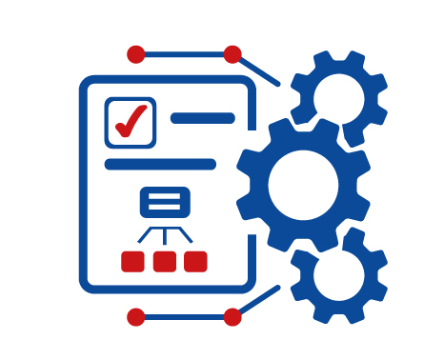

Customer Categorization and Adoption
Early adopters, multinational organizations, multi-cloud integrations, disruptive leaders, geographic specific etc.
E.g.: GROW customers
Ready for SAP BTP Public Cloud
Large organizations with security driven infrastructure, Privately owned data centers, local regulatory compliances, closely-bounded application landscapes, large volumes of data, geographic specific etc.
E.g.: SABIC, ARAMCO, OQ, Riyadh Airports
On-Premise or Private Cloud Customers
Fully secured DMZ deployments, no external integration, government or defense sectors with security first models, Privately owned data centers, local regulatory compliances, closely-bounded application landscapes, large volumes of data, geographic specific etc.
E.g.: CANADIAN DEFENCE, COAL INDIA
Defence & Government Customers
www.piloggroup.com
Restricted Use
Notes:
Model for customer categorization & adoption driving market segmentation

Slide 10
Go To Market for 2025 & 2026
“Enable Revenue with Net New, Cross /Up Sell”
www.piloggroup.com
Restricted Use

Slide 11
Middle East – KSA, UAE, Oman, Qatar, Kuwait (1/2)
S.No | Account Name | IBU | Country | Account Type | Potential Opportunities | Probability of Win | Potential Revenue (MEUR)
1 | Petro Rabigh | Chemicals | KSA | Net New | PiLog Data Quality and Governance Suite for Materials, Services, and EAM Objects | High | 0.5
2 | SWA (Saline Water Conversion Corporation ( SWCC) | Utilities | KSA | Net New | PiLog Data Quality and Governance Suite for Materials, Services, and EAM Objects | High | 0.5
3 | WTCO (Water Transmission Company) | Utilities | KSA | Net New | PiLog Data Quality and Governance Suite for EAM Objects | High | 0.3
4 | Marafiq (MaSa) | Utilities | KSA | Net New | PiLog Data Quality and Governance Suite for Material, Service, and EAM Objects | Medium | 0.4
5 | Sasref | Energy, Oil and Gas | KSA | Net New | PiLog Data Quality and Governance Suite for Material, Service, and EAM Objects | High | 0.3
6 | Qatar Energy | Energy, Oil, and Gas | QATAR | Net New | PiLog Data Quality and Governance Suite for Material, Service, and EAM Objects | High | 0.5
7 | NAWAH Energy | Energy, Oil, and Gas | UAE | Net New | PiLog Data Quality and Governance Suite for Material, Service, and EAM Objects | High | 0.4
www.piloggroup.com
Restricted Use

Slide 12
Middle East – KSA, UAE, Oman, Qatar, Kuwait (2/2)
S.No | Account Name | IBU | Country | Account Type | Potential Opportunities | Probability of Win | License Revenue (MUSD)
8 | KNPC | Energy, Oil, and Gas | Kuwait | Net New | PiLog Data Quality and Governance Suite for Material, Service, and EAM Objects | High | 0.5
9 | OQ Group | Energy, Oil, and Gas | Oman | Cross / Up Sell | PiLog Data Quality and Governance Suite for Service, and EAM Objects | High | 0.5
10 | SABIC | Chemicals | Global | Cross / Up Sell | PiLog Data Quality and Governance Suite for EAM Objects | High | 1.0
11 | ARAMCO | Energy, Oil & Gas | Global | Cross / Up Sell | PiLog Data Quality and Governance Suite for Material, Service, and EAM Objects | High | 1.0
12 | ADNOC Group | Energy, Oil & Gas | Global | Cross / Up Sell | PiLog Data Quality and Governance Suite for Material, Service, and EAM Objects | High | 1.0
13 | YASREF | Energy, Oil & Gas | KSA | Cross / Up Sell | PiLog Data Quality and Governance Suite for EAM Modules | High | 0.2
14 | Riyadh Airports | Travel & Transports | KSA | Cross / Up Sell | PiLog Data Quality and Governance Suite for EAM Modules | High | 0.2
15 | JIGPC | Utilities | KSA | Cross / Up Sell | PiLog Data Quality and Governance Suite for Material, Service, and EAM Objects | High | 0.3
www.piloggroup.com
Restricted Use

Slide 13
Africas
S.No | Account Name | IBU | Country | Account Type | Potential Opportunities | Probability of Win | License Revenue (MUSD)
1 | MTN | Telecommunications | RSA | Net New | PiLog Data Quality and Governance Suite for Materials, Services, and EAM Objects | Medium | 0.2
2 | Dangote | Cross Industry | Nigeria | Net New | PiLog Data Quality and Governance Suite for Materials, Services, and EAM Objects | Medium | 0.5
3 | Vodafone | Telecommunications | RSA | Net New | PiLog Data Quality and Governance Suite for Materials, Services, and EAM Objects | Medium | 0.3
4 | Exxaro | Mining | RSA | Cross / Up Sell | PiLog Data Quality and Governance Suite for Materials, Services, and EAM Objects | Medium | 0.3
5 | DRC | Mining | RSA | Cross / Up Sell | PiLog Data Quality and Governance Suite for Materials, Services, and EAM Objects | Medium | 0.4
6 | Transnet | Travel & Transport | RSA | Cross / Up Sell | PiLog Data Quality and Governance Suite for Materials, Services, and EAM Objects | Medium | 0.4
www.piloggroup.com
Restricted Use

Slide 14
North America
S.No | Account Name | IBU | Country | Account Type | Potential Opportunities | Probability of Win | License Revenue (MUSD)
1 | Motiva | Energy, Oil & Gas | USA | Cross / Up Sell | PiLog Data Quality and Governance Suite for Materials, Services, and EAM Modules | High | 0.4
2 | Chevron | Energy, Oil & Gas | USA | Cross / Up Sell | PiLog Data Quality and Governance Suite for Materials, Services, and EAM Modules | Low | 0.5
3 | SLB | Oil & Gas | USA | Net New | PiLog Data Quality & Governance Suite for EAM data (iContent Foundry) | High | 0.4
4 | ConAgra | Agri Nutrients | USA | Cross / Up Sell | PiLog Data Quality and Governance Suite for EAM Modules | Medium | 0.2
5 | Anglo Americas | Mining | Global | Cross / Up Sell | PiLog Data Quality and Governance Suite for EAM Objects | High | 0.5
www.piloggroup.com
Restricted Use

Slide 15
Asia Pacific & Japan
S.No | Account Name | Industry Business Unit | Country | Account Type | Potential Opportunities | Probability of Win | License Revenue (MUSD)
1 | JSW Group | Cross Industry | INDIA | Cross / Up Sell | PiLog Data Quality and Governance Suite for EAM Modules | High | 0.4
2 | Vedanta Group | Cross Industry | INDIA | Cross / Up Sell | PiLog Data Quality and Governance Suite for EAM Modules | High | 0.4
3 | Aditya Birla Group | Cross Industry | INDIA | Cross / Up Sell | PiLog Data Quality and Governance Suite for EAM Modules | High | 0.4
4 | Adani Group | Cross Industry | INDIA | Cross / Up Sell | PiLog Data Quality and Governance Suite for EAM Modules | High | 0.4
5 | JSPL | Cross Industry | INDIA | Cross / Up Sell | PiLog Data Quality and Governance Suite for EAM Modules | High | 0.4
www.piloggroup.com
Restricted Use

Slide 16
PiLog Suite – Price Catalogue
“Best Value for Investment on PiLog Suite”
www.piloggroup.com
Restricted Use

Slide 17
List Price – Multi Domain Master Data Governance Licenses
Blocks | Objects in Blocks | Objects in Blocks | License Block Pricing in Euros (1 Block - 10 Seat /User Licenses)
Multi Domain Master Data Governance |  |  | (Annual Subscription)
EAM Objects-1 |  | Equipment, Functional Location, Work Center | € 49,999.00
EAM Objects-2 |  | Task List, Measuring Points, Maintenance Item, Maintenance Plan, Inspection List | € 79,999.00
EAM Objects-3 |  | eBOM, fBOM, mBOM | € 29,999.00
Financial Assets |  | Financial Asset Registry | € 39,999.00
Material Master Object |  | Materials (All Types) | € 19,999.00
Service Master Object |  | Services (Service Master Records, Model Service Spec) | € 19,999.00
iSPIR (Capital Projects) |  | Spare Parts Interchangeability Records | € 29,999.00
Business Partner |  | Vendor On-Boarding, Customer On-Boarding | € 29,999.00
AI Lens / AI Agent |  | One Use – Case | € 19,999.00
Workbench |  | Data Quality & Governance Suite Configuration / Deduplication / Data Routing / Integration Workbench | € 49,999 (One Seat / User License)
www.piloggroup.com
Restricted Use
Notes:
EAM Objects are bundles based on the rationale wrt the standard practices
Material Object is strictly relevant to spare parts of the assets as indicated in any of the BoMs, it doesn’t compete with SAP MDG for Product domain. (This is aligned with Markus Kuppe, CPO of SAP MDG)
Financial Assets Register evaluates the value, condition & longevity of the asset installed in the plant or facility
iSPIR object is for managing the Capital (Green field) projects
Business Partner Onboarding is relevant only for the OEM, OCM, Service Provider of Asset, Material & Services, this would integrate with BN4P and sourcing functional module
Workbenches are the accelerators to improve the total value of the product when it comes to maintenance & support

Slide 18
List Price – Multi Domain Master Data Governance Licenses (Example 1)
Global Asset Centric industry ~500 Maintenance users - Requestors, Stewards, Managers & Approvers to manage Asset data
~200 Users from Materials Planning, Inventory & Procurement controls of Materials & Services to manage Supply Chain data
AI Lens / Agents – 4 Use Cases are leveraged
Blocks | Objects in Blocks | Objects in Blocks | License Block Pricing (1 Block - 10 Seat /User Licenses) - A | Assumptions & Estimations | Total Blocks - B | Total Price (Euro) C = A * B
Multi Domain Master Data Governance |  |  | (Annual Subscription)
EAM Objects-1 |  | Equipment, Functional Location, Work Center | € 49,999 | All 500 users are required | 50 | € 24,99,950
EAM Objects-2 |  | Task List, Measuring Points, Maintenance Item, Maintenance Plan, Inspection List | € 79,999 | Only 40% of users are expected to perform this activity from Reliability & Planning departments | 20 | € 15,99,980
EAM Objects-3 |  | eBOM, fBOM, mBOM | € 29,999 | ~40% of users are expected to perform this activity from Reliability & Planning departments | 20 | € 5,99,980
Financial Assets |  | Financial Asset Registry | € 39,999 | ~100 Users in Finance Controlling are required | 10 | € 3,99,990
Material Master Object |  | Materials (All Types) | € 19,999 | ~50%, 100 users are required to perform this action from Material Planning, Capital Projects etc, | 10 | € 1,99,990
Service Master Object |  | Services (Service Master Records, Model Service Spec) | € 19,999 | ~50%, 100 users are required to perform this action from Service Planning, Capital Projects etc, | 10 | € 1,99,990
iSPIR (Capital Projects) |  | Spare Parts Interchangeability Records | € 29,999 | ~50%, 100 Users from Capital Projects, Materials & Service Planning | 10 | € 2,99,990
Business Partner |  | Vendor On-Boarding, Customer On-Boarding | € 29,999 | ~25%, 50 Users of SCM, Category Management team are expected to manage vendor life cycle | 5 | € 1,49,995
AI Lens / AI Agent |  | One Use – Case | € 19,999 | ~4 User Cases are leveraged for the customer | 4 | € 79,996
Workbench |  | Data Quality & Governance Suite Configuration / Deduplication / Data Routing / Integration Workbench | € 49,999 (One Seat / User License) | ~5 Users are expected to perform this activity | 5 | € 2,49,995
 |  |  |  | Total Yearly Subscription |  | € 6,279,856
www.piloggroup.com
Restricted Use
Notes:
E.g.1: Any company with 1bn-10bn revenue would need at least 500 users as part of the enterprise governance in any of the asset-centric industries
If the company has 100,000 assets; 10,000 Functional locations (Utilities); 20,000 unique BOMs; 100,000 plans, 20,000 Equipment Specific Task Lists; 10,000 Inspection Lists; 20,000 Maintenance Strategies covering at least 4 disciplines (Mech., Elec., Inst., Civil), at least 500 user licenses would be needed for Operations and Maintenance. 200 Users are required for managing materials, services and 100 users for capital projects

Slide 19
List Price – Multi Domain Master Data Governance Licenses (Example 2)
Global Asset Centric industry ~100 Maintenance users - Requestors, Stewards, Managers & Approvers to manage Asset data
~50 Users from Materials Planning, Inventory & Procurement controls of Materials & Services to manage Supply Chain data
AI Lens / Agents – 2 Use Cases are leveraged
Blocks | Objects in Blocks | Objects in Blocks | License Block Pricing (1 Block - 10 Seat /User Licenses) - A | Assumptions & Estimations | Total Blocks - B | Total Price (Euro) C = A * B
Multi Domain Master Data Governance |  |  | (Annual Subscription)
EAM Objects-1 |  | Equipment, Functional Location, Work Center | € 49,999 | All 100 users are required | 10 | € 4,99,990
EAM Objects-2 |  | Task List, Measuring Points, Maintenance Item, Maintenance Plan, Inspection List | € 79,999 | Only 40% of users are expected to perform this activity from Reliability & Planning departments | 4 | € 3,19,996
EAM Objects-3 |  | eBOM, fBOM, mBOM | € 29,999 | ~40% of users are expected to perform this activity from Reliability & Planning departments | 4 | € 1,19,996
Financial Assets |  | Financial Asset Registry | € 39,999 | ~20 Users in Finance Controlling are required | 2 | € 79,998
Material Master Object |  | Materials (All Types) | € 19,999 | ~50%, 20 users are required to perform this action from Material Planning, Capital Projects etc, | 2 | € 39,998
Service Master Object |  | Services (Service Master Records, Model Service Spec) | € 19,999 | ~50%, 20 users are required to perform this action from Service Planning, Capital Projects etc, | 2 | € 39,998
iSPIR (Capital Projects) |  | Spare Parts Interchangeability Records | € 29,999 | ~10%, 10 Users from Capital Projects, Materials & Service Planning | 1 | € 29,999
Business Partner |  | Vendor On-Boarding, Customer On-Boarding | € 29,999 | ~50%, 10 Users of SCM, Category Management team are expected to manage vendor life cycle | 1 | € 29,999
AI Lens / AI Agent |  | One Use – Case | € 19,999 | ~2 User Cases are leveraged for the customer | 2 | € 39,998
Workbench |  | Data Quality & Governance Suite Configuration / Deduplication / Data Routing / Integration Workbench | € 49,999 (One Seat / User License) | ~1 Users are expected to perform this activity | 1 | € 49,999
 |  |  |  | Total Yearly Subscription |  | € 1,249,971
www.piloggroup.com
Restricted Use
Notes:
E.g.2: Any company with $200M revenue
If the company has 20,000 assets; 2,000 Functional locations (Utilities); 4,000 unique BOMs; 20,000 plans, 4,000 Equipment Specific Task Lists; 2,000 Inspection Lists; 4,000 Maintenance Strategies covering at least 4 disciplines (Mech., Elec., Inst., Civil), at least 100 user licenses would be needed for Operations and Maintenance. 50 Users are required for managing materials, services and 10 users’ for capital projects

Slide 20
List Price – Multi Domain Data Quality, Content Foundry and Data Migration Licenses
AI Driven Data Quality (Per block input of 10,000 records) | Unit Price in Euros (Annual Subscription)
Multi-Domain Master Data Quality (Cleansing, Standardization, and Accuracy)
Material, Service, Asset & EAM Objects – Basic Cleansing & Structuring | € 9,999.00
Material, Service, Asset & EAM Objects – Advanced Structuring, Standardization & De-duplication | € 14,999.00
Material, Service, Asset & EAM Objects – Enrichment, Structuring, Standardization & De-duplication | € 19,999.00
Other Objects | € 19,999.00
iContent Foundry (Per block of 10,000 records – Search and/or Consume)
Material, Service, Asset Objects (Models & Parts) | € 9,999.00
EAM Objects – Generic FC:CC:RC, BoMs, Maintenance Objects | € 14,999.00
Material or Service or Asset Taxonomy (Block of 500 Templates) | € 9,999.00
OEM or Operator Classification Integration Module (Establish & Maintain) | € 29,999.00
Data Migration (Per block of 10,000 records)
Master or Meta Data | € 2,999.00
Transactional Data | € 999.00
www.piloggroup.com
Restricted Use
Notes:
Classification integration with SAP ECC, S4 (PCE, OP, Cloud) & Non-SAP EAM systems as well
Data migration licensing covers, staging, transformation, loading, Mocks & Go-Live

Slide 21
List Price – Multi Domain Data Quality & iContent Foundry Licenses (Example 1)
Global Asset Centric industry ~500K Assets & associated objects; ~100K Materials, ~30K Services, ~150K HR Master etc.
Asset, Work Centers, FLOC etc. would require Basic Cleansing
Finance, HR, Maintenance Items, Plans would require Advanced Cleansing
Tasks List, Inspection, MPC etc. require Advance Cleansing
AI Driven Data Quality (Per block input of 10,000 records) | Unit Price in Euros (Annual Subscription) | Total Price (Euro) (Annual Subscription)
Multi-Domain Master Data Quality (Cleansing, Standardization, and Accuracy)
Material, Service, Asset & EAM Objects – Basic Cleansing & Structuring | € 9,999.00 | € 9,999.00
Material, Service, Asset & EAM Objects – Advanced Structuring, Standardization & De-duplication | € 14,999.00 | € 14,999.00
Material, Service, Asset & EAM Objects – Enrichment, Structuring, Standardization & De-duplication | € 19,999.00 | € 19,999.00
Other Objects | € 19,999.00 | € 19,999.00
 | Total Yearly Subscription | € 64,996.00
~30,000 Search and/or Consume Material, Service, Asset Objects (Models & Parts)
~20,000 EAM Objects – Generic FC:CC:RC, BoMs, Maintenance Objects
~3 OEM or Operator Classification Integration Module (Establish & Maintain)
AI Driven Data Quality (Per block input of 10,000 records) | Unit Price in Euros (Annual Subscription) | Quantity | Total Price (Euro) (Annual Subscription)
iContent Foundry (Per block of 10,000 records – Search and/or Consume)
Material, Service, Asset Objects (Models & Parts) | € 9,999.00 | 3 | € 29,997.00
EAM Objects – Generic FC:CC:RC, BoMs, Maintenance Objects | € 14,999.00 | 2 | € 29,998.00
OEM or Operator Classification Integration Module (Establish & Maintain) | € 29,999.00 | 3 | € 89,997.00
 |  | Total Yearly Subscription | € 149,992.00
www.piloggroup.com
Restricted Use

Slide 22
List Price – Multi Domain Data Quality & iContent Foundry Licenses (Example 2)
Global Asset Centric industry ~100K Assets & associated objects; ~25K Materials, ~10K Services, ~20K HR Master etc.
Asset, Work Centers, FLOC etc. would require Basic Cleansing
Finance, HR, Maintenance Items, Plans would require Advanced Cleansing
Tasks List, Inspection, MPC etc. require Advance Cleansing
AI Driven Data Quality (Per block input of 10,000 records) | Unit Price in Euros (Annual Subscription) | Total Price (Euro) (Annual Subscription)
Multi-Domain Master Data Quality (Cleansing, Standardization, and Accuracy)
Material, Service, Asset & EAM Objects – Basic Cleansing & Structuring | € 9,999.00 | € 9,999.00
Material, Service, Asset & EAM Objects – Advanced Structuring, Standardization & De-duplication | € 14,999.00 | € 14,999.00
Material, Service, Asset & EAM Objects – Enrichment, Structuring, Standardization & De-duplication | € 19,999.00 | € 19,999.00
Other Objects | € 19,999.00 | € 19,999.00
 | Total Yearly Subscription | € 64,996.00
~8,000 Search and/or Consume Material, Service, Asset Objects (Models & Parts)
7,000 EAM Objects – Generic FC:CC:RC, BoMs, Maintenance Objects
~1 OEM or Operator Classification Integration Module (Establish & Maintain)
AI Driven Data Quality (Per block input of 10,000 records) | Unit Price in Euros (Annual Subscription) | Quantity | Total Price (Euro) (Annual Subscription)
iContent Foundry (Per block of 10,000 records – Search and/or Consume)
Material, Service, Asset Objects (Models & Parts) | € 9,999.00 | 1 | € 9,999.00
EAM Objects – Generic FC:CC:RC, BoMs, Maintenance Objects | € 14,999.00 | 1 | € 14,999.00
OEM or Operator Classification Integration Module (Establish & Maintain) | € 29,999.00 | 1 | € 29,999.00
 |  | Total Yearly Subscription | € 54,997.00
www.piloggroup.com
Restricted Use

Slide 23
List Price – Data Migration Licenses (Example 1)
Example 1: High volume Data Migration to Rise with SAP
Master & Meta Data Covering Assets, Supply Chain, Finance HR etc. ~500K
Transactional Data across Assets, Supply Chain, Finance HR etc. business processes ~10M
AI Driven Data Quality (Per block input of 10,000 records) | Unit Price in Euros (Annual Subscription) | Quantity | Total Price (Euro) (Annual Subscription)
Data Migration (Per block of 10,000 records)
Master or Meta Data | € 2,999.00 | 50 | € 149,950.00
Transactional Data | € 999.00 | 1000 | € 999,000.00
 |  | Total Yearly Subscription | € 1,148,950.00
List Price – Data Migration Licenses (Example 2)
Example 1: Mediocre volume Data Migration to Grow with SAP
Master & Meta Data Covering Assets, Supply Chain, Finance HR etc. ~100K
Transactional Data across Assets, Supply Chain, Finance HR etc. business processes ~1M
AI Driven Data Quality (Per block input of 10,000 records) | Unit Price in Euros (Annual Subscription) | Quantity | Total Price (Euro) (Annual Subscription)
Data Migration (Per block of 10,000 records)
Master or Meta Data | € 2,999.00 | 10 | € 29,990.00
Transactional Data | € 999.00 | 100 | € 99,900.00
 |  | Total Yearly Subscription | € 1,29,890.00
www.piloggroup.com
Restricted Use

Slide 24
List Price
Value Levers/Packs (Per block input of 10,000 records) | Lumpsum Price or One Time Cost in Euros
Meta Data Optimizer (AI/ML Models)
Asset Criticality Analyzer | € 24,999.00
Planning Meta Data Modeler | € 34,999.00
Scheduling Meta Data Modeler | € 44,999.00
Materials Criticality Analyzer | € 24,999.00
Inventory & Procurement Meta Data Modeler | € 24,999.00
Service Master Data Generator + Configuration Workbench | € 14,999.00
www.piloggroup.com
Restricted Use
Notes:
The meta data optimizer can be leveraged without any dependencies. However, to get optimized results, data maturity assessment & data quality improvement would be the pre-requisites and highly recommended before the optimizers are utilized. To endure and ensure the dynamic data control is established, meta data optimizers are expected to Run once in three years to meet dynamic business changes & requirements.

Slide 25
Customer Success Stories & Business Value Management
“Continually Enabling Value & Customer WoW”
www.piloggroup.com
Restricted Use

Slide 26










































































PiLog Industry Experience(1/3)
Mill Products, Mining & Chemicals
Aerospace & Defense
EC&O
www.piloggroup.com
Restricted Use

Slide 27






































PiLog Industry Experience(2/3)
Oil, Gas, and Energy
Industrial Manufacturing
Consumer Products
Public Sector
Telecommunication
www.piloggroup.com
Restricted Use

Slide 28
PiLog Industry Experience(2/3)
Oil, Gas, and Energy
Industrial Manufacturing
Consumer Products
Public Sector
Telecommunication
www.piloggroup.com
Restricted Use

Slide 29
























PiLog Industry Experience (3/3)
Travel & Transport
Utilities
www.piloggroup.com
Restricted Use

Slide 30





Key Business KPIs Qualified Improvement enabled for Cross Industry Asset Management
29-34%
Improved Equipment Availability
24-28%
Improved Overall Equipment Effectiveness
32-37%
Increase in Mean Time before Failure
32-37%
Reduce in Mean Time to Repair
20-25%
Reduced Maintenance Costs
f {Average Asset Operating Time between failures & No. of Failures}
f {Unplanned Breakdown Maintenance Time & No. of Failures}
f {CAPEX, OPEX}
f {Actual Operating & Planned Operating Time}
f {Availability, Performance & Quality }
PiLog’s Data Quality & Governance Suite
Data Governance
Data Quality Management
iContent Foundry
Meta Data Optimizers
Asset Master
Document Indexing
Maintenance Strategy
Measuring Points
Services
Asset Criticality Analyzer
Bill of Materials
Maintenance Item
Task List
Maintenance Criticality
Failure, Cause, Resolution Codes
Planning Meta Data Modeler
FLOC & Work Center
Maintenance Plan
Inspection List
Materials
Fixed Asset (Financials)
Scheduling Meta Data Modeler
ISO 14224 / 81346
ISO 45000 / 55000
ISA JA 1011,1012
API, OREDA
UNSPSC, ISIC, e@class
DUNS, SOX etc.
www.piloggroup.com
Restricted Use

Slide 31


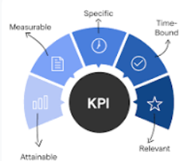
Key Business KPIs Qualified Improvement enabled for Cross Industry Supply Chain Management
28-30%
Reduced Inventory Hoarding Costs
20-25%
Reduced Procurement Costs
27-36%
Improved Supplier SLA Performance
12-15%
KPIs (TCO, IRR, ROI)
f {Quality, Time, Physical Inventory Count, Procurement & Handling Costs Value}
f {Quality, Time, Order Quantity, Procurement & Handling Costs Value etc.}
f {Quality, Time, Outcome, Value}
f {Time, Benefits / Value, Outcome, Sustenance}
PiLog’s Data Quality & Governance Suite
Data Governance
Data Quality Management
iContent Foundry
Meta Data Optimizers
Materials
Document Indexing
Material Criticality
Materials Criticality Analyzer
Bill of Materials
Maintenance Criticality
Spare Parts Strategy
Planning Meta Data Modeler
Services
Maintenance Strategy
Sourcing & Strategy
Inventory & Procurement Meta Data Modeler
UNSPSC, ISIC, e@class
DUNS, SOX etc.
www.piloggroup.com
Restricted Use

Slide 32
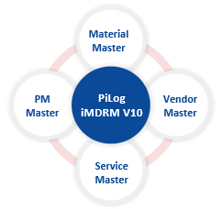

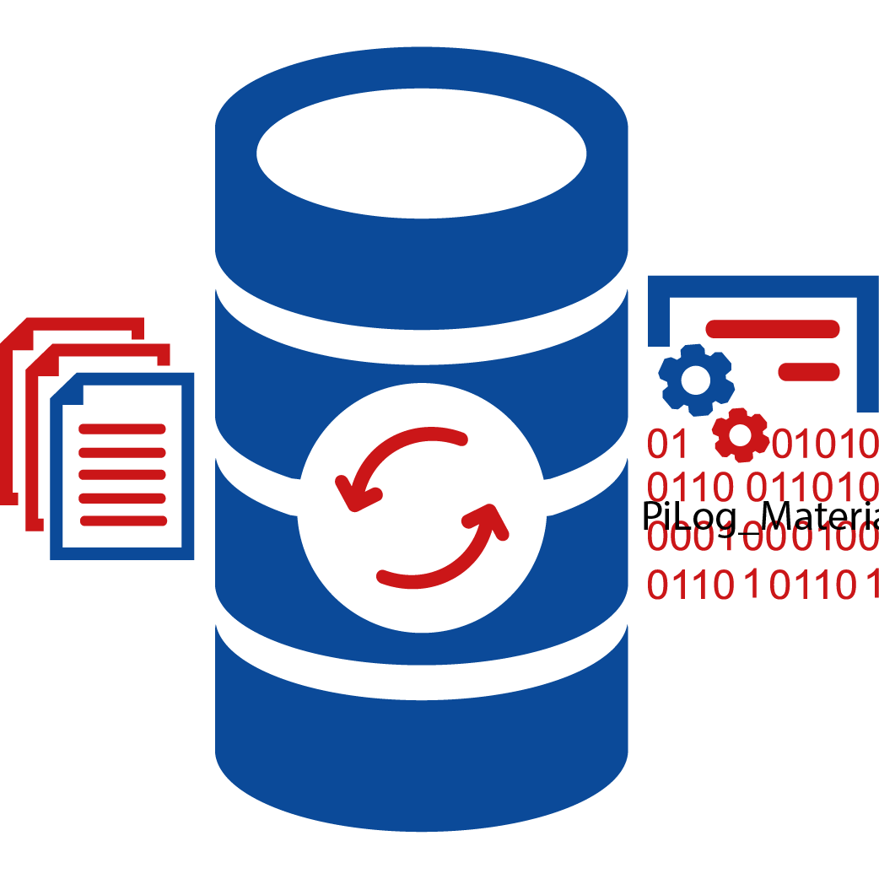



















Long lasting partnership with One of the largest Petrochemical Conglomerate, journey portrays excellence
Domains Implemented
3500+ Users
20+ Processes
10+ Departments
1.9M Material Records
60K Service Records
27K Vendor Records
~100K Assets Linked
6000+ Predefined Templates
for Material & Service Master Data Management
250+ Locations
20+ Languages
Regions: APAC, LA, NA, EU, AF
Service Excellence 2002 - 2024
Value Delivered
Capital & Expansion Projects data migration & merging
Estimated inventory reduction ~3% of 1.6 BUSD
PiLog MDRM V6 Material Master Implemented
Master Data objects for P2P, S2C Europe & KSA
PiLog MDRM V10 implemented with improved processes
Inventory Optimization at one of the plant
Potential Cost Reduction of ~45MSAR in ST and 80-100 MSAR in MT-LT
2002 - 2007
2008 - 2013
2014 - 2018
2019 - 2024
2006 - 2008
PiLog MDRM Service Master Implemented
PiLog MDRM V7 Upgraded to latest version
MDRM V7 extended to LA, NA & APAC Regions
MDRM V10 extended for EAM (All Regions)
Building Master, Meta Data and Process Transportation for SABIC STS; outbound supply chain Global Transportation & Logistics Optimized
Partnership Enrichment 2025-2030
Improved APM KPIs & KRAs by Asset Data and Performance Management by ~3% YoY from baseline
Management Consulting
End to End Supply Chain Optimization
Reliability by Design (Partner of Choice)
Extended Data
Management
www.piloggroup.com
Restricted Use

Slide 33
Key Business Value Generated with Improved Master & Meta Data for Major Petrochemical Conglomerate for Year 2024
Operations & Maintenance processes we evaluated the company’s current situation and compare it with their peers with the goal of estimating the total improvement potential
Key Value driver | Baseline | % Improvement Scenarios | Potential savings
Reduction in O&M Costs with Improved Maintenance Strategies, Planning and Task Execution | Total Revenue * 0&M Cost | Conservative 10% Most likely 12% | Conservative 26.4 MUSD Most likely 51.7 MUSD
 | 37.7 USD * 0.7%
 | 263.9 MUSD
12% reduction in O & M Costs
O & M cost [% of revenue]
-10 to -12%
Higher Costs of Operations & Maintenance processes are cumulated with Plant Restart and Unstructured Data and Suboptimal Processes Management
www.piloggroup.com
Restricted Use

Slide 34
Key Business Value Generated with Improved Master & Meta Data for Major Petrochemical Conglomerate for Year 2024
Turnaround Maintenance (TAM) processes were evaluated by analyzing the company’s current state and benchmarking it against industry peers to estimate the total improvement potential.
Key Value driver | Baseline | % Improvement Scenarios | Potential savings
Reduction in TAM Services Engagement | Total Revenue* TAM Cost | Conservative 7% Most likely 12% | Conservative 13.2 MUSD Most likely 22.62 MUSD
 | 37.7 B USD * 0.5%
 | 188.5 MUSD
12% reduction in TAM Costs
TAM cost [% of revenue]
-7 to -12%
Higher Costs of Turnaround Maintenance (TAM) are driven by extended plant downtime, unstructured data, and suboptimal process management, leading to inefficiencies and increased operational expenses
www.piloggroup.com
Restricted Use

Slide 35
Key Business Value Generated with Improved Master & Meta Data for Major Petrochemical Conglomerate for Year 2024
Human Capital Management (HCM) processes were evaluated by analyzing the company’s current state and benchmarking it against industry peers to estimate the total improvement potential
Key Value driver | Baseline | % Improvement Scenarios | Potential savings
Reduced Costs with Improved Human Capital Skillset | Total Revenue * Maintenance Team Cost | Conservative 3% Most likely 7% | Conservative 2.26 MUSD Most likely 5.27 MUSD
 | 37.7 B USD * 0.2%
 | 75.4 MUSD
7% reduction in Human Capital Costs
TO&M HCM cost [% of revenue]
-3 to -7%
Higher Costs of Human Capital Management (HCM) arise from inefficient workforce planning, unstructured data, and suboptimal talent management processes, leading to productivity gaps and increased operational expenses
www.piloggroup.com
Restricted Use

Slide 36


Oil & Gas Customer – Asset & Associated Objects Data Management & Governance with Optimized Maintenance Strategies & Reliability Management
Domains Implemented
150K+ Assets & Associated
100K+ Materials & BOMs
30K+ Services
5000+ Users
7 Processes
25 Departments
4500+ Predefined Templates
for Equipment & Material Master Data Management
Regions: Arabian Gulf
Asset & Associated Objects
[ISO 14224, API, OREDA]
Value Delivered
Service Excellence 2023-2024
iMDRM Implementation for PM Objects and integration with S/4 HANA
Optimization of Inventory and Planning Parameters to reduce inventory hoarding by 10% ~15-17 MUSD
30K Assets & Associated Objects Created
iMDRM (MM) Upg.
Asset Strategy Management
Meta Data Management
2024 (Q1, Q2)
2024 (Q3, Q4)
Zero Maverick Spend, Spot Buying of Products and Services
2023 (Q1, Q2)
2023 (Q3, Q4)
2006 - 2008
15K Assets & Associated Objects Created
PiLog Application Setup
50K Assets & Associated Objects Created
100K Assets & Associated Objects Created
150K Assets & Associated Objects Created
Reduction of Operations and Maintenance Costs by 12% YoY ~12-15 MUSD
Improvement in TAMM and Major Shutdown by schedule, costs, timelines etc. resulting in productivity improvement by 7-8% in Y1
Partnership Enrichment 2025-2026
Upgrade iMDRM on iDxP
SPM, iSPIR Implementation
End to End Asset Life Cycle Optimization
Implementation of MS & Roadmap for BIC
Extended Data
Management to Cover TAMM, Shutdowns etc.
Reliability by Design
Implementation of APM Solution
100% Adherence to Compliance and Regulatory Requirements
www.piloggroup.com

Slide 37
Key Business Value Generated with Improved Master & Meta Data for Major Oil & Gas for Year 2024
Operations & Maintenance processes we evaluated the company’s current situation and compare it with their peers with the goal of estimating the total improvement potential
Key Value driver | Baseline | % Improvement Scenarios | Potential savings
Reduction in O&M Costs with Improved Maintenance Strategies, Planning and Task Execution | Total Revenue * 0&M Cost | Conservative 10% Most likely 12% | Conservative 7 MUSD Most likely 8.4 MUSD
 | 10 B USD * 0.7%
 | 70 MUSD
12% reduction in O & M Costs
O & M cost [% of revenue]
-10 to -12%
Higher Costs of Operations & Maintenance processes are cumulated with Plant Restart and Unstructured Data and Suboptimal Processes Management
www.piloggroup.com
Restricted Use

Slide 38
Key Business Value Generated with Improved Master & Meta Data for Major Oil & Gas for Year 2024
Turn Around Maintenance processes we evaluated the company’s current situation and compare it with their peers with the goal of estimating the total improvement potential
Key Value driver | Baseline | % Improvement Scenarios | Potential savings
Reduction in TAM Services Engagement | Total Revenue* TAM Cost | Conservative 12% Most likely 15% | Conservative 10.8 MUSD Most likely 13.5 MUSD
 | 10 B USD * 0.9%
 | 90 MUSD
15% reduction in TAM Costs
TAM cost [% of revenue]
-12 to -15%
Higher Costs of Turn Around processes are cumulated with Plant Restart, Offline Planning & Execution and Suboptimal Processes Management
www.piloggroup.com
Restricted Use

Slide 39
Key Business Value Generated with Improved Master & Meta Data for Major Oil & Gas for Year 2024
MRO Inventory processes we evaluated the company’s current situation and compare it with their peers with the goal of estimating the total improvement potential
Key Value driver | Baseline | % Improvement Scenarios | Potential savings
Reduction in MRO Inventory Costs | Total Revenue* MRO Inventory Cost | Conservative 7% Most likely 10% | Conservative 6.3 MUSD Most likely 9 MUSD
 | 10 B USD * 0.9%
 | 90 MUSD
10% reduction in MRO Inventory Costs
MRO Inventory cost [% of revenue]
-7 to -10%
Higher Inventory Costs Around
Non-Moving Inventory around 300 MUSD; a special program has been setup for reduction and subsequent elimination which is not part of the current improvement
Other aspects linked with BOM Optimization for Unique Make Model, adjusting planning & inventory parameters
www.piloggroup.com
Restricted Use

Slide 40

Inventory Optimization with improvised Master & Meta data for Supply Chain Maturity
Objectives
PiLog roadmap for Phase 2 enabling faster ROI with saving benefits of ~45-60 MSAR in short term and ~100-150 MSAR YoY…
~ 10K Duplicate elimination with potential saving of ~ 41 MSAR
~50% increase in value & ~ 20% increase in quantity for non-moving inventory over past 10 years, huge potential savings of 20-25% with revised inventory management strategy
Data Quality Standards and Governance to be improved to meet ISO 8000 & 22745 compliance requirements
Top ten commodity 20K material master records with Value ~129 MSAR (30%) of total cost of Inventory (Average of 5 Years) ~ 445 MSAR potential saving through Partner Managed Inventory
Qualifying enterprise asset and maintenance data objects w.r.t ISO 14224 and maintenance strategy optimization deriving potential benefit in reduction of maintenance costs YoY by 15%
Why PiLog
Implement Governance Solution
Optimize procurement and inventory strategy
Review and recommend, way forward of next gen maintenance functions
Benefits
Faster improvement in data quality
Better, more efficient planning for asset and Material Spend and Investment
Accurate Spend Analysis
Optimized inventory operations
Approach
Wave 1:Material Master Cleansing Services (ISO 8000) including MDG ADD On Implementation
Wave 2:100% cleansed and linked eBoMs & mBOMs
Wave 3:Optimize Inventory Strategy Management based on industry best practices
Wave 4:Equipment Criticality and EAM Data Objects Assessment (Optional) – ISO 14224 standards
Wave 5: Business Rules for SAP MDG
Lower
Roadmap to reduce maintenance costs by 15% YoY and Improved KPIs
Reduction of Inventory Cost by 15%
Reduce the Cost of Procurement by 15%
Better
Improvement in Planning & Forecasting by 15-20%
Improvement of Spend Performance by 20%
Higher
Data quality for accurate and 100% complete technical data
100% Contract Compliance
Customer’s initiative for Spares Warehouse Optimization (Phase 1) : Diagnostic was duly addressed by PiLog with business value articulation and roadmap to excel
PiLog was awarded Phase 2 : Inventory Process Optimization, Materials & eBOMs Cleansing Services and Optimization of existing MDM solutions with rich industry standards, maturity, innovative methods in early’2020
www.piloggroup.com

Slide 41
Key Business Value Generated with Improved Master & Meta Data for Supply Chain Maturity
KRAs | Discovery Phase | Strategic Roadmap | % Saving | $ Cost Reduction
Single Source of Truth | ~65K MRO Material Records | ~11K Duplicates records Identified & Eliminated | 10-12% | 13.6 MUSD
Inventory Value Optimization | Total Inventory Value: ~155 MUSD Non-Moving Inventory: ~44 MUSD | Performed Data Maturity Assessment based on the Industry-specific algorithms [MCR, ABC, XYZ, VED] Optimized the MRP & Inventory meta data for ~25K materials like Safety Stock, ROP, Lead Time, Min / Max Levels etc | 19.5% - Y1 6-7% - Y2 | 30.2 MSD 9-10 MUSD
Inventory Process Optimization [Cross-Functions] | Maintenance Only 40% Unique Make Model Equipments had eBoM Cost of maintenance planning & control was estimated at ~10MUSD | Reviewed the existing maintenance strategies 100% cleansed and linked 10K eBoMs leveraging ISO 14224 standards | ~10% - Y1 | ~2 MUSD
 | Sourcing & Procurement Contract compliance at 60% 20% of MRO Items had contracts Yearly MRO Spend ~66 MUSD | Sourcing to Contract Compliance & Procurement suggested for 80% of MRO items 30% of MRO contracts recommended with JIT / VMI | ~10% - Y1 | ~8 MUSD
 | Warehouse Maintenance cost ~25MUSD | Recommended Strategies for Shelf-life, Storage Conditions, Packaging, Replenishment, Bin management | ~10% - Y1 | ~2 MUSD

Slide 42
PiLog Data Quality & Governance Suite vs PG MDG EAM SolEx Vs Prospecta MDO
“Enable Best Choice for Customer Success”
www.piloggroup.com
Restricted Use

Slide 43





Choosing Right Product for EAM Data (PiLog Suite Vs. PG EAM SolEx
Scalable, Flexible, Adoptable, Economical driven by AI
Standards, Compliance & Regulations
Functional Business Requirements
Architecture & Technical Requirements
ISO-8000-100
ISO-14224, 81346, 45000, 55000, KKS
API, IEEE, IE, OREDA, COBie, EXPRO
ISO 23081 - Records Management
ISO / IEC 11179 Parts 1 – 7 (MDR)
SO/IEC 19506 Software Systems
Multi-Domain Data Governance
Business Rules & Validations
Workflows & Alert Management
Seamless User Experience
Class based Data Models & quality
KPI & Dashboard
On Premise & Cloud Deployment
Seamless Integration with SAP or any other COTS solution
Low Code or No Code
Database on OS Compatibility
Data Digitalization
Advanced Technology Adoption
Partner Assessment & Qualification
Augmented AI Techniques
Robotic Process Automation (RPA)
IoT & IIoT
Mobility Enablement
OCR / Digitization
SO/IEC 19506 Software Systems
Appetite to Invest & Sustain
Progressive Product Roadmap
Customer Insights & Value
Team Capability
Process, Methods, Procedures
Industry Expertise
www.piloggroup.com
Restricted Use

Slide 44









Leveraging GEN AI in Asset Master Data Management Solution Improving MDM Efficiencies & Effectiveness
Mapping to hierarchies
Text classification
GEN AI in MDM
Categorization
Discover Data
Acquisition
Match & Merge
Data Modelling
Data Quality
User Experince
Data Insights
Compliance
Data Sharing
Intelligent automation
Secure framework
Filtering
Discovering data
Proposing new master domains
Automatic classification
Personally identifiable information (PII) detection
ESG data
Attribute identification
Automated data ingestion
Entity discovery
Extended attributes for product master data
Automating associations
Insights from stewardship activity
Insights from unstructured data
Automated matching rules
Hybrid golden records
Schema matching
Automated MDM models
Model Recommendations
Assistants
Conversational interfaces
Gen AI-personalized UX
Rule recommendations
Dashboards
Smart fields
www.piloggroup.com
Restricted Use
Notes:
This is Gartner’s recommendation for Master Data Management Solutions with Gen AI evolution

Slide 45
Inducing Sustainability in Operations & Maintenance MDM Importance Environmental, Social & Governance (ESG)
Low ESG Maturity
ESG Information Maturity
High ESG Maturity
Manual
Data Collection
Automated
Data Management
Spread Sheets
Database
Data Update Cycle
Annual
Continuous
Data Validation
Interval
Audited
Analytical Focus
Hindsight
Insight/Foresight
Siloed
Data Availability
Democratized
Data Requirements
Current Data Collection Method
Source & Current Systems
Assess Business Importance & Condition
Data Owners & Governance
Process for Sustainability Tool Assessment
Source: Gartner
www.piloggroup.com
Restricted Use

Slide 46
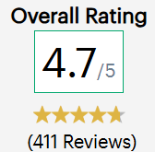
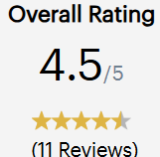
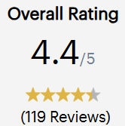
Overall Capability Score (MDM Solutions) Gartner Peer Insights
Capability Parameters | PiLog | Prospecta | SAP
Workflow / BPM | 4.6 (371) | 3.8 (6) | 4.4 (82)
Loading / Synch / Business Services | 4.5 (372) | 4.2 (6) | 4.5 (82)
Data Modelling | 4.6 (372) | 3.5 (6) | 4.5 (82)
Information Quality/Semantics | 4.6 (372) | 3.5 (6) | 4.4 (81)
Perform/Scale/Availability/Security | 4.6 (372) | 4.2 (6) | 4.4 (81)
Hierarchy Management | 4.6 (371) | 3.4 (6) | 4.3 (82)
Information Stewardship Support | 4.5 (369) | 4.2 (6) | 4.4 (81)
Information Governance Support | 4.6 (370) | 4.2 (6) | 4.3 (82)
Multiple Implementation Style Support | 4.5 (173) | 4.0 (2) | 4.3 (51)
Multiple Usage Scenario Support | 4.5 (371) | 4.0 (6) | 4.3 (80)
Multiple and Multi-domain Support | 4.6 (371) | 4.0 (6) | 4.3 (82)
Product Suite Internal Integration | 4.5 (171) | 4.5 (2) | 4.4 (51)
Scalability | 4.9 (29) | 4.4 (5) | 4.7 (15)
Integration | 5.0 (29) | 4.6 (5) | 4.5 (15)
Customization | 5.0 (29) | 4.6 (5) | 4.5 (15)
Ease of deployment, administration, and maintenance | 5.0 (29) | 4.6 (5) | 4.6 (15)
www.piloggroup.com
Restricted Use

Slide 47
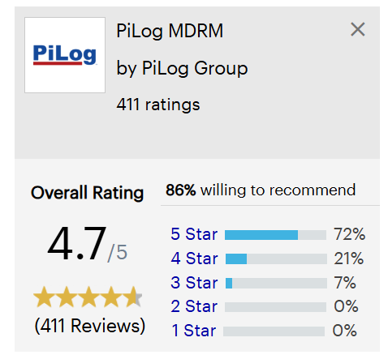
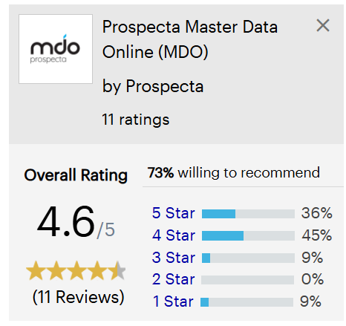
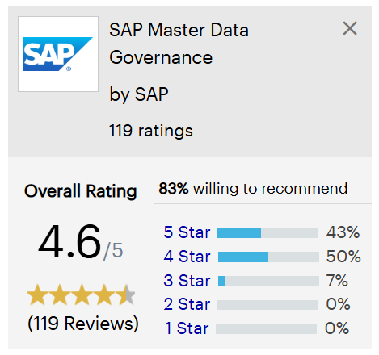
Impactful Business Value Management with PiLog Suite
Gartner Peer Insights
Favorable Review
Favorable Review
Favorable Review
Very reliable with stable integration power and excellent analysis of data calculations
User-friendly tool offering powerful data analysis and connects easily with other tools
Very efficient at handling large datasets and provides a stable reporting structure
Critical Review
Critical Review
Critical Review
The product is a very comprehensive and valuable tool.
MDO - not ready for the prime time
SAP MDG Review from Indian multi sector business
www.piloggroup.com
Restricted Use

Slide 48

Standards & Templates Leveraged in Build of Asset Data Management Governance Solutions
Master Data Objects | Standards** | PiLog Suite | PG EAM
Work Centers | SAP Internal Standard, Process Model, Operating Model, Engg. Drawings
Equipment Master | ISO 14224, 81346, KKS, COBie, EXPRO, Engg. Drawings
Functional Location | ISO 14224, 81346, KKS, COBie, EXPRO, Engg. Drawings
Object Links & Networks | SAP Internal Standard
Maintenance Items, Plans & Task Lists | ISO 45000, 55000, OEM Manuals, API, OREDA etc.
Measuring Points | ISO 45000, 55000, OEM Manuals, API, OREDA etc.
Service Master | ISO 8000, UNSPSC
MRO BOM | ISO 45000, 55000, OEM Manuals, SPDP
Inspection List | ISO 45000, 55000, OEM Manuals, SPDP
FC, CC, RC, IC | ISO 45000, 55000, OEM Manuals, API, OREDA etc.
Document Indexing & Linkage | ISO 999
Finance Asset Register | IFRS, IAS16
Key Insights:
PiLog Suite covers 360 Degree of EAM Data requirements whereas PG MDG covers base data objects, partial data objects
PiLog covers both Industry Agnostic & Specific standards; they are blended whereas PG MDG has partial reference to standards
PiLog Suite adopted Standards are applicable to meet cross business Form, Fit and Function
PiLog Suite adopted Standards are applicable to Master, Meta Data for better business control
ISO 8000 Data Quality Management standards are benchmarked across all EAM Domain Objects
** Industry Agnostic Standards
Full Covered
Partially Covered
Not Covered
Not Applicable
www.piloggroup.com
Restricted Use

Slide 49

Key Functional Business Requirements and Solution Mapping
Key Business Requirements | PiLog Suite | PiLog Suite Solution Comments | PG EAM | PG EAM Solution Comments
Configurable Workflow |  | Can configure n step sequential, simultaneous, alternate, substitute workflows |  | Limited with BRF+; some coding is required through Workflow BADIs implementation
Templates / Taxonomy per Asset Types with Industry Agnostic & Specific standards |  | OOB Solution with 12K Plus Templates for Assets, Services and Materials |  | Need to customize templates with development effort in UI, application and DB layers
Data Quality Maturity Assessment & Improvements |  | OOB Data Maturity Assessment with ranking and improvement against benchmark (iDQM) 15Million Industry Standard Golden Records with ability to pull data from external sources (Open APIs) |  | Additional Software – Information Steward for Data Quality Management is required Benchmark and dashboard requires custom development No OOB reference data
Multi Domain Master Data Governance |  | Covers all Master Data Technical Objects including Linear Assets as per list in above slide |  | Does not cover all objects and functionality is limited as per list in above slide
Mass load and Mass change functionality across EAM Data Objects |  | OOB Solution with PiLog Suite for mass load and change function |  | uXLoader is needed for mass load for better efficiencies, additional component
Configurable UI with Fiori / UI 5 |  | Build on UI5 with analogy of Fiori which are user configurable |  | OOB Fiori and UI5 configurable, custom apps are required
Key Insights:
PiLog Suite supports all EAM data objects as compared to PG MDG
Data Maturity Assessment & Improvement is OOB is PiLog Suite with 20K+ templates and 15M Golden Records make data readiness cheaper & faster
PiLog Suite is highly configurable with Low Code models whereas MDG needs higher customization and development effort
Out of Box
Custom Development
Not Available
www.piloggroup.com
Restricted Use

Slide 50

Key Technology & Architectural Requirements and Solution Mapping
Key Technology Requirements | PiLog Suite | PiLog Suite Solution Comments | PG EAM | PG EAM Solution Comments
Deployment options on Cloud vs. on Premise Vs. Hybrid |  | Supports all options aligning with SAP strategy on Suite First |  | Has limited Cloud deployment options
Single Sign On with LDAP |  | Configurable SSO Role & Authorization Control per objects with multi roles based on business operation and execution RACI |  | Configurable SSO Role & Authorization Control per objects with multi roles based on business operation and execution RACI
Seamless Integration with SAP Suite of Products |  | Certified Interfaces with SAP S/4 HANA on Premise or Cloud Open APIs can extend way and beyond existing & future SAP Suite footprint interoperability |  | Limited integration with on premise and on cloud version for integration with high development investment No open APIs for future scalability
Technology Stack – ABAP, JAVA, .NET |  | Supports JAVA Stack |  | Supports ABAP and JAVA Stack
Product Availability – OS & DB |  | Support limited to OS & DB combinations |  | Supports almost all OS & DB Combinations
Third Party Software Integration |  | Seamless integration, digitization with Engineering products like AutoCAD, GIS, ECM / EDM, OCR, Mobility etc. |  | Custom development for integration and digitization Leverage ADD Ons with high costs
Key Insights:
PiLog Suite is scaled to have seamless integration with Rise & Grow with SAP, SAP Business Technology Platform (BTP) and Business Network Asset Collaboration (BNAC)
Investment by PiLog for extending the compatibility across OS and DB
Third Party Software integration with PiLog Suite provides cutting edge in Asset Data Acquisition and Digitization before transformation, cataloguing to meet business Form, Fit and Function
Out of Box
Custom Development
Not Available
www.piloggroup.com
Restricted Use

Slide 51


AI & ML Modelling
Key Technology Requirements | PiLog Suite | PiLog Suite Solution Comments | PG EAM | PG EAM Solution Comments
AI Co-Pilot |  | AI Lens, Co-Pilot for PiLog Suite |  | Feature not available
LAM, LLM, NLP etc. Models |  | Scale Down LLM, LAM & NLP Build up |  | Feature not available
AL Technique Embedded - GEN AI, CHATGPT OPEN AI etc. |  | Conversational AI GEN AI Approach |  | Feature not available
Personalized & Augmented AI |  | Embedded in Solution |  | Feature not available
Key Insights:
AI Lens (Co-Pilot): A Co-Pilot for data management and endurance with rich user experience is build to endure & ensure data quality over its life cycle embedded in PiLog Suite and iDQM with conversational, GEN AI capabilities
Use Case for AI Enablement:
Use Case 1: Product - Knowledge Base
Use Case 2: Status, Timelines, Progress, Navigation, Research, etc.
Use Case 3: Analytics (Pivot Table)
Use Case 4: Sourcing Location with Indicative Price (approx.)
Use Case 5: Data Science Services
Use Case 6: AI Lens Input Data Edit
Use Case 7: Drag and Drop
Use Case 8: Manual/Auto Mapping
Use Case 9: Progress Meter with Dashboards
Out of Box
Custom Development
Not Available
www.piloggroup.com
Restricted Use

Slide 52
Partner Assessment & Qualification
Key Partners | PiLog Suite | PiLog Suite Solution Comments | PG EAM | PG EAM Solution Comments
Appetite to Invest & Sustain |  | 5-6 MUSD for build of MDM on SAP BTP 1-2 MUSD for Rise and Grow with SAP Functionality Enhancement |  | No further investment on SAP MDG EAM envisaged by PG
Progressive Product Roadmap |  | PiLog Suite Roadmap - Functionality improvement Roadmap for MDM on SAP BTP |  | No concrete roadmap for MDG for Rise, Grow with SAP nor BTP
Customer Insights & Value |  | Gartner Voice of Customer Ranking more than 4.6 on scale of 5 Rich customer base on MDM with some customer partnership of more than 2 decades |  | Gartner Voice of Customer Ranking around on scale of 5 Customer base with less than 5 years
Team Capability |  | Advisory Consulting – 10 EAM Process Consultants / SMEs – 10 EAM Data Consultants - 50 |  | Information not available
Process, Methods, Procedures |  | ISO 8000, 14224, 45000, 55000, 81346 etc. Reusable Strategies, SOPs, Methods, Work Instructions, KPIs for Asset Types |  | Information not available
High Focus
Low or NO Focus
Not Available
www.piloggroup.com
Restricted Use

Slide 53
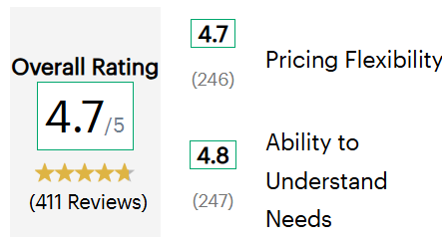
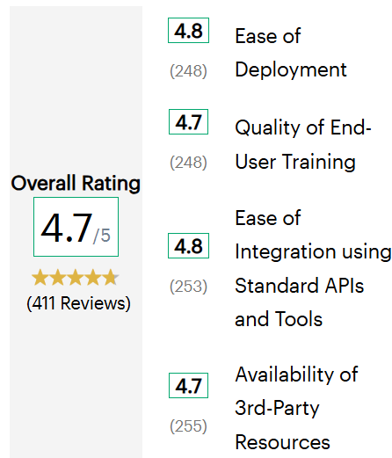
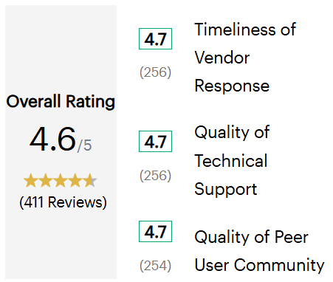
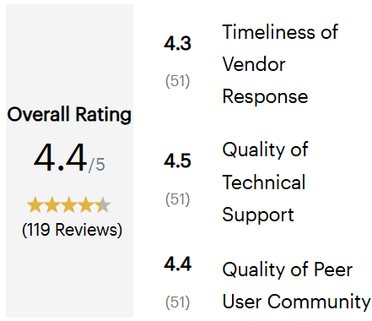
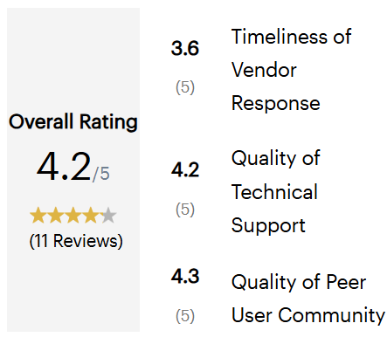
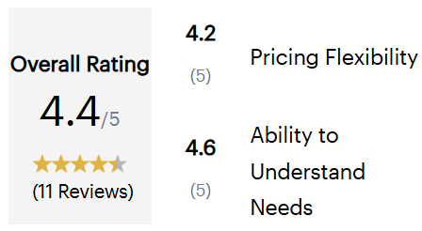
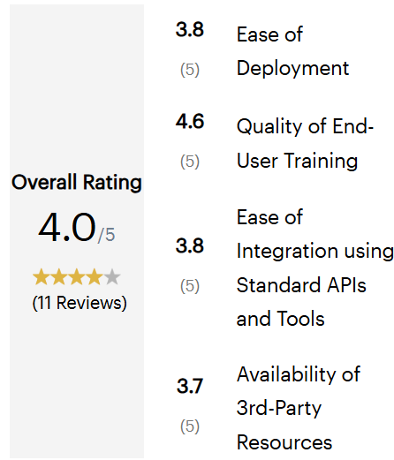

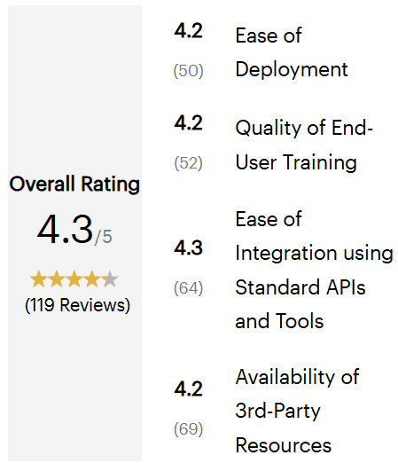
Other Capability Score (MDM Solutions)
Gartner Peer Insights
Evaluation & Contracting
Integration & Deployment
Service & Support
PiLog
Prospecta
SAP
www.piloggroup.com
Restricted Use

Slide 54
Likes & Dislikes (MDM Solutions)
Gartner Peer Insights
PiLog
Prospecta
SAP
Its fast-processing power helps us manage large data flows more effectively in real-time pipelines and allows instant processing of data inputs. I like that it automatically scales resources based on workload demands, ...
Implementation was completely straightforward and on the customer support side we always receive immediate response from them. It allows us to easily explore large amounts of data and quickly get business ...
It offers a wide range of visualization options that make it easy to create robust reports which speeds up our decision-making processes and improves our ability to track key performance indicators. The speed ...
The product is labor intensive because you need to fill all the field manually.
Implementation took way too long. Basic changes require consulting support. Product is not agile for our needs.
User Interface Number of Clicks Lack of Attachment support to view within browser Data replication issues in IDOC method in downstream system
www.piloggroup.com
Restricted Use

Slide 55
Data Quadrant Reports – Master Data Management
InfoTech - Software Reviews
Category Overview
Rank | Product | Composite Score | NET Emotional Score | Vendor Capabilities | Product Features | Likeness to Recommend | Number of Reviews
1 | PiLog MDRM | 9.3/10 | +95 | 89% | 90% | 95% | 79
8 | SAP Master Data Governance | 7.7/10 | +78 | 78% | 80% | 83% | 93
15 | Prospecta MDO | 5.8/10 | +71 | 65% | 65% | 69% | 10
Vendor Capabilities Summary
Rank | Product | Overall Capability Satisfaction | Business Value Created | Breadth of Features | Quality of Features | Product Strategy & Rate of Improvement | Usability & Intuitiveness | Vendor Support | Ease of Data Integration | Ease of Administration | Ease of Customization | Availability & Quality of Training | Ease of Implementation
1 | PiLog MDRM | 89% | 91% | 89% | 87% | 88% | 89% | 90% | 87% | 90% | 86% | 87% | 91%
8 | SAP MDG | 78% | 83% | 79% | 83% | 79% | 74% | 78% | 78% | 78% | 77% | 78% | 74%
15 | Prospecta MDO | 65% | 70% | 68% | 65% | 61% | 70% | 83% | 67% | 65% | 63% | 63% | 60%
Score
1 – 65%
66 – 79%
80 – 100%
www.piloggroup.com
Restricted Use

Slide 56
Data Quadrant Reports – Master Data Management
InfoTech - Software Reviews
Product Feature Summary (1/2)
Rank | Product | Overall Feature Satisfaction | Data Modelling Tools | Golden Record Management | Intrinsic Data Model | Meta Data Management | Record Deduplication | Record Management | Workflow Management
1 | PiLog MDRM | 90% | 86% | 92% | 88% | 92% | 91% | 90% | 87%
8 | SAP Master Data Governance | 80% | 78% | 79% | 78% | 81% | 81% | 81% | 81%
15 | Prospecta MDO | 63% | 67% | 63% | 58% | 65% | 42% | 75% | 75%
Product Feature Summary (2/2)
Rank | Product | Overall Feature Satisfaction | Aggregation Hierarchies Management | Entity Deduplication | Entity Relationship Management | Multi-Domain Mastering | Record Linage | Reference Data Management
1 | PiLog MDRM | 90% | 93% | 91% | 87% | 92% | 90% | 92%
8 | SAP Master Data Governance | 80% | 84% | 85% | 88% | 84% | 87% | 89%
15 | Prospecta MDO
Score
1 – 65%
66 – 79%
80 – 100%
www.piloggroup.com
Restricted Use

Slide 57
Emotional Footprint Reports – Master Data Management
InfoTech - Software Reviews
Emotional Footprint Overview
Rank | Product | CX Score | NET Emotional Score | Value Index | Strongest Positive Emotions | Strongest Negative Emotions | Number of Reviews
1 | PiLog MDRM | 95% | +95% | 93% | Respectful – 100% Caring – 99% | Charges for Product Enhancements – 3% Overpromised – 3% | 81
8 | SAP Master Data Governance | 78% | +80% | 85% | Respectful – 92% Trustworthy – 91% | Charges for Product Enhancements – 9% Overpromised – 13% | 95
15 | Prospecta MDO | 63% | 71% | 76% | Continually Improving – 100% Integrity – 90% | Frustrating – 20% Over Priced – 25% | 10
Score
1 – 65%
66 – 79%
80 – 100%
www.piloggroup.com
Restricted Use

Slide 58
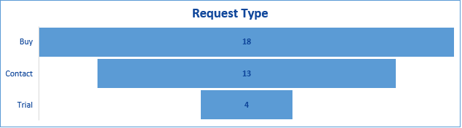
SAP App Store Performance & Potential Opportunities
PiLog Solution on SAP App Store | App ID | Count
PiLog's Lean Data Governance (since Oct-24) | 2001042 | 6
PiLog's Material Master Taxonomy on MDG SAP S/4HANA (since 2021) | 2000531 | 29
Request Type | Count
Buy | 18
Contact | 13
Trial | 4
Deal Closures | Contract Value (USD) | SAP Revenue Share (USD)
Dragon Oil | $ 23,700 | $ 3,562.00
Canadian Defence | $ 200,000 | $ 30,000.00
Total |  | $ 33,562.00
PiLog Solution on SAP App Store | Count
United Arab Emirates | 2
Brazil | 2
Canada | 1
Germany | 1
France | 2
India | 7
Saudi Arabia | 6
United States | 12
South Africa | 2
www.piloggroup.com
Restricted Use

Slide 59
SAP App Store Potential Opportunities (1/3)
PiLog’s Lean Data Governance (App ID: 2001042) (Since Oct 2024)
Oppor. ID | Date | Customer | Solution Plan | Created By | Email | Request Type | Country
102076 | 12-Mar-25 | Sanofi Winthrop Industrie | Enterprise Edition | Gwenaelle Bonnet | gwenaelle.bonnet@sap.com | Contact | FR
96940 | 17-Oct-24 | NEOM Green Hydrogen Company Limited | Basic Edition | Nouf Aljuhaini | nouf.aljuhani@sap.com | Buy | SA
97246 | 24-Oct-24 | Orient Cement | Enterprise Edition | Abhishekam Reddy | abhishekam.g@orientcement.com | Contact | IN
97248 | 24-Oct-24 | Finolex Industries | Enterprise Edition | Sudam Das | skd@finolexind.com | Contact | IN
97249 | 24-Oct-24 | Rubicon Research Pvt. Ltd. | Enterprise Edition | Santhosh Rawat | santosh.rawat@rubicon.co.in | Contact | IN
97406 | 30-Oct-24 | Modern Mills | Enterprise Edition | Mohammad Seddik | mohammad.seddik@modernmills.com.sa | Contact | SA

Slide 60
SAP App Store Potential Opportunities (2/3)
PiLog’s Material Master Taxonomy for SAP Master Data Governance -1 (App ID: 2000531)
Oppor. ID | Date | Customer | Solution Plan | Created By | Email | Request Type | Country
101589 | 3-Mar-25 | EMSTEEL | Taxonomy Medium | Mohammed Ansari | mohammedm.ansari@emsteel.com | Buy | AE
 | 29-Nov-24 | VICAT SA | Taxonomy Small | Laurene Schuster | laurene.schuster@sap.com | Contact | FR
98704 | 30-Oct-24 | Ultra Clean Holdings Inc | Taxonomy Small | Michael Thompson | michael.thompson01@sap.com | Contact | US
97438 | 21-Aug-24 | NEOM GREEN HYDROGEN COMPANY LIMITED NGHC | Taxonomy Enterprise | Nouf Aljuhaini | nouf.aljuhani@sap.com | Buy | SA
94640 | 14-Aug-24 | NEOM Company | Taxonomy Enterprise | Nouf Aljuhaini | nouf.aljuhani@sap.com | Buy | SA
94410 | 14-Aug-24 | Nouryon | Taxonomy Small | Lee Posey | lee.posey@nouryon.com | Buy | US
94427 | 14-Nov-23 | Aramco - Dammam Office Building | Taxonomy standard | Mahmoud Abdelhaleem | mahmoud.abdelhaleem@sap.com | Contact | SA
82966 | 13-Jun-23 | Grupo Potencial | Taxonomy MDG One | Danilo Andrade | danilo.s@pbbios.com | Buy | BR
74985 | 3-May-23 | EY | Taxonomy MDG One | Talat Qadeer | talat.qadeer1@pk.ey.com | Buy | SA
72806 | 22-Dec-22 | NOMAC | Taxonomy MDG One | Kanchan Patra | kanchan.patra@nomac.com | Buy | AE
66847 | 24-Aug-22 | Thungela Resources Global Shared Services | Taxonomy MDG One | Braam Loubser | braam.loubser@sap.com | Buy | ZA
61452 | 20-Jun-22 | Chevron Technical Center | Taxonomy MDG One | Jason Glenn | jason.glenn@sap.com | Buy | US
58410 | 16-May-22 | Sasol South Africa Limited | Taxonomy MDG One | Keith Nethercote | keith.nethercote@sap.com | Contact | ZA
56912 | 8-Sep-21 | Baker Hughes | Taxonomy MDG Standard | Michael Keresztesy | michael.keresztesy@bakerhughes.com | Contact | US
25430 | 1-Sep-21 | Self | Material Master Taxonomy | Fayazuddin Syed | fayazuddin.syed@gmail.com | Contact | IN
25202 | 1-Sep-21 | Self | Material Master Taxonomy | Fayazuddin | fayazuddin.syed@gmail.com | Contact | IN

Slide 61
SAP App Store Potential Opportunities (3/3)
PiLog’s Material Master Taxonomy for SAP Master Data Governance -2 (App ID: 2000531)
Oppor. ID | Date | Customer | Solution Plan | Created By | Email | Request Type | Country
24159 | 21-Jul-21 | slbproductions | Material Master Taxonomy | Manorma Sharma | manorma.sharma2410@gmail.com | Trial | US
22971 | 12-Jun-21 | Lundin Mining Corporation | Material Master Taxonomy | Christopher Frizzell | c.frizzell@sap.com | Buy | CA
20825 | 9-Apr-21 | IBM | Material Master Taxonomy | Dipesh Kumar | dipesh.ceg@gmail.com | Trial | IN
12885 | 5-Nov-20 | Private | Material Master Taxonomy | Steph B | stephanie.bellen@gmail.com | Contact | US
7912 | 5-Aug-20 | Whirlpool Corporation | Material Master Taxonomy | Guillaume Vingtier | g.vingtier@sap.com | Buy | US
7913 | 5-Aug-20 | Mars, Incorporated | Material Master Taxonomy | Guillaume Vingtier | g.vingtier@sap.com | Buy | US
7914 | 5-Aug-20 | Microsoft | Material Master Taxonomy | Guillaume Vingtier | g.vingtier@sap.com | Buy | US
7915 | 5-Aug-20 | Tyson Foods Inc | Material Master Taxonomy | Guillaume Vingtier | g.vingtier@sap.com | Buy | US
7916 | 5-Aug-20 | Ita Unibanco Centro Tecnolgico | Material Master Taxonomy | Guillaume Vingtier | g.vingtier@sap.com | Buy | BR
2268 | 2-Jul-19 | Intas Pharama | Material Master Taxonomy | Nikunj Thaker | nikunj_thaker@intaspharma.com | Buy | IN
2037 | 22-May-19 | SAP | Material Master Taxonomy | Olaf Kexel | olaf.kexel@sap.com | Buy | DE
5117 | 19-Feb-19 | Sigma-Aldrich Corporation | Material Master Taxonomy | Umasankar Gelasam | umasankar.gelasam@sial.com | Trial | US
5072 | 29-Jan-19 | melia.com | Material Master Taxonomy | Pedro Covas | pedro.covas@melia.com | Trial | US

Slide 62
PiLog Data Quality & Governance Suite (PiLog Suite) – Solution Overview
Data Governance with AI Lens (Copilot)
Data Quality Management
iContent Foundry
Data Migration: Data Extraction, Transformation & Load
Spare Parts Interchangeability Records (iSPIR) & Financial Asset Register (iFAR)
Meta Data Optimizers (AI/ML Models)
“Data Readiness for SAP Suite First & AI First”
www.piloggroup.com
Restricted Use
Notes:
PiLog Data Quality & Governance Suite outlay with various functional modules

Slide 63

Value Engineering Portfolio
Data Quality Foundry
Enterprise Data/AI Strategy
EAM Objects: Floc, Eqpt, eBoM, fBoM, MI, TL, MP…
Enterprise Data Mgmt.
Data/AI Advisory
Data Migration / Upgrades
Capital Projects Management
[EPC: SPDP + iSPIR]
MRO Inventory Optimization
Asset Lifecycle Mgmt.
Supply Chain Mgmt.
Plant Maintenance Strategy
Value Engineering Portfolio
Services & Contracts Management [S2C]
Financial Assets Management
S2P, P2I, S2C, A2R, O2C: Business Process Optimization
Facilities Management
Digital Transformation & Robotic Process Orchestration
MDM: AMR/EMR, MMR, SMR, VMR, EAM etc.
Data Governance & Analytics
Sourcing, Category & Spend Mgmt.
Single Version of Truth
Spend & Category Management, Predictive & Strategic Procurement
Integration, Orchestration Business Services
Data Quality Hub: Orchestration, Consolidation & Reconciliation
Data Quality Mgmt.
Descriptive, Prescriptive & Predictive Analytics
BP Data Regulatory, Statutory Compliance & Cross-functional Governance
On-Cloud & On-Premise
BP Data Classification, Categorization, Industry Clusters
Data Quality Compliance, Data Maturity Audit
Data Cleansing, Classification & Enrichment
ISO: Meta Data, Taxonomy, Ontologies Assessment
NATO, eCl@ss, PIDX, eOTD, PPO, ISIC, HS etc.
www.piloggroup.com
Restricted Use
Notes:
Value Engineering Portfolio, see the detailed slides for Product & Service bifurcation

Slide 64
Value Engineering Portfolio by Products & Services (1/4)
Functional Footprint | PiLog Products | PiLog Services
Enterprise Data Strategy
Data Quality Foundry | iContent Foundry
Enterprise Data/AI Strategy | PiLog IP LLM and AI | Data & AI Guidelines based strategy definition / Optimization
Data/AI Advisory |  | Data and AI Advisory
Data Migration / Upgrades | PiLog Data Quality & Governance Suite, Data Migration Component | Strategy Advisory Services for migration and transformation services
Supply Chain Mgmt.
MRO Inventory Optimization | Meta Data Optimizer | Advisory services on Inventory Best Practices
Services & Contracts Management [S2C] | Data Governance (Service Master) Data Migration: Contracts and Supply Chain Transactional Data | Advisory Services – Supply Chain Management
S2P, P2I, S2C, A2R, O2C: Business Process Optimization | Data Governance (Asset, Material, Service, Vendor, Sourcing, Customer, BP, Contracts Master) SCM Meta Data Optimisers | Advisory Services on Business Process, Data Maturity Assessment & Recommendations System Appreciation & Portfolio Rationalization
www.piloggroup.com
Restricted Use

Slide 65
Value Engineering Portfolio by Products & Services (2/4)
Footprint | PiLog Products | PiLog Services
Supply Chain Mgmt.
Digital Transformation & Robotic Process Orchestration | Data Governance Solution Data Migration Solution Data Quality Solution AI / ML Models | SCM Advisory Services
Sourcing, Category & Spend Mgmt.
Spend & Category Management, Predictive & Strategic Procurement |  | SCM Advisory Services SOX Standards
Data Quality Hub: Orchestration, Consolidation & Reconciliation | Data Governance Solution Data Migration Solution Data Quality Solution AI / ML Models | SCM Advisory Services Data Management Advisory Services System Appreciation Study & Application Rationalization
BP Data Regulatory, Statutory Compliance & Cross-functional Governance | Data Governance Solution AI / ML Models | Data Strategy Consulting Data Standards Guidelines & Industry Best Practices
BP Data Classification, Categorization, Industry Clusters | Data Quality & Governance Solution iContent Foundry | Data Advisory Services
www.piloggroup.com
Restricted Use

Slide 66
Value Engineering by Portfolio Products & Services (3/4)
Footprint | PiLog Products | PiLog Services
Data Quality Mgmt.
Data Cleansing, Classification, Categorization & Enrichment | Data Quality Solution AI/ML Models | Data Advisory Services for Maturity Improvement
ISO: Meta Data, Taxonomy, Ontologies Assessment NATO, eCl@ss, PIDX, eOTD, PPO, ISIC, HS etc. | Data Quality Solution iContent Foundry | Data Advisory Services for Maturity Improvement Data Standards from ISO, UNSPSC, NATO, ISIC etc.,
Data Quality Compliance, Data Maturity Audit | Data Quality Solution iContent Foundry AI/ML Models | Data Advisory Services for Maturity Improvement Data Standards from ISO, UNSPSC, NATO, ISIC etc.,
Data Governance & Analytics
MDM: AMR/EMR, MMR, SMR, VMR, EAM etc. Single Version of Truth | Data Quality & Governance Solution powered by AI | Data Strategy Management System Appreciation and Implementation
Integration, Orchestration Business Services | SMART and Open APIs for On Premise and Cloud Deployments including reconciliations / remediations | System Appreciation and Implementation
www.piloggroup.com
Restricted Use

Slide 67
Value Engineering by Portfolio Products & Services (4/4)
Footprint | PiLog Products | PiLog Services
Data Governance & Analytics
Descriptive, Prescriptive & Predictive Analytics | AI/ML Models | Advisory Services for Supply Chain and Asset Management Analytics
Asset Lifecycle Mgmt.
AM Objects: Floc, Eqpt, eBoM, fBoM, MI, TL, MP… Financial Assets Management Facilities Management | Data Quality & Governance Solution powered by AI iContent Foundry | Advisory Services Data and Asset Data Management Advisory for Maintenance Strategies
Capital Projects Management [EPC: SPDP + iSPIR] | iSPIR – Spare Parts Interchangeability Records iContent Foundry | Advisory Services – Spare Parts Management
Plant Maintenance Strategy | iContent Foundry Data Quality & Governance Solution AI / ML Models Mobility Industrial Automation | Advisory for Maintenance Strategies Major, Minor and Turn Around Maintenance
www.piloggroup.com
Restricted Use

Slide 68














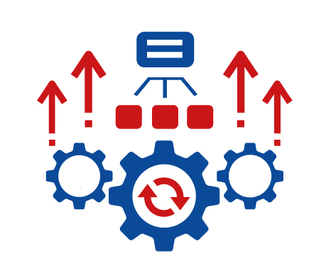




ALM, APM, SCM Solution Management on SAP S/4 HANA, APM, BTP & Business Network Optimized with PiLog Accelerators
Data Taxonomy & Repository
Optimized Process Control
Technology Adoption
Work Centers
Critical Assets
Measuring Points
Materials & Assets Criticality
Planning, Inventory, Procurement Control Parameters Based on Best Practices
Knowledge Management
Online & Classroom Training on SAP Suite
Asset Hierarchy
Functional Location
FC, CC, RC, IC
Reusable Configuration Data, Validations, Workflows, Rules etc.
Test Scripts for S/4 HANA, BTP and FSM Solutions
SCM & ALM Process Maturity w.r.t Industry Benchmarks
Maintenance Strategies
Bill of Materials
Document Indexing
Spare Parts Interchangeability
Open API for Seamless Integration Cloud / On Premise
Sourcing & Procurement Strategos
AI Models
Spare Parts Strategy
Pre-Defined Libraries
SCM, Maintenance SOPs, KPIs, KRAs
Mobility, RPA, IoT, IIoT
SAP Build Apps, Canned Reports etc.
MI, MF, MPs
Task List & Inspection List
Materials & Services
www.piloggroup.com
Restricted Use
Notes:
Data driven solutions from PiLog delivering value through data taxonomy, repositories with technology integration for optimized business processes

Slide 69



PiLog’s Data Governance
PiLog’s data governance applies the principles of lean management to the governance of data within organizations. It focuses on ensuring that data-related processes are efficient, effective, and aligned with the organization's goals while minimizing time. Primarily Small and Medium businesses can benefit from this lean Architecture as well as extend it to Enterprise Level.
The Foundation of Data Governance is built on
Simple
Agile
Swift
Preconfigured & Augmented Business & Data Content
Shift Left User Engagement models
Scalable Modular Solutions & Architecture for any deployment models
Enables Multi-Domain, Multi-Lingual
Tenant & Language
ERP / COTs agnostic Data
Mart & Interoperability
Deployed within few
weeks with Zero Flaws
Modular deployment
with ease
Measure & Realize Value
from Data Maturity &
Process Efficiencies
Plug and Play though
enabled on Cloud
Minimal Change
Management
Zero Disruption &
Maintenance
Available on Hyperscalers
AI & ML powered
This conceptual approach is forged into a powerful product suite that has a complete set of tools to serve the event and data driven digital transformation that contemporary enterprises seek.
www.piloggroup.com
Restricted Use
Notes:
Foundation of PiLog Data Governance suite (Simple, Agile, Swift) development and deployment
Shift Left Approach:
The "shift left" approach in software development emphasizes integrating testing, security, and quality assurance activities earlier in the software development lifecycle (SDLC), aiming to identify and address issues proactively, leading to improved quality, reduced costs, and faster time-to-market.
Here's a more detailed explanation:
Traditional Approach:
Traditionally, testing and quality assurance activities are performed later in the SDLC, often after the code is written.
Shift Left Philosophy:
The shift left approach advocates for moving these activities earlier, closer to the beginning of the SDLC.
Benefits:
Early Defect Detection: Identifying and fixing bugs and vulnerabilities early in the development process is significantly easier and less costly than fixing them later.
Improved Software Quality: Proactive testing and quality assurance lead to higher quality software products.
Reduced Costs: Early defect detection and resolution translate to lower overall development costs.
Faster Time-to-Market: By identifying and addressing issues early, the development process can be streamlined, leading to faster time-to-market.
Enhanced Collaboration: Shift left encourages collaboration between developers, testers, and other stakeholders, leading to a shared understanding of the product and better communication.
Shift Left in Different Areas:
Shift Left Testing: Focuses on moving testing activities earlier in the SDLC.
Shift Left Security: Integrates security practices and measures early in the SDLC.
Shift Left in Data Integration: Applies the principles of shift left to data integration processes.
Tools and Technologies:
Tools and technologies like automated testing frameworks, continuous integration/continuous delivery (CI/CD) pipelines, and static analysis tools can facilitate the adoption of a shift left approach.
Agile and DevOps:
The shift left approach aligns well with Agile and DevOps methodologies, which emphasize iterative development, continuous feedback, and collaboration.
Challenges:
Implementing a shift left approach can require changes in organizational culture, resource allocation, and training.

Slide 70



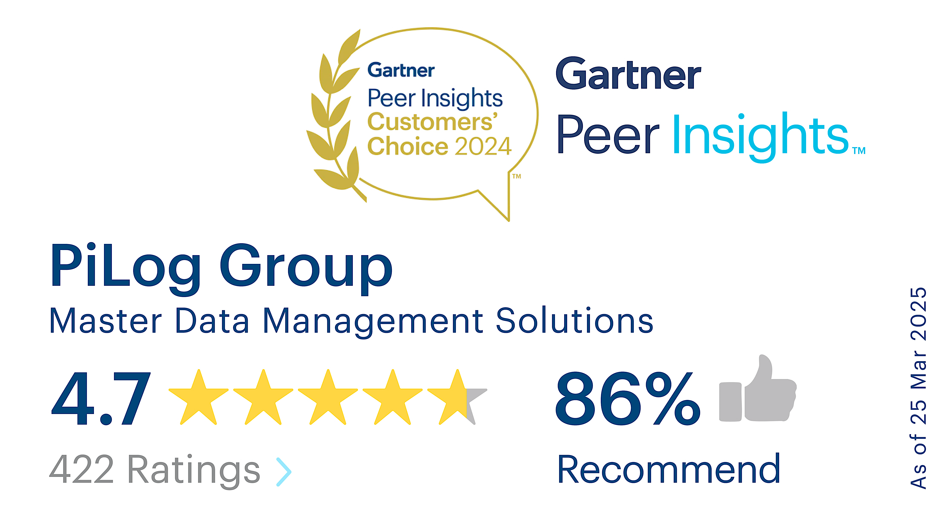




PiLog’s Data Quality & Governance Suite – Powered by AI
PiLog’s data quality and governance suite is built on lean management principles, incorporating best industry practices, ISO standards, and AI-driven content. This suite provides comprehensive features, processes, and methodologies for effective data lifecycle management.
Data Acquisition Data Quality Assessment Data Classification Data Harmonization Data Migration Data Governance Data Analytics
Challenges
Non-Unified Master Data in Supply-Chain
High MRO Inventory Hoarding
Higher O&M Costs due to excessive planning & poor execution
Inefficient Asset Reliability & Integrity
Engg. Data outdated or not available
O&M knowledge limited to handful
Customized OEM Data for Assets & Components
ERP application leveraged as backend
Opportunities
Unification of Master Data
Reduce MRO Inventory Costs with OEM to OPM / OCM Inventory reduction; EOQ & Inventory Optimization
Improve Asset Strategy and Data Management
Improved Data Quality with AI & Governance
Improved Tech Adoption with SMART Maintenance & Automation
Leverage best utilization of SAP & associated business application, Process Orchestration
Multi-Domain &
Multi-Lingual
SAP Store
BTP Cloud Ready
AI Agents & ML Models
AI/ML Data Management
SAP Certified
S4 & RISE Integration
Predefined Rules &
Processes
ISO Content + Industry-Proven Practices
SIMPLE – AGILE – SWIFT
PiLog
Data Quality
&
Governance
Suite
Cross-Sell, Upsell & Integrations
SAP BTP & PiLog Solution
SAP IBP MRO for Inventory Optimization
SAP APM for Asset Integrity & Reliability
SAP BNAC for OEM & Operator Collaboration
SAP BN4P for Material & Service Procurement
SAP IPD for OEM data handover
SAP S4 HANA for RSH
Industry Best Practices & Standards
ISO 8000, ISO 14224, ISO 81346, ISO 45000, ISO 55000, ISO 11179, IEC 60050 (IEV), ISO 27001, UNSPSC etc.)
Value Levers
29-34%
Improved Equipment Availability
f {Actual Operating & Planned Operating Time}
Reference Customers (Serving Since decade with Avg Users ~1000/Customer)
32-37%
Reduce in Mean Time to Repair
f {Unplanned Breakdown Maint. Time & No. of Failures}
20-25%
Reduced O&M and Inventory Costs (TCO)
f {OPEX}
Statutory, Regulatory Compliance with optimized TCO
SAP Partner Manager: Smitha.Rayala@sap.com
PiLog Sales: Umar.Farooq@piloggroup.com
www.piloggroup.com
Restricted Use
Notes:
A glance of PiLog Data Quality & Governance Suite powered by AI for augmented business processes complementing and supplementing SAP Suite

Slide 71



























PiLog’s Data Governance Solution
Comprehensive data quality & governance solution powered by AI
Single or Mass Process (Parallel & Sequential WF)
Multi-Domain &
Multi-Lingual
Predefined Rules &
Processes
SAP Certified
S4 & RISE Integration
SAP Store
Cloud Ready
AI Agents
CREATE
ISO Content + Industry-Proven Practices
CHANGE
SAP ERP-1
SIMPLE – AGILE – SWIFT
DATA
GOVERNANCE
EXTEND
DELETE
UNDELETE
SAP ERP-2
BLOCK
UNBLOCK
ERP-3
MERGE
Requestor
Approver
Steward
Manager
LINK / REF
FLOC + Asset
Service
Material
iFAR
iSPIR
eBoM
Work Center
fBOM
mBoM
Asset-Centric Industries
Maintenance Plan
MSS
Measure-Point
Task-List
Vendor
Customer
Employee
Leave
Incident
www.piloggroup.com
Restricted Use
Notes:
Data Governance for multi domain master and meta data enabling GOLDEN RECORD MANAGEMENT

Slide 72
PiLog’s Data Quality & Governance Suite – Key Capabilities (1/2)
 | Features Released | Status
Current | Comprehensive Governance: Material, Equipment / Asset, Vendor, Customer, On-Boarding Process (Vendor, Customer), Fixed Asset Registry, Service, iSPIR, eBOM, fBOM, mBOM​, MI, MP, TL, Measuring Point, Business Partner, Article Master, HR Mini Master (Tech. Resources), Work Center​ (Please refer to Product Availability slide) | ✅Released​
 | Searchability: Smart (Fuzzy), Parametric, Category & UNSPSC, Dictionary & Classification
 | Workflows: Sequential, Parallel, Composite, Graphical Workflow Builder
 | Workbench: Taxonomy WB, Rules Configuration WB​, Data Quality Assessment & Remediation WB​, Data Integration WB, Data Routing WB, Data Synchronization WB​
 | Integrations: SAP ECC, S/4 HANA using middleware SAP PI / PO / CPI, BNAC
 | Copilot: AI Lens, AI Agents –DH Agent (iSPIR, Mass, PDF, Image), DE Agent, DQ Agent,
 | Mass Data Processing: Create, Change, Extend, Delete & Undelete
 | Audit Trail: Data Migration Logs, Checksum & Audits​, Timeline
 | Configurators: Service Master
 | Mobility: Search, Approve, Uploading Documents (Online, Offline), Barcode scanning
 | Content Foundry: 15 Million + Unique Records, 12 K + Templates & Hierarchies for Assets, Products and Services,
 | Migration: Open & SMART API for Data Extraction and Loading, with ability to integrate and operate with major ERP’s, COT’s, Databases, etc. for unstructured and structured data
 | Data Transformation: AI enabled Transformation for Non-Governance based master, meta and transactional data
 | Meta Data Optimizers: For Planning, Procurement, Asset and Execution Business Processes
 | Criticality Ranking: Asset & Material: Maturity Optimizers – Data & Process
www.piloggroup.com
Restricted Use
Notes:
Product capabilities and functionalities with comprehensive future roadmap

Slide 73
PiLog’s Data Quality & Governance Suite – Key Capabilities (2/2)
Quarter | To Be Released | Status
Q2 2025 | Custom Object (Cost Centre, Profit Centre, etc.)​ | ⏳InProgress
 | Searchability: Voice Recognition
 | Configurators driven by AI Agents (For scaling): Equipment, Material Master
 | UI/UX: Improved UI using UI5
 | Content Foundry: 20 Million + Unique Records, 20K + Templates & Hierarchies for Assets, Products and Services
 | Mass Data Processing: Scheduled Batch Processing​​​ using AI Agent
 | Copilot: Voice based AI Agent
 | Integrations: IPD, FSM, Ariba, IBP MRO, APM, RISE (PCE), BN4P
Q4 2025 | Mobility: Registering new Equipment / Asset, Changing existing Equipment / Asset | 🛠️Planned
 | Content Foundry: 25 Million + Unique Records, 21K + Templates & Hierarchies for Assets, Products and Services
 | SAP QM Objects
www.piloggroup.com
Restricted Use
Notes:
Configurators accelerates the implementation of the solution by cutting down the effort & cost by up to 40%, however Configurator licenses need to be procured

Slide 74


PiLog’s Data Quality & Governance Suite (Available Objects)
Objects | Create | Copy | Change | Duplicate Check | Merge | Extend | Delete / Undelete | Block / Unblock | Mass Data Processing
Asset/Equipment Master |  |  |  |  |  |  |  | NA
Functional Location |  |  |  |  |  |  |  | NA
eBOM |  |  |  | NA | NA |  |  | NA
fBOM |  |  |  | NA | NA |  |  | NA
Maintenance Plan |  |  |  |  |  |  |  | NA
Maintenance Item |  |  |  |  |  |  |  | NA
Task Lists |  |  |  |  |  |  |  | NA
Measuring Point & Counter |  |  |  |  |  |  |  | NA
Work Centre |  |  |  |  |  |  |  | NA
Material Master |  |  |  |  |  |  |  | NA
mBOM |  |  |  | NA | NA | NA | NA | NA
eBOM |  |  |  | NA | NA | NA | NA | NA
fBOM |  |  |  | NA | NA | NA | NA | NA
Service Master |  |  |  |  |  | NA |  | NA
Model Service Spec (BOS/MSS) |  |  |  | NA | NA | NA |  | NA
Vendor |  |  |  |  |  |  | NA
Customer |  |  |  |  |  |  | NA
www.piloggroup.com
Restricted Use
Notes:
CRUD Matrix for PiLog’s Data Quality & Governance Suite for multi-domain master data objects

Slide 75
iContent Foundry – Solution Overview
PiLog’s iContent Foundry is the central repository of 15M+ Golden Records, 12k+ Templates, taxonomies hierarchies and ontologies, which confirm to specific industries and Standards. It caters to major industries like Oil and Gas, Petrochemicals, Mining, Manufacturing, Utilities, Transport and Facilities and can be used by any SAP solutions and applications used to Design, Planning, procurement, operations and services. It is powered by AI/ML.
ISO Compliance
Industry Best Practices & Standards (ISO 8000, UNSPSC, DUNS, SOX,ISO 14224, ISO 45000, ISO 55000,11179, IEC 60050 (IEV), 81346, API, TUV3000 etc.)
Master Data Quality (ISO 8000 – 100)
Asset and Location Hierarchy ISO 14224
Asset Management ISO 55000 Series
ISMS ISO/IEC 27001
Quality Management System ISO 9001
Open Technical Dictionaries and Data Exchange - ISO 22745
Industrial Data Representation and Exchange - ISO 29002
Energy & Natural Resources Petro-Chemicals Chemicals, Milling, Mining & Metals Railways Cement Iron & Steel Facilities Management Manufacturing Utilities Marine Airports & Aviation Aerospace & Defence Pharma Consumer Products Public Sector | iContent Foundry 15M+ Golden Records 20K+ Templates Spend Management Hierarchies Industry Ontologies | SAP | Products: 1. Physical & Performance Characteristics 2. Industrial System Integration: Iso 29002 3. Maintenance Strategy & Planning 4. System Integration – ISO 81346, BoMs Materials & Suppliers: 1. Spares Catalogue 2. Supplier Optimization 3. Spares Criticality 4. EOQ 5. Spares Planning Asset, Service, EAM, Material &Supplier 1. Direct & Indirect Materials 2. BOMs 3. Sourcing & Procurement 4. EAM Data Assets: 1. System Objects ISO 81346 2. Failure Codes ISO 14224 3. Asset Hierarchies, Classification, Maintenance, BOMs 4. Master Data Quality ISO 8000 Services: 1. Master Data Quality ISO 8000 2. Bill of Services 3. Contracts & Service Procurement
 |  | Design (IPD) Planning (IBP MRO) BNAC Operator (APM) Services (FSM)
Industries
Pricing Models
Supported SAP Products
Public Sector, Facilities Management, Manufacturing, Utilities, Marine, Airports & Aviation, Aerospace & Defense, Railways, Energy & Natural Resources, Petro-Chemicals, Chemicals, Milling, Mining & Metals, Cement, Iron & Steel, Pharma, Consumer Products.
Subscription-Based: Annual or monthly SaaS
On-Premise Licensing: One-time license fee, implementation with AMC
Custom Packages: Tailored solutions for enterprise needs.
SAP S/4HANA Cloud, Private Edition
SAP S/4HANA Cloud, Public Edition
SAP ECC
Design (IPD), Planning (IBP MRO), BNAC, Operate (APM), Field Service Management (FSM)
Deployment Options
Deployment: SaaS Cloud, On-Premise, Hybrid
www.piloggroup.com
Restricted Use
Notes:
iContent Foundry scope, content, standards and interoperability with SAP suite

Slide 76

Solution Diagram of iContent Foundry
OEM / Manufacturer
OEM / OCM / OPM play a critical role in managing the asset data lifecycle. Will provide essential information regarding the products & assets' specifications, technical documentation, and maintenance guidelines
Content
PiLog DQG
Mapping
Content Partner is PiLog DQG Solution closely integrated with OEMs through SAP BNAC to ensure the correct operation, repair, and maintenance of assets. PiLog Suite will provide standardized, structured, categorized and enriched data meeting FFF – Business Form, Fit and Function with category-based templates and allowed values; provisioning high value added
Partner
SAP BNAC
Partner
Operators are SAP PM/EAM and APM solutions closely integrated with SAP BNAC, Content Partners to ensure the correct operation, repair, and maintenance of assets. Will also be involved in monitoring asset performance, identifying issues, and requesting spare parts or technical support from OEMs or suppliers; Partner and SAP BNAC
Content
PiLog DQG
Mapping
SAP PM / EAM
Operator
SAP BNAC Central Data Quality & Management HUB integrated with OEMs, PiLog DQG Partner Solution, SAP PM / EAM and APM – operators to ensure Right Data is Available to Operators and continual feedback is established with Content Partner and OEMs for data quality and value upliftment
Operator(s)
SAP APM
CY DTM
www.piloggroup.com
Restricted Use
Notes:
PiLog DQG as content provider integration and process mapping with SAP suite, OEMs and other consuming & provisioning applications

Slide 77
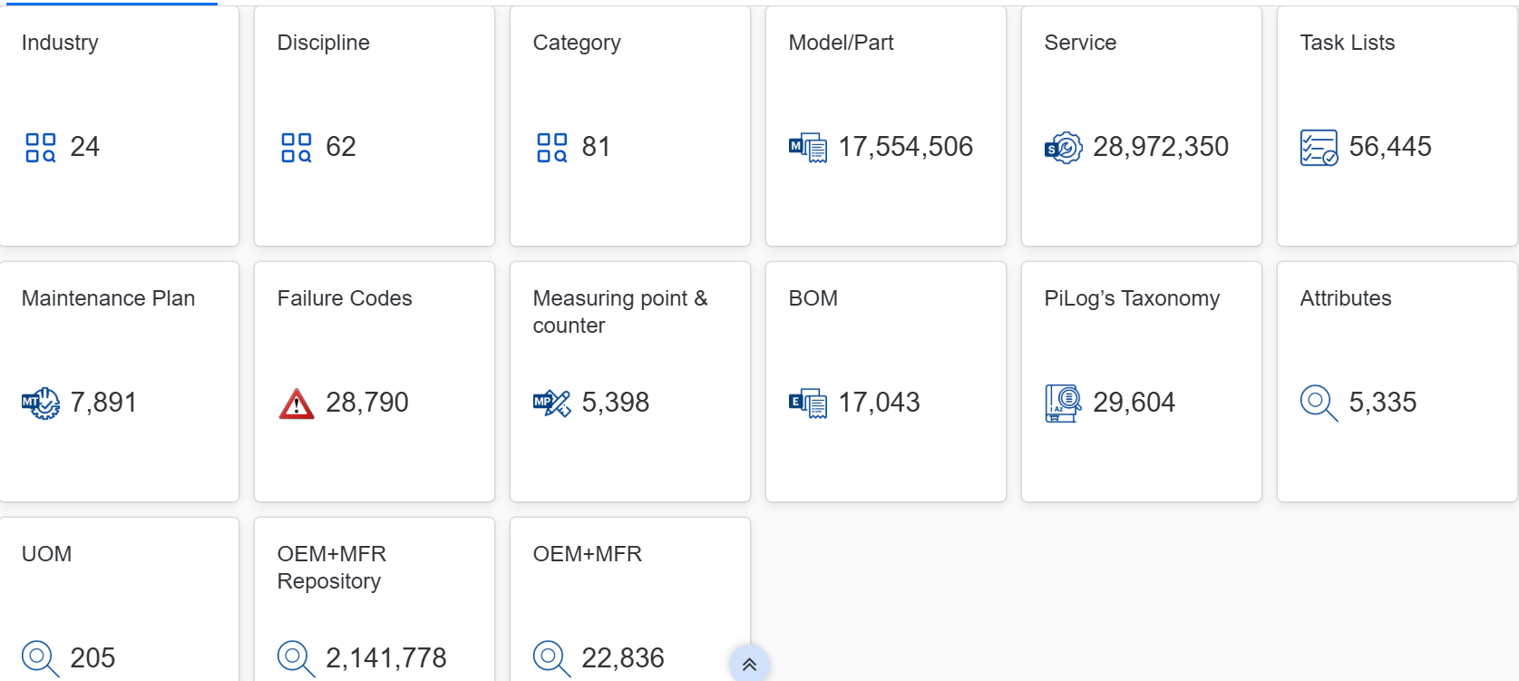
iContent Foundry Statistical Counts
Stats and Facts
www.piloggroup.com
Restricted Use
Notes:
Current stats and figures of object wise records across industry

Slide 78
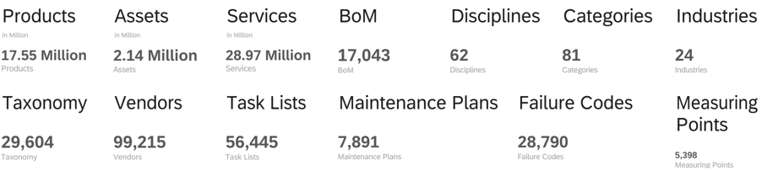
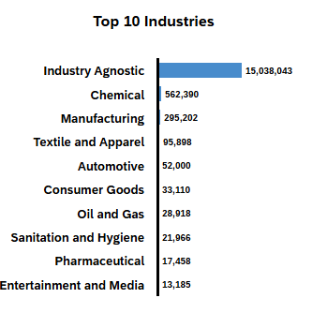
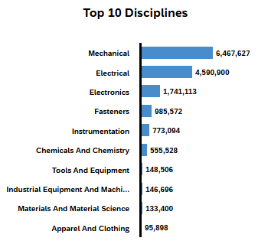
iContent Foundry Statistics
Stats and Facts
www.piloggroup.com
Restricted Use

Slide 79
PiLog’s Data Quality & Governance Suite – Product Availability
Data Quality
Asset Master
eBOM Linking
fBOM Linking
mBOM Linking
Material Master
Service Master
Model Service Spec
Data Governance
Asset Master
eBOM Linking
fBOM Linking
mBOM Linking
Material Master
iSPIR
Service Master
Model Service Spec
Fixed Asset Registry
Maintenance Plan
Maintenance Item
Measuring Point
Task Lists
Work Center
Functional Location
Vendor Master
On-Boarding Process
Customer Master
Content Foundry
Asset Master
Maintenance Plan
Measuring Point
Task Lists
Failure Codes
Material Master
Service Master
Vendor Master for Asset Model/Part
Released till 2024
June 25 Release
www.piloggroup.com
Restricted Use
Notes:
PiLog’s Data Quality & Governance Suite, Product availability matrix by data objects

Slide 80


PiLog’s Data Quality & Governance Suite
User Interface, Security & Authorization Control (HTML5, UI5)
Data Health Assessment
Data Metrics
Validation Rules
Workflows
Search
Taxonomy
Enrichment
Taxonomy
Search
Enrichment
Quality Control
Classification
Taxonomy Reference
Master Data Repository
Auto Text Description
Codification
Quality Control
Auto Text Description
Codification
Business Process
Staging Area
Cleansing
Standardize
Meta Data Repository
Create & Update
Validation Rules
Data Metrics
iContent Foundry
Data Quality
Data Governance
SAP BTP Cloud Foundry - Integration Layer (APIs, Webservices)
S/4 HANA
RISE (PCE)
IBP MRO
IPD
APM
FSM
BNAC
BN4P
www.piloggroup.com
Restricted Use
Notes:
PiLog’s Data Quality & Governance Suite functional architecture dig. Powered by AI

Slide 81





PiLog’s Data Quality & Governance Suite – System Landscape
SAP Business Technology Platform
Integrated Business Planning (IBP MRO)
S/4 HANA on
Private Cloud/On-Prem
Business Network Asset Collaboration (BNAC)
PiLog System Landscape (Hyperscaler/Private Cloud/On-Prem)
Asset Performance Management (APM)
Business Network For Procurement (BN4P)
SSL
Field Service Management (FSM)
Integrated Product Development (IPD)
Data Base
WildFly App
AI Models
APIs
Cloud Connector
BTP Cloud Foundry (CPI)
Business AI Powered Processes
PiLog integrates with SAP using SAP CPI middleware webservices
www.piloggroup.com
Restricted Use
Notes:
PiLog’s Data Quality & Governance Suite technical architecture dig. With seamless integration with SAP suite

Slide 82

PiLog Suite On-Cloud/On-Premise Landscape
PiLog System Landscape (On-Premise)
PiLog Suite Application server
Real time integration with SAP
Direct call from PiLog Suite java
API to SAP Web service
Direct call to SAP web service
Running on SAP PI or PO or CPI
1521
SSL
SAP (Private Cloud / On-Premise of Client / Public Cloud)
DB
WildFly App
Transfer
to SAP
PiLog Suite Database Server:
Installed Database
Base tables data
Access Control
Roles, User & Security
Operational data
Classification data
AI Powered Processes
LLM
LAM
AI/ML Models
APIs
SAP
SAP Server:
In both the scenarios SAP will be either on Private Cloud or On-Premise of Client or Public Cloud
Transfer to SAP
1521
SSL
Cloud
DB
WildFly App
PiLog integrates with SAP using SAP web services of SAP PI/PO/CPI component
The SAP web service will be invoked from PiLog using SOAP or ESB
SAP web services are called synchronous, and a message will be returned to the sender
Real-time integration would be implemented
SAP PI/PO/CPI would use the BAPIs developed by PiLog to push the data to SAP ERP
PiLog System Landscape (On-Cloud)
www.piloggroup.com
Restricted Use
Notes:
PiLog’s Data Quality & Governance Suite deployment models on premise as well as on cloud on hyperscaler

Slide 83
PiLog Implementation Approach
Plan
& Prepare
Business Analysis &
Blueprint
Configure& Realize
Deploy & Test
Transform & Validate (Data)
Go-Live & Hyper Care Support
Steady State Support
Kick-off Meeting Project.
Project Governance
Team setup
Project Charter
Business Requirements
VPN Access, Access to Customer Network.
Infra readiness
Database & PiLog Suite Servers
BBP Document (AS IS TO BE, GAP)
SAP KDS Fields
(Template will be shared by PiLog)
Sign-Off BBP from specific/all the respective stakeholders
DEV & Quality Environment readiness & Deployment
Setup, Create, and Configure Oracle database instance for DQG Quality System
Migrate Group 1 data into DQG schema for Development
Business Rules, Validations, Workflows etc. Configuration
Configure the Create, Change, Interfaces for dev & testing
Full Cycle Test
Performance Test (Stress & Benchmarking)
Interface Test
Integration Testing (SIT)
Create the DQG Schema in Prod. System
DQG to ERP Interface testing in Production
Cutover planning
Base Tables Data
Operational Tables Data
Data Access Layer
Dictionary Tables
Configuration Tables Data
,Roles & Authorizations
Integration, Functional, Performance & Full Cycle Testing (Prod)
Mock
Go Live Decisions
Data Loads Validation
Hypercare Support
Techno-Functional as per SLAs
Value AMS for CI
Production Support post Go Live
Identify any customizations or changes for further improvements
Change
Management & Training
Communication Plan.
Change Governance
Training Plan
Events Plan
Internal & External Communication.
Train the Trainer Program Management
Change Mgmt. Events
Measurements of Improvement
Change Impacts
Corrective & Preventive Measures
Closure Report
www.piloggroup.com
Restricted Use

Slide 84
PiLog Implementation Timelines
1) Plan & Prepare
Execution Plan Completed
2 Weeks
Realization Complete
2) Business Analysis & Blueprint
UAT & SIT
Completed
2 Weeks
Production
Ready
Project
kick off
3) Configure & Realize
2 to 4 Weeks
4) Deploy & Test
Business Design
Complete
2 Weeks
Hypercare Support
Business Continuity
& Sustenance
5) Transform & Validate
1 Week
6) Change Management & Training
Data
Cut-Over
1 Week
7) Go-Live & Support
2 Weeks
www.piloggroup.com
Restricted Use

Slide 85



Knowledge Transfer & Continual Support to Governance Solution System Changes (Optional)
KT Planning
Knowledge Acquisition
Shadow & Lead Phase
Continual Support
Determine Objectives, SLAs and program charter
Prepare Transition Plan
Resource identification & onboarding with SABIC and PiLog
Training Content Build with Self Help and Knowledge Repository
Certification & Accreditation alignment
Pre Read Content review
Training Execution
On job
Classroom
Simulations
Self Help driven online
Mocks and Trail Runs
Certification Preparation
Tests & Accreditations to Tasnee standards
SLAs for Shadow or Lead Phase
Shadow Phase with due guidance from SMEs from PiLog and / or industry experts
Lead Phase with due supervision from SMEs from PiLog and / or industry experts
Measure & Control Performance & Quality
SLAs for Continual Support
Performance measurement & reporting
ALM Process Management, SAP PM Optimization, PiLog iMDRM Stabilization
Knowledge Management
Value improvement in augmented process
CI Initiatives
Shift Left Models deployment
Cross skill and upskill of resources
www.piloggroup.com
Restricted Use

Slide 86
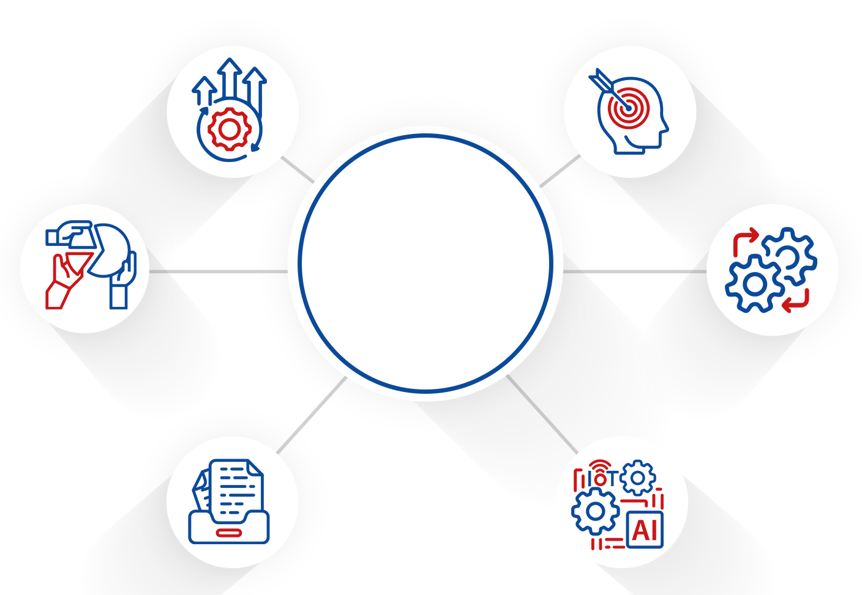
Key aspects of Data Governance
This conceptual approach is forged into a powerful product suite that has a complete set of tools to serve the event and data driven digital transformation that contemporary enterprises seek
Continual Improvement
Initiatives
Value & Vision
(KPIs & KRAs)
PiLog
Data
Governance
Change Management
(Learning, Communication
Collaboration)
Process, Standards
& Procedures
Reusable Content,
Repository & Dictionary
Technology Adoption
Data Science, AI/ML , IoT, RPA
www.piloggroup.com
Restricted Use
Notes:
Data Governance overview

Slide 87








Design to Operate – SAP + PiLog Emulating Value (1/3)
Design
Plan
Receive customer feedback
- define requirement and system concept for new/changed product
Create product design and maintain master data for new/changed product
Handover to manufacturing and service to manage BOM and Routing
Plan demand for new/changed components
Plan supply for new/changed components
Create master
production schedule
SAP S/4 HANA Cloud for
Intelligent Product Design
SAP S/4 HANA
SAP 30 Visual Enterprise
SAP Engg. Control Center
SAP S/4 HANA
SAP Engg. Control Center
SAP Asset Intelligence Network
SAP Integrated Business Planning SAP S/4HANA
SAP Integrated Business Planning
SAP SAHANA
SAP S/4 HANA
PiLog iContent Foundry
Ready to use Asset, BOMs, MS & Task List, Routing, Work Center etc.
PiLog Meta Data Optimizers AI/ML Models
iContent Foundry for Assets, Services & Products
Procure
Manufacture (Subassemblies)
Procure components to build subassemblies
Manage and track Inbound delivery
Receive procured components into warehouse
Schedule subassembly production
Produce subassemblies. and track progress
Receive subassemblies.
Into warehouse
SAP S/4 HANA
SAP S/4 HANA
SAP Global Track and Trace
SAP S/4 HANA
SAP Global Track and Trace
SAP S/4 HANA
SAP S/4 HANA
SAP Digital Manufacturing Cloud
SAP S/4 HANA
SAP Digital Manufacturing Cloud
PiLog Meta Data Optimizers AI/ML Models
iContent Foundry for Assets, Products, BoMs, Vendors
PiLog iContent Foundry
Ready to use Asset, BOMs, MS & Task List, Routing, Work Center etc.
PiLog Data Quality & Governance
Assets, Products, BoMs, Vendors
www.piloggroup.com
Restricted Use
Notes:
PiLog’s Data Quality & Governance Suite value levers

Slide 88


Design to Operate – SAP + PiLog Emulating Value (2/3)
Sell
Manufacture (Finished Product)
Deliver
Receive customer
sales order.
(Assemble to Order)
Schedule finished
product production
Produce finished product and track progress
Register serialized finished product
Receivefinished
product into warehouse
Plan transport, pick,
pack and load product
for delivery
Perform & track
outbound transportation
and receive proof
of delivery
SAP S/4 HANA
SAP S/4 HANA
SAP S/4 HANA
SAP Digital Manufacturing Cloud
SAP Asset Intelligence Network
SAP S/4 HANA
SAP Digital Manufacturing Cloud
SAP S/4 HANA
SAP S/4 HANA
SAP Global Track and Trace
PiLog iContent Foundry
Material, Services, Transportation Data
Meta Data Optimizers
PiLog iContent Foundry
Ready to use Asset, BOMs, MS & Task List, Routing, Work Center etc.
Operate
Receive asset master data, and on-board asset
Monitor assets with loT data, perform analysis. predict asset failure
Plan asset maintenance
Perform inspection. maintenance and repair
Request product improvement
De-commission asset
SAP S/4 HANA
SAP Asset intelligence Network
SAP Pred. Maint. and Service SAP Pred. Engg. Insights
SAP S/4 HANA
SAP Asset Strategy and Perf. Mgmt.
SAP Pred. Maint and Service
SAP S/4 HANA
SAP Asset Manager
SAP Pred. Maint and Service
SAP Pred. Engg Insights
SAP Asset Intelligence Network
SAP S/4 HANA Cloud for Intelligent Product Design
PiLog iContent Foundry
Ready to use Asset, BOMs, MS, Task List, FC, RC, IC, CC etc.
Assets, Materials & Services Data
Asset Criticality Analyzers
PiLog iContent Foundry
MS, Task List, Inspection List, MPC
FMEA
PiLog iContent Foundry
Failure Analytics
Asset Criticality Reassessment
PiLog’s Data Quality & Governance
Assets, Products, BoMs, Vendors & EAM
www.piloggroup.com
Restricted Use
Notes:
PiLog’s Data Quality & Governance Suite value levers

Slide 89
Design to Operate including Service – SAP + PiLog Emulating Value (3/3)
Sell
Manufacture (Finished Product)
Deliver
Receive customer
sales order.
(Assemble to Order)
Schedule finished
product production
Produce finished product and track progress
Register serialized finished product
Receivefinished
product into warehouse
Plan transport, pick,
pack and load product
for delivery
Perform & track
outbound transportation
and receive proof
of delivery
SAP S/4 HANA
SAP S/4 HANA
SAP S/4 HANA
SAP Digital Manufacturing Cloud
SAP Asset Intelligence Network
SAP S/4 HANA
SAP Digital Manufacturing Cloud
SAP S/4 HANA
SAP S/4 HANA
SAP Global Track and Trace
PiLog iContent Foundry
Material, Services, Transportation Data
Meta Data Optimizers
PiLog iContent Foundry
Ready to use Asset, BOMs, MS & Task List, Routing, Work Center etc.
Service
Receive asset master data, and on-board asset
Monitor assets with loT data, perform analysis. predict asset failure
Plan asset maintenance
Perform inspection. maintenance and repair
Request product improvement
De-commission asset
SAP S/4 HANA
SAP Asset intelligence Network
SAP Pred. Maint. and Service SAP Pred. Engg. Insights
SAP S/4 HANA
SAP Asset Strategy and Perf. Mgmt.
SAP Pred. Maint and Service
SAP S/4 HANA
SAP Asset Manager
SAP Pred. Maint and Service
SAP Pred. Engg Insights
SAP Asset Intelligence Network
SAP S/4 HANA Cloud for Intelligent Product Design
PiLog iContent Foundry
Ready to use Asset, BOMs, MS, Task List, FC, RC, IC, CC etc.
Assets, Materials & Services Data
Asset Criticality Analyzers
PiLog iContent Foundry
MS, Task List, Inspection List, MPC
FMEA
PiLog iContent Foundry
Failure Analytics
Asset Criticality Reassessment
PiLog’s Data Quality & Governance
Assets, Products, BoMs, Vendors & EAM
www.piloggroup.com
Restricted Use
Notes:
PiLog’s Data Quality & Governance Suite value levers

Slide 90
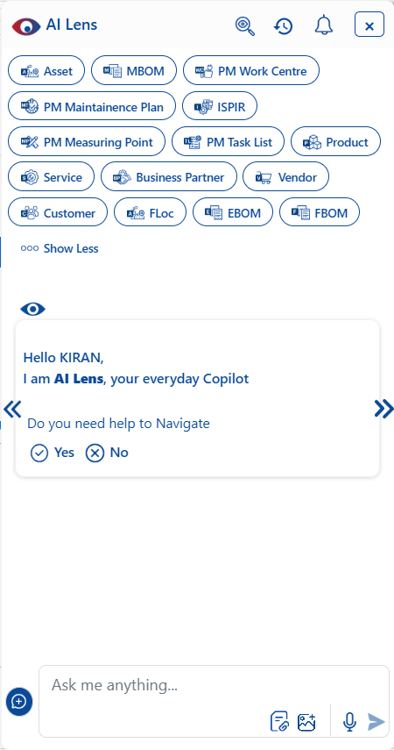

AI Lens is PiLog’s copilot, a virtual assistant embedded in Suite
AI Lens is conceived & designed
Conversational AI
Scaled-down LLM & LAM Model
Generative AI Approach
Trained Contextually
NLP Model
Knowledge base
Augmented AI
Configurable features
Simple & Extended Analytics
Real-time & Staged Integration with SAP or Oracle or APIs
Guide as Subject Matter Expert
Qualitative Validations & more
Multimodal Understanding
Auto-learning & Continuous Improvement
Domain Adaptation & Customization
The Conversational AI is application of Artificial Intelligence that simulates human-like conversations engaged in answering queries, guides the users as subject matter expert, provides insights on specific data points, showcases the analytics, pivoting the data, transverses the processes as per the personalized configuration
AI Agents
DH007 - Data Harmonization Agent
DE007 - Data Extraction Agent
QC007 - Data Quality Check
www.piloggroup.com
Restricted Use
Notes:
AI Lens, Co-Pilot for PiLog’s Data Quality & Governance Suite design and utilization
A Global API is created to deploy the model on-premise option, AI use-cases can not only be deployed for Cloud but also for on-premise, using API Hub concept

Slide 91
PiLog AI Agents
AI agents are software systems that use AI to pursue goals and complete tasks on behalf of users
Every agent defines its role, personality, and communication style, including specific instructions and descriptions
Here are some of the active agents with their Activity:
S.No | Agent Name | Agent Activity | Description
1 | DH007 | Data Harmonization Process | AI Agent involves integrating data from various sources into a unified structure. AI Agent classifies, standardizes, and maps data for consistency. It detects and corrects anomalies or duplicates automatically. This ensures clean, structured data
2 | DE007 | Data Extraction Process | Data extraction from PDFs, scanned documents, websites, and various file types. AI Agent classifies, formats, and aligns the data to maintain consistency and accuracy. This transforms raw inputs into structured
3 | QC007 | Data Quality Check Process | AI Agent performs automated checks to ensure data uniqueness, consistency, and completeness. It validates accuracy, detects duplicates, and flags anomalies or missing values. This process ensures reliable, high-quality data
4 | SR007 | iSPIR Extraction Process | AI Agent extracts structured and unstructured data from iSPIR documents, including tag numbers, equipment models, and spare parts lists It classifies and standardizes the content while automatically linking equipment with their associated spare parts. This results in accurate, well-organized data, ready for integration into asset management
Note: We are currently working on more than 10 use cases
www.piloggroup.com
Restricted Use

Slide 92
ISLexitas LLM Process Model
Specially Trained with Master Data
Trained with all Industries Data
Industry Tuned Accuracy
Precision Tailored to Industry Standards
Domain Fine Tuning & Traceability
Precision Training for Domains with Traceable Outputs
Secure AI Deployment
Data Protection & Controls
End user sends Query to LLM
Embedding Model
(ISLexitas)
Vector Database
End User
UI
Initial Prompt
Data Filter
Output sent to End user
Prompt Optimized Tool
LLM Output
Content Filter
Content Filter Scans output for Harmful Content
LLM API
LLM HOST
www.piloggroup.com
Restricted Use
Notes:
PiLog IP’ LLM Process model, ISLexitas - IntelliSense Lexitas - The name Lexitas combines two Latin words, the first being Lex, Lexical. The latter part of our name is derived from Veritas, the Latin word for truth
"Lexical" in the context of LLMs (Large Language Models) refers to the study and application of word meanings and their relationships, including how LLMs understand and use words in different contexts, and how they can be used for tasks like lexical simplification or semantic analysis.
Here's a more detailed explanation:
1. Lexical Semantics and LLMs:
Lexical Semantics:
This is the study of word meanings, including how words structure their meaning, how they act in grammar, and the relationships between different senses and uses of a word.
LLMs and Lexical Understanding:
LLMs, trained on vast amounts of text data, have demonstrated a remarkable ability to understand and generate human-like text, which includes understanding the nuances of lexical semantics.
Contextualized Representations:
LLMs provide high-dimensional, contextually modulated representations of words, meaning that the meaning of a word can change depending on the context in which it is used.
2. Applications of Lexical Analysis with LLMs:
Lexical Simplification:
LLMs can be used to simplify text at the lexical level, replacing complex words with simpler synonyms while maintaining the original meaning.
Lexical Semantic Change Detection:
LLMs can be used to identify how the meanings of words change over time.
Evaluating LLM Capabilities:
Researchers are using lexical semantics tasks to evaluate the capabilities of LLMs in understanding and using language, such as identifying lexical semantic equivalence in context.
Prompt Engineering:
Understanding the lexical sensitivity of LLMs is crucial for crafting effective prompts that elicit desired outputs.
3. Examples of Lexical Analysis with LLMs:
Identifying Synonyms:
An LLM can be prompted to find synonyms for a given word, demonstrating its understanding of lexical relationships.
Understanding Word Meanings in Context:
An LLM can be asked to explain the meaning of a word in a specific sentence, demonstrating its ability to understand contextual nuances.
Detecting Semantic Change:
An LLM can be used to analyze how the meaning of a word has changed over time, based on its usage in different historical texts.
4. Challenges and Future Directions:
Lexical Sensitivity:
LLMs can be overly sensitive to lexical variations in instructions, even when the variations are imperceptible to humans.
Evaluating LLM-Generated Text:
Researchers are exploring methods for evaluating the lexical richness and diversity of text generated by LLMs.
LLMs and Language Evolution:
Understanding how LLMs use language can provide insights into the potential impact of these models on the evolution of languages.
Veritas is a Latin word that means "truth" or "reality". It is also the name of the Roman goddess of truth.
Etymology
The English words "very" and "verity" are derived from Veritas.
The Latin proverb in vino veritas translates to "in wine, truth".
Harvard University's motto is Veritas.
Roman mythology
In Roman mythology, Veritas is the daughter of Saturn (Cronus) and the mother of Virtus.
She is sometimes considered the daughter of Jupiter (Zeus) or a creation of Prometheus.
She is depicted as a virgin dressed in white or as the "naked truth" (nuda veritas) holding a hand mirror.
The equivalent Greek goddess is Aletheia.
Latin phrases
Magna est veritas et praevalebit translates to "truth is mighty and will prevail".
Veritas vos liberabit translates to "truth will set you free".
Vincit omnia veritas is another Latin phrase.

Slide 93
LLMs used in our Solutions - ISLexitas/Llama 3.3/Mistral 24B
The Role of LLMs
Automated Data Extraction: Intelligently identifies and pulls data from varied sources, reducing manual integration work
Smart Mapping & Transformation: Learns from data patterns to auto-map fields, detect relationships, and apply correct transformations.
Data Profiling: Analyzes datasets to detect anomalies, patterns, frequency distributions, and completeness levels.
Data Classification: Automatically categorizes unstructured or semi-structured data
Product Specification Extraction: Extracts critical specifications (e.g., size, material, voltage, weight) from textual product descriptions using NLP and AI techniques
Data Harmonization: AI helps standardize and align data from diverse sources, ensuring consistency across systems and improving data usability.
Continuous Quality Monitoring: Identifies inconsistencies in real-time and suggests proactive corrections across datasets
Data Enrichment: Generative AI infers missing values, generates metadata, and suggests standardized formats to enhance data completeness.
Natural Language Q&A: The system supports NLP-driven question-and-answer functionality, enabling users to query data assets or governance policies in plain language and receive accurate, contextual responses.
Application Navigation Support: Generative AI interprets user intent to guide them to relevant tools, datasets, or functions within the system.
Data Governance: AI ensures that data policies, classifications, and quality checks are applied consistently
OCR: OCR is a technology that enables machines to read and convert text from images, scanned documents, or PDFs into machine-readable and editable text.
www.piloggroup.com
Restricted Use
Notes:
Other LLMs leveraged in PiLog’s Data Quality & Governance Suite CHAT GPT & Llama

Slide 94


Impactful Business Value Management with PiLog Suite (Powered by AI)
Data Quality Management is aimed to automate the process of standardization, cleansing & management of unstructured/free text data by utilizing ASA (Auto Structured Algorithms) built on PiLog’s taxonomy and the catalog repositories of master data records.
Enrich the Data from Manufacturing websites
Collect the
Field Data & Auto Data Harmonization
Data Health Assessment, Maturity Assessment
Auto
Classification, Categorization
Extract the data from cloud and other sources and Validation
Analyze
The source
Data, Data Profiling
QC Checks and Validations
Data Standardization as per ISO Standards
AI Generated Reports
Auto Extract the Product Specifications like Characteristic values and Reference Data
NLP Questions and Answers
AI Insights on Data
Auto Mapping
of Source Data
with PiLog
Repositories
Identification
of Redundant
Records
www.piloggroup.com
Restricted Use
Notes:
Business Impact and Value of AI in PiLog’s Data Quality & Governance Suite

Slide 95
















Impactful Business Value Management with PiLog Suite (Powered by AI)
Data Quality Management leverages ISLexitas-powered large language models to streamline the classification, harmonization, and health assessment of unstructured or free-text data
Data Health Assessment
Data Maturity Assessment
Enrich the Data from Manufacturing websites
Data Standardization as per ISO Standards
AI Insights on Data
Collect the Field Data
Auto Data Harmonization
Vendor Sourcing Information
Data Profiling
QC Checks and Validations
Auto Classification
Categorization
UNSPSC
ISIC
RPA - Robotic Process Automation
Extract the data from cloud and other sources and Validation
AI Generated Reports
Auto Extract the Product Specifications
Reference Data Extraction
OCR - extracts data from images or scanned documents
NLP Questions and Answers
Identify the Duplicates based Source Description
www.piloggroup.com
Restricted Use
Notes:
Business Impact and Value of AI in PiLog’s Data Quality & Governance Suite

Slide 96
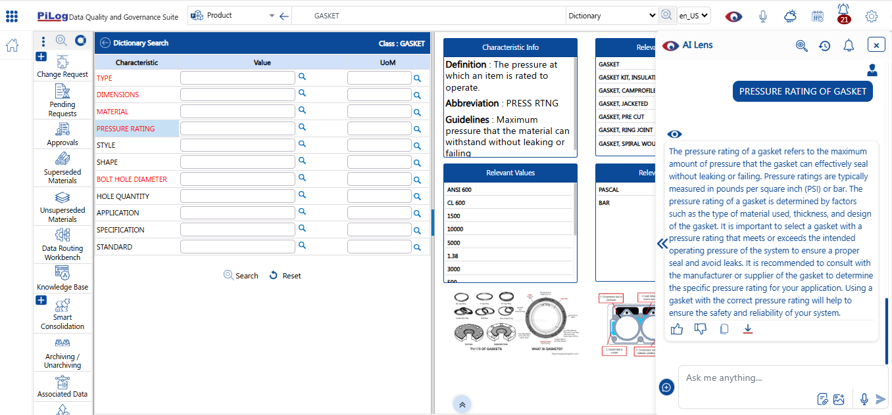
Use Case 1 - Product - Knowledge Base (1/4)
Invoking AI Lens on the Characteristic name selection Eg: PRESSURE RATING of GASKET
Strictly Confidential
Notes:
AI Lens use case 1 guiding users for data characteristics updates for quantitative and qualitative improvement

Slide 97
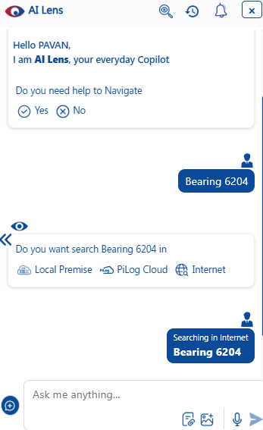
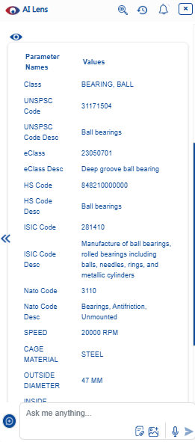
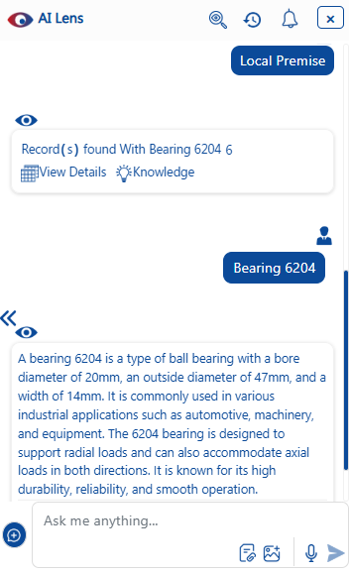
Use Case 1 - Knowledge Base (2/4)
You can search any description on ‘Local Premise’ or ‘PiLog Cloud’ or ‘Internet’
Searching for ‘BEARING 6204’ on Internet & ‘View Details’ on Local Premise
Refer next slide
Strictly Confidential
Notes:
AI Lens use case 1 guiding users for data characteristics updates for quantitative and qualitative improvement

Slide 98
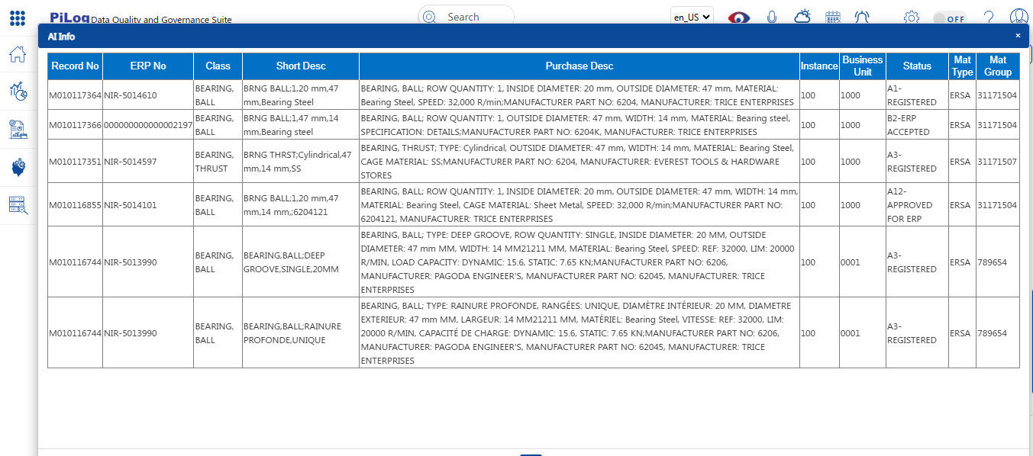
Use Case 1 - Knowledge Base (3/4)
‘View Details’ on Local Premise
Notes:
AI Lens use case 1 guiding users for data characteristics updates for quantitative and qualitative improvement

Slide 99
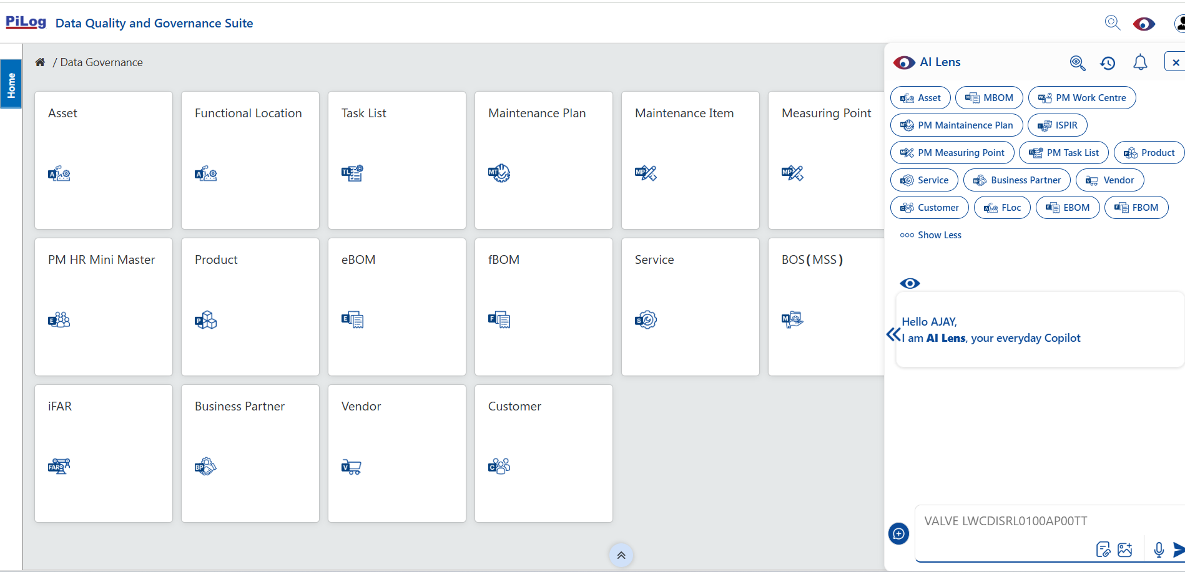
Use Case 2 – Navigation with Intuitive Prompts (1/3)
‘Navigation’ across the application through AI Lens with user friendly (Intuitive) Prompts, in SAP UI5 Theme
Strictly Confidential
Notes:
AI Lens use case 1 guiding users for data characteristics updates for quantitative and qualitative improvement

Slide 100
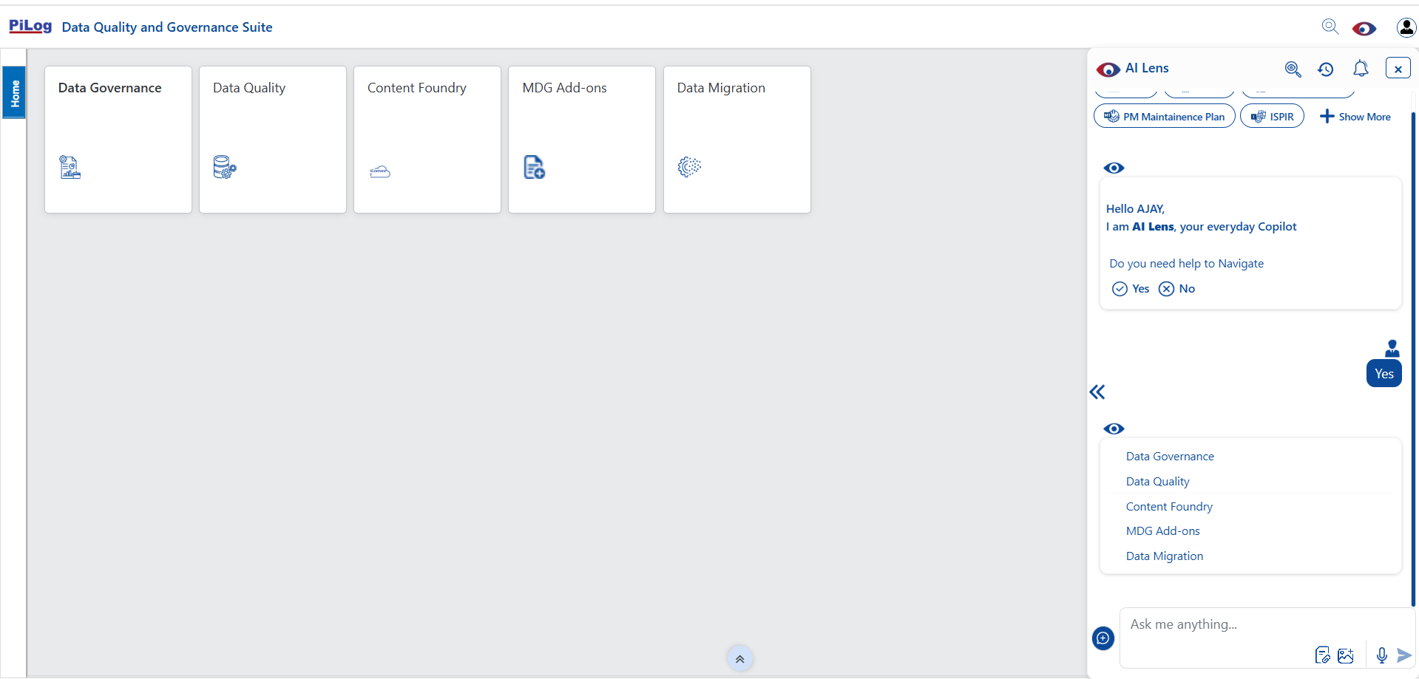
Use Case 2 – Navigation with Intuitive Prompts (2/3)
‘Navigation’ across the application through AI Lens with user friendly (Intuitive) Prompts, in SAP UI5 Theme
Intuitive Prompts
Strictly Confidential
Notes:
AI Lens use case 1 guiding users for data characteristics updates for quantitative and qualitative improvement

Slide 101
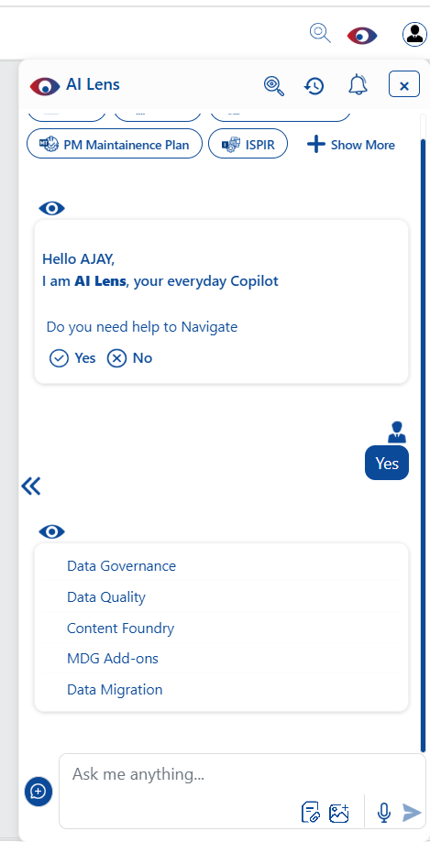
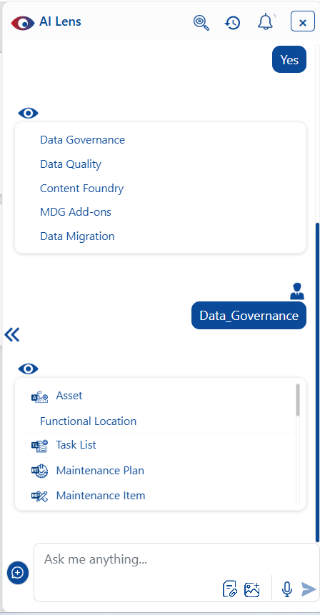
Use Case 2 – Navigation with Intuitive Prompts (3/3)
Intuitive Prompts
Intuitive Prompts
Strictly Confidential
Notes:
AI Lens use case 1 guiding users for data characteristics updates for quantitative and qualitative improvement

Slide 102
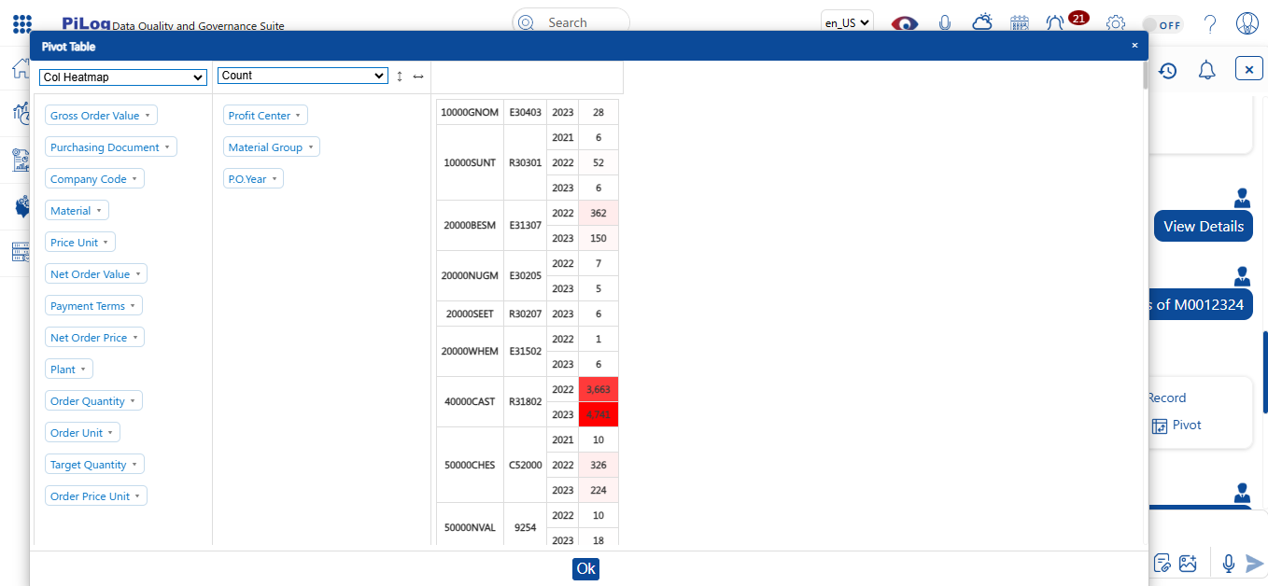
Use Case 3 - Analytics (Pivot Table)
A Pivot Table lets you rotate the data and look at it from different Angles or perspectives
Strictly Confidential
Notes:
AI Lens use case 3 providing analytical view of data quality using OLAP models
In Solution/In-App analytics uses OLAP models for analytics. OLAP – Online Analytical Processing models

Slide 103
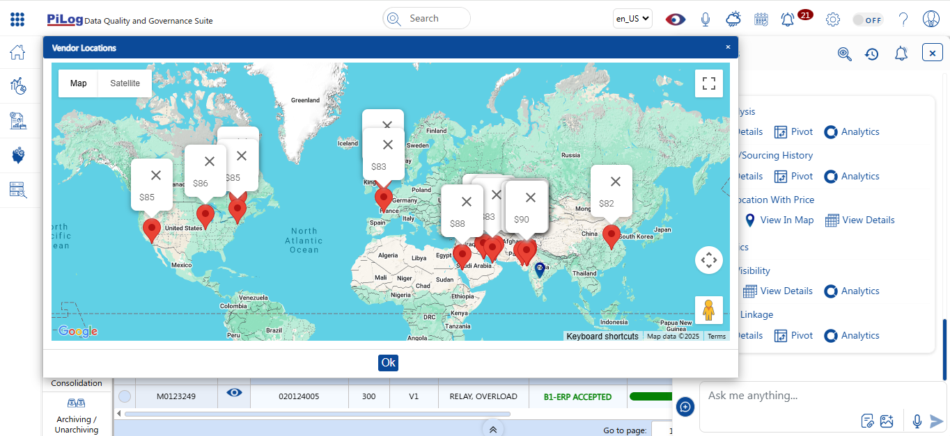
Use Case 4 - Sourcing Location with Price (approx.)
Highlighting Locations with Price details using AI Lens
Strictly Confidential
Notes:
AI Lens use case 4 providing Global Sourcing & Pricing (Lab Preview)

Slide 105
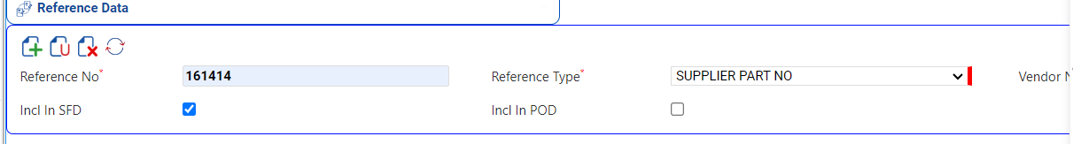
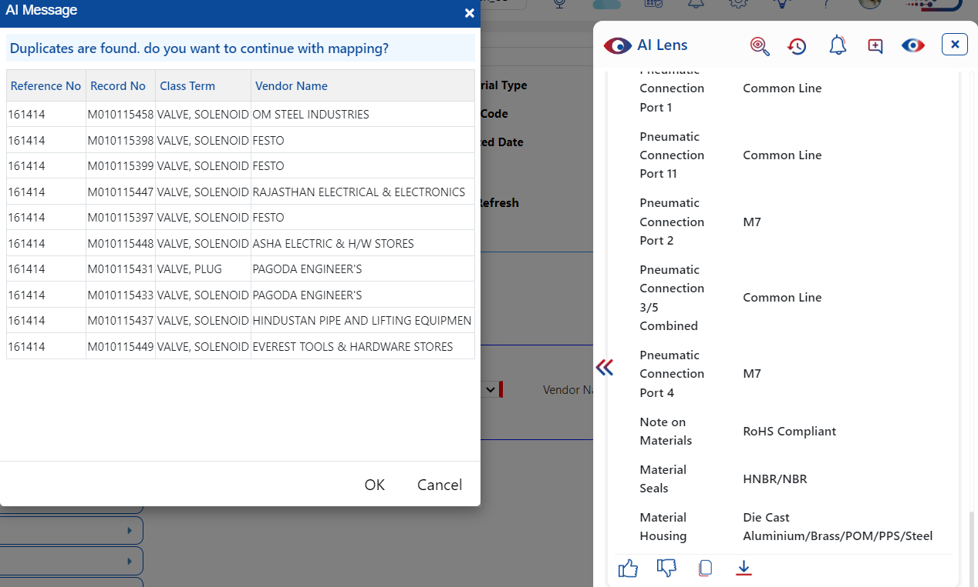
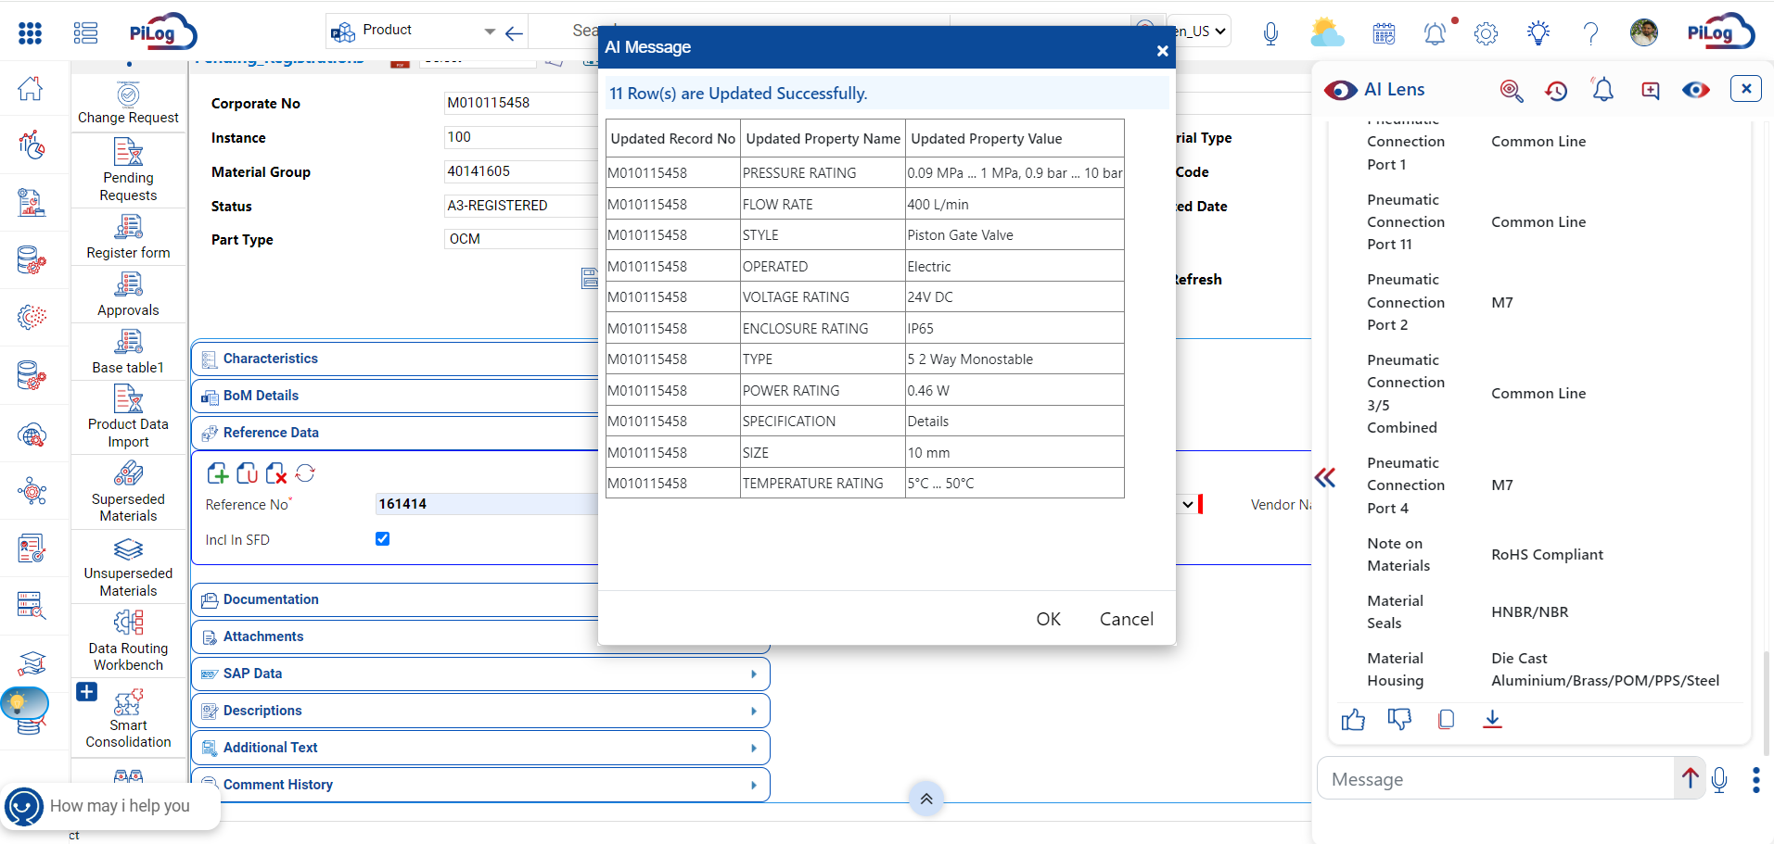
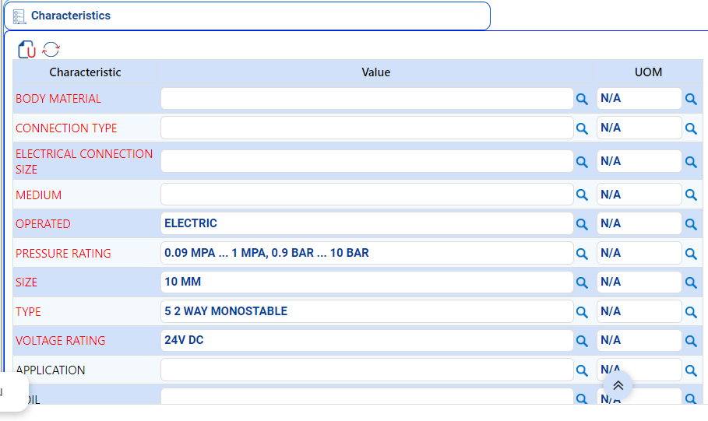
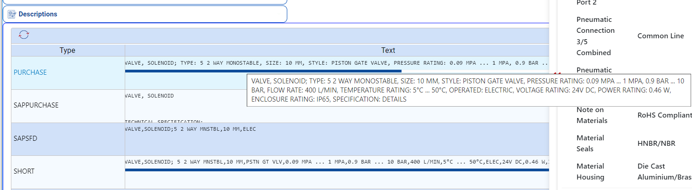
Use Case 5 - Data Science Services
Product Creation - Data Science API is used to enrich the relevant data based on the Reference Number from Manufacturing Website
Strictly Confidential
Notes:
AI Lens use case 4 Data as Service enabling seamless external integration for data enrichment

Slide 106
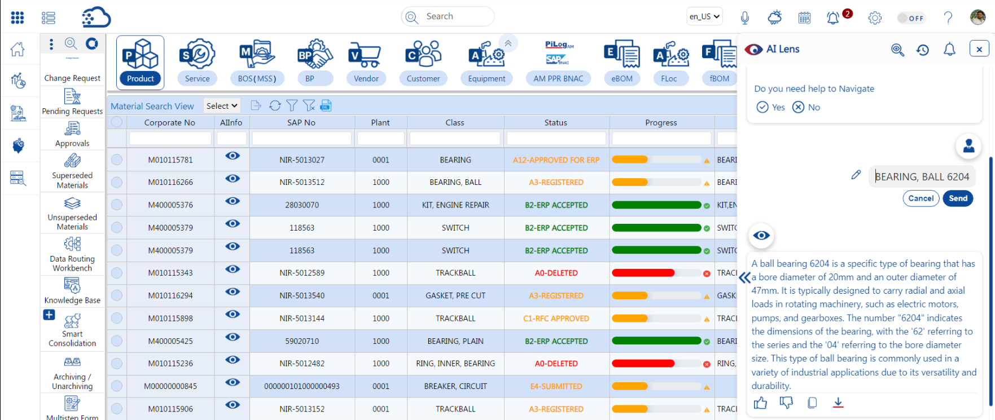
Use Case 6 - AI Lens Input Data Edit
After entering input data into the AI Lens, an option to edit the entered input has been added
Strictly Confidential
Notes:
AI Lens use case 5 Data adoption and change management with end user collaboration

Slide 107
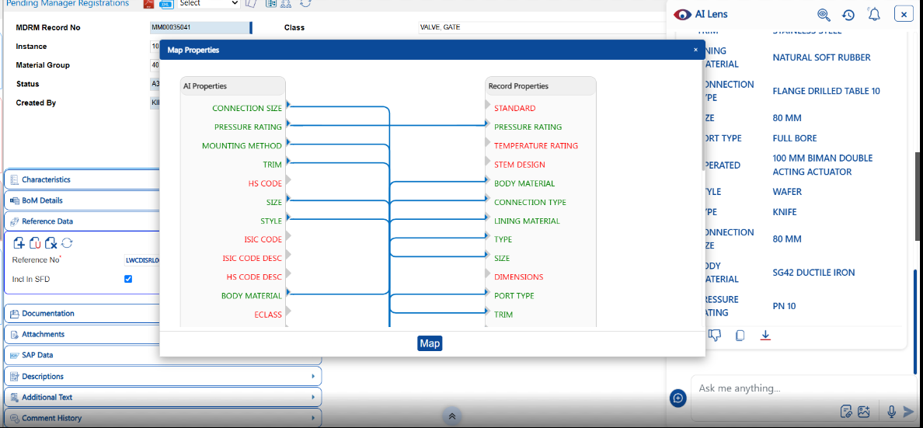
Use Case 7 – Classification Auto Mapper
The mapping is provided automatically, however the mapper allows the user to map the characteristics
Strictly Confidential

Slide 108

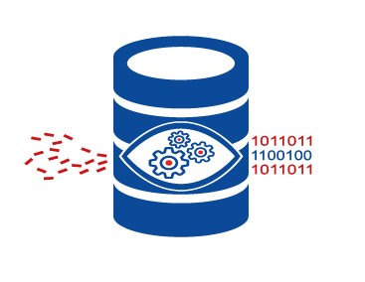





PiLog’s Add-On for SAP MDG (Material, Service)
PiLog's Material & Service Master Taxonomy for SAP Master Data Governance delivers the industry proven best practices to improve supply-chain, procurement and maintenance, repair, operations (MRO) processes. It utilizes the maintenance, repair and operations taxonomy within the SAP Master Data Governance classification to render systematic multi-lingual short & long descriptions, identify duplicates and enforce ISO compliant data quality. It also features iSPIR, mBoM and eBOM
Solution Benefits
Improved & Accurate Searchability using classification Reduces the time taken for material identification
Ready to use Industry proven taxonomy & ISO compliant content ( Class, Characteristics, Values & UOMs)
100% improved De-duplication processes
100% ISO Compliant Master Data Governance
10% Savings on Inventory cost
50% improved Master Descriptions
Multi-Lingual Descriptions
Reduces the time to populate the required field and validations
2 times Faster & Accurate Search using embedded Taxonomy
Empowering the work force by introducing the standards
ISO Compliant
Master Data Governance
Improved Master
Descriptions for easy
procurement
PiLog Preferred Ontology - ISO 8000 &
ISO 22745 compliant taxonomy,
technical dictionary templates readily
mapped with UNSPSC, HSN, SAC
classifications
Improved
De-duplication
Processes
Solution Features
Creating Class and Characteristics to SAP Custom
Workflows configured with 4 roles in Change Request
Duplicate Check based on Class and Characteristic values
Duplicate Check based on Class and Part No or only on Part No
Create Change Request from PPR (PiLog Preferred Repository)
Data Quality, Processes & Methodology compliance to standards ISO 8000,
ISO 22745, ISO 11179, ISO 29002 & IEC 60050 (IEV)
Savings
on Inventory Cost by
De-duplication
www.piloggroup.com
Restricted Use
Notes:
PiLog MDG Add on, certified by SAP for materials and services repository & dictionary

Slide 109
PiLog’s Configured CR Workflow in SAP MDG
SAP MDG
SAP ERP
Create
Change
SAP ERP
Extend
Delete
Undelete
Requestor
Approver
Steward
Manager
SAP ERP
Role | Activity | Location
Requestor | Search, Initiate CR, Populate the values, Governance Checks, Process | Plant
Approver | Review CR details, Corrective Actions, Governance Checks, Process | Plant
Steward | Review CR details, Governance Checks, Process | Center of Excellence
Manager | Review CR details, Governance Checks, Process for Replication | Center of Excellence
www.piloggroup.com
Restricted Use
Notes:
Multilevel approval work flow in PiLog’s Data Quality & Governance Suite

Slide 110

End to End Data Transformation Framework
Source Systems
Staging Area
Data Transformation Area
Load/Reconciliation
Target System
Equipment, Functional Location, Maintenance Plan, Maintenance Item, Task Lists, eBOM, fBOM, mBOM, Material, Service, MSS
SAP ECC
Queue
Applying Harmonization Rules
Queue
Staging Area
CRM
SAP S/4HANA CLOUD
Transform & Validate
SOAP Webservices
SRM
Review & Approve
Log
SAP S/4HANA On-premise
NON-SAP
Error Handling
PiLog
www.piloggroup.com
Restricted Use

Slide 111
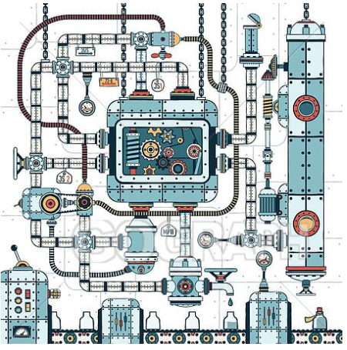


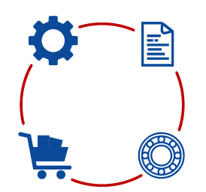
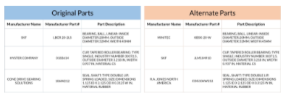
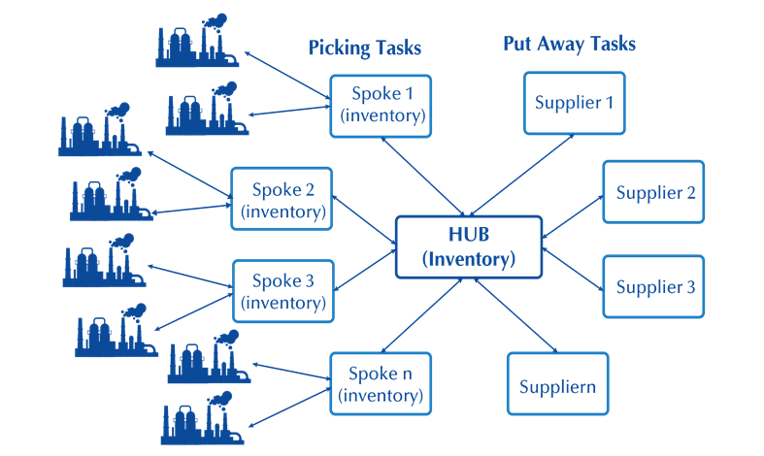





Spare Parts Life Cycle Management – A Lifeline for Operational Excellence
Equipment Design & Spare Part Data Package
Equipment Commissioning & Availability of Spare Parts
Optimization of SPIRs and Parts Sourcing
Multienterprise Colloboration
Parts Disposal
Optimization of Parts Planning, Analytics & Storage
Equipment Design
Commissioning & Startup
Spare Part Interchangeability Records
Parts Planning
Multienterprise Supply Chain Business Networks
Asset Decommissioning & Parts Disposal
Inventory Analytics
Spare Parts Data Package
Availability of Spare Parts
Make or Buy Strategy
Central demand aggregation & planning
Inventory Colloboration
SME Colloboration
Inventory Cost reduction
Better Supplier Management
Identification of decommissioned equipment / spare parts
Resale avenues
Scrapping
Refurbish & Reuse
Compliance & Regulatory Requirements
SMART Inventory
Entire Spares List
Cost Benefit Analysis
Domestic Vs. Import
Compliance & Regulations
Start up Spares
Capital & Two-Year Warranty Spares
www.piloggroup.com
Restricted Use
Notes:
SAP S/4 HANA, SAP IBP MRO, SAP BN4P, PiLog iSPIR, PiLog Data Quality & Governance

Slide 112
Capital Project Lifecycle Management
Data Acquisition / Project Phase
Data Management / Operational Phase
Upload to ERP
Planning
Preparation
Inventory
Feedback
Configuration
Requisition
Data Extraction
Procurement
Documentation
Receiving
Construction
Issuing
Level of Effort
Procurement
Maintenance
Design
Phase -Out
18 months
Max Level of Effort
Best Business
Practice
Existing
Practice
Plant Commissioning
Time
4 - 5 years
Handover
20+ years
Restricted Use

Slide 113







Capital Project Lifecycle Management
Data Acquisition / Project Phase
Data Management / Operational Phase
Management
in ERP
Planning &
Inventory
18 months
Max Level
of Effort
Procurement &
Construction
Operations &
Maintenance
Level of Effort
Best Business
Practice
Closure &
Phase out
Existing
Practice
Existing
Practice
Existing
Practice
4-5 Years
Handover
20+ Years
Time
Restricted Use

Slide 114
Data Acquisition for SAP S/4 HANA
(1) {PO, VENDOR, TYPE OF PO, STATUS OF PO}
EQUIPMENT
SPARES
EQP PO/CONTRACT
PACKAGE
FILTRATION
(2) EQUIPMENT
STRUCTURE
CIRCULATION
SUPPLIER
CRITICALITY
TREATMENT / DOSING
(3) SPARES
TYPES OF SPARES
DOCUMENT CONTROL
CLASSIFICATION
CAPITAL
Planned Del, Actual Del, Actions/ Status with dates
(1) SUPPLIER
COMMISSIONING ERECTION
SPIR
QUANTITY (Min, Max ROP)
2 Yrs OPERATIONAL
PO
Inspection Report
Spares Delivery Report
Client Bin
Date of PO placement
ERP Requirements
A = (1) Vendor Master E = (3)+(1) = Vendor info Record
B = (2) Equipment Master F = (2)+ Classification = Equipment Classification
C = (3) Material Master G = (3)+Inv Level = Inventory
D = (2)+(3) = Plant Maintenance BOM H = (2)+Maint Task = PM Maint Task
Inspection Planning: Lead Time + Transport = Planned / Expected delivery of spares. (From the date of PO)
Restricted Use

Slide 115



iSPIR, an operational lifeline for equipment health management
PO Registration
SPIR Registration
Collect SPDP and Engineering Documents
Brown Field ~ XXX SPIRs
Validate SPDP and SPIR?
Deliverable – ~XXX Documents linked and indexed
Acceptance criteria – Quality >95 %
Key Assumptions ~ Small SPIR: 20-30 materials, Medium: 60-100, Large 300-500, Extra large1000 materials
Upload SPIR into Staging
Y
N
Duplicate Item?
(PDR1&2)
Catalogue & Enrich Spares
N
Transfer to MDG
Duplicate project and Catalogued Items?
(PDR1)
Y
N
Transfer Non Duplicate SPIR Items to OPS Catalogue
Register Vendors
(Auto)
Y
Duplicate Items
Transfer to ERP
Register Equipment
(Auto)
Duplicate Items
Key composition of SPIR –
Unique MRO material components
Make, model, drawing specification reference
Frequency
Linked material components like BOMs, hierarchies etc.
Quantities and value
Merge Duplicates
End
Register Equipment BoM
(Auto)
Merge Duplicates
End
End
Restricted Use

Slide 116

Data Acquisition for SAP S/4 HANA
5
1
3
2
6
4
1. Parent Equipment Tag/Model/Serial Number
2. Installed number of Spares
3. Spare Part Description
4. SPIR Number
5. Equipment Supplier & Manufacturer details
6. Price
Restricted Use

Slide 117
Financial Assets (Fixed) Verification, Data Collection, Condition Assessment
Registered (ERP)
Master Data
Financial Accounting
Rules
Asset
Location
Grouping
A
L
G
Asset Status
Tracking
A1
L1
G1
A2
L2
G2
Tagging
Condition
A3
L3
G3
Makes it easier to strategically manage and track fixed assets
A fully integrated asset survey tool (digitization, data collection, and condition assessment)
Group assets in correct depreciation classes
Establish asset life
Componentize, move, scrapping, identify ghost assets
Alignment to finance and integration with ERP asset counting systems
Flexible fixed
asset structure
Flexible Location
structure
Flexible Type/ Group
structure
Restricted Use

Slide 118

Process Integration and Standardisation Offering
Establish a proper FAR structure that is aligned with IFRS requirements and supports Capital projects, Client Operations with Assets, and Maintenance management strategies; (the ‘’Blue” structures are applicable to the other business objectives and data structures needed in each process)
In accordance with Work Breakdown Structure
Conforming to IAS 16
In accordance with maintenance strategies and tactics
Align to prepare
for FAR population
Align to populate
FAR
Align to update
FAR at the
correct level
Capital project
budgeting structures
Capital project
as-built asset structures
Maintenance
object structures
FAR
In Accordance with Work
Breakdown Structures
Conforming to IAS 16
In Accordance with
Maintenance strategies and tactics
Restricted Use
Notes:
https://www.ifrs.org/issued-standards/list-of-standards/ias-16-property-plant-and-equipment/

Slide 119












Data Maturity Assessment of Master & Meta Data
Multi-Domain Master Data
Data Maturity Assessment:
Qualitative data management against standards & provisional reporting
Assessment on data quality dimensions such as Completeness, Accuracy, Traceability, Consistency, Timeliness, Availability and Validity
START
Acquire the Data from the Customer System
Data Planning Workbench
(a) Matched Records
Data Identification & Verification
Data Matching with Repository
Data Standardization
Load the Customer Data in the Shared Folder
(b) Unmatched Records
Run QC Tools
Map and Import the Data in DQM System
Run Profiling on the imported Data
Pattern Recognition for Analysis
Description Generation
DHA Workbench
Data Segregation
B
Customer Review
Moderate Data
Preparation & Alignment on Customer's Expectation
END
C
Redundant Data
A
Complete Data
A: Records with 10-15% FFT of
source description
B: Records with more than 10-15% FFT of source description
C: Records with No-class and reference details
Sign-Off on the SoP Documents
Class
Data Validation
Characteristics
www.piloggroup.com
Restricted Use

Slide 120
Data Maturity Assessment
Licensing Structure
Model | License Term | Deliverables | Notes
Per-Assessment | One-time | 1 DMA report, findings, recommendations | Good for pilot or PoC
Annual Subscription | 1 year | Quarterly DMA, dashboard access | Great for ongoing governance
SaaS Access | Monthly/yearly | Self-service DMA tool, AI suggestions | Scalable and productized
Consulting + Platform | Project-based | In-person consulting + tool access | High-touch, custom engagements
Skills Required for DIY Users Data Literacy Ability to understand basic data types, data structures, and metadata. Familiarity with concepts like data governance, quality, lineage, and stewardship. Analytical Thinking Capability to interpret assessment questions in a business and technical context. Skill in identifying maturity gaps and prioritizing areas for improvement.
Tool Proficiency Comfort with Excel/Google Sheets (formulas, drop-downs, scoring models). Ability to navigate dashboards, input data, and interpret results. Domain Knowledge Understanding of internal data ecosystems (e.g., sources, systems, workflows). Knowledge of organizational goals to align maturity metrics with business needs.
Restricted Use

Slide 121





PiLog’s Data Harmonization Solution PiLog’s iVision Methodology and Product Suite powered by AI / ML
Material, Service, Asset & EAM Objects – Basic Cleansing & Structuring
Material, Service, Asset & EAM Objects – Advanced Structuring, Standardization & De-duplication
Material, Service, Asset & EAM Objects – Enrichment, Structuring, Standardization & De-duplication
“
AI and GenAI streamline the data harmonization process by automating data extraction, intelligently mapping and cleansing diverse datasets, and continuously enhancing data quality and consistency across systems - minimizing dependence on manual rules and isolated expertise
Data Ready – AI Ready
Discovery &
Extraction
Ingest & Clean
Data Migration
NLP driven Standardization, Auto Correction & Co-relations
Patterns based Data feed & Migrating to the target systems
Source identification & seamless data acquisition
Data Maturity Assessment
Harmonize & Evaluate
AI driven As-Is & To-Be and identifying the gaps
Continual Quality Improvement & Enrichment
“
Data Harmonization Process
© PiLog Group
www.piloggroup.com
121
Restricted Use

Slide 122


Data & Process Maturity Models powered by AI
Data Quality
Data Objects
Evaluation Models
Data Outcome
Data quality assurance, real-time process monitoring, maturity assessment at scale, and dynamic data-driven decision-making to maximize organizational efficiency and performance
Standards, Governance, Risk & Controls for efficient & effective decision making
Asset, Products & Services Masters for ALM & SCM Business Processes
Data & Process Maturity Scoring Mechanism build on NLP Models
Data & Process Maturity Score Cards, Recommendations & Business Case
Data & Process Maturity
Data Maturity = f(data strategy, quality, technology & tools, culture etc.)
Equipment Category | Counts | Completeness | Consistency | Uniqueness | Accuracy | Validity
MECH | 3352 | 52 | 63 | 98 | 74 | 69
ELEC | 3012 | 63 | 79 | 97 | 95 | 87
INST | 2843 | 43 | 53 | 99 | 62 | 58
FIRE | 1583 | 69 | 82 | 86 | 94 | 88
ANAL | 92 | 76 | 71 | 100 | 66 | 69
CIVL | 71 | 50 | 75 | 100 | 100 | 88
Data Quality
Completeness
Accuracy
Consistency
Availability
Timeliness
Traceability
Supply Chain (P2I) Maturity = f (cost of procurement & operations; compliance & regulatory, supplier performance management; etc.)
Weights & factoring of parameters are industry & organization specifics
www.piloggroup.com
Restricted Use

Slide 123







PiLog Data Harmonization Approach – 1/2
Data Discovery
Data Acquisition /
Extraction
Data Maturity Assessment
Establish Baseline & Business Rules
Data Upload & Verification
Process Automation
Data Cleansing /
Codification
Workshop
Structure of master data
Format of master data
Relation ship to other data elements
Number of objects
S-T Mapping
Transformation Rules
Domains: Material, Service, Asset & EAM Objects
PiLog will share domain-wise
data Extract
Template
Customer Team will
Extract the data
Data Extraction will
be In .xls or .xlsx
(Preferred)
Extracted Data Will
be reviewed by
Domain Expert
Data Verification
Data Quality Analysis
Completeness
Accuracy
Consistency
Availability
Timelines
Traceability
Data Maturity
Assessment & DQ
Score Cards for Various Domains
Set Up DH Instance
Configure the Rules
based on the
Target System
Configure the UoMs
Upload PiLog’s
Taxonomy
Finalize Data
Harmonization
Document/SignOff
Draft the User
Guidelines &
Manuals
Final Checklist
Upload the data in iDXP as per the checklist
Cross verification of the uploaded data
Data Harmonization document preparation
Run the Uploaded data thru data Accelerators /Automated Tools
1. AI Co-Pilot
2. Golden Repository
3. DH Tool
4. LAM, LLM, NLP etc. Models
5. AL Technique Embedded - GEN AI, CHATGPT
OPEN AI, Grok, etc
Prepare a Batch
Run QC Checks
Perform Values
Standardization &
Abbreviations
Generate Short & Long
Descriptions
Data Quality Sign-Off by
PM, TL & QL
Delivery Notification
Data Insights, Deliverables & Recommendations powered by AI
Verification of Final Data Set to be Cleansed
Data Harmonization Document Sign-Off
Auto Catalogued Data
Improves the data Delivery
Batch Delivery &
Notification As per the Project Plan
Reduces Time to Deliver Batch
Less manual Intervention
Roadmap for
executing MDM
Project along
with Blueprint
Final Data Set to be Cleansed
Project Planning and define the Roadmap
Setting Up Data
Cleansing Tool
Finalizing Data
Cleansing Rules

Slide 124






PiLog Data Harmonization Approach – 2/2
Data Cleansing
Un-Processed
Customer Review & Acceptance
Delta Records Harmonization
De-Duplication (Domain-Wise)
Transformation, Sign-Off & Loading
Project Close-out Report
Customer Case Studies
Class Assignment
Cataloguing and
QC
Perform Values
Standardization
Data Quality
Sign-Off by PM, TL & QL
Delivery
Notification
Creating User IDs in Data Cleansing tool for the Customers
Cleansed Data validation
& discussions
Extract the Data which is created during data cleansing phase
Perform repeat of the steps and Submit the
data
Perform de-Duplication Reports
Type-1: Based on reference data such as Part Number, Model Number
Type 2:- Based on Properties Or Specifications
Run the Report and Share the Potential Duplicates with Customer
Prepare the Final data set after confirmation on
duplication codes
Finalize the final data set to be Uploaded to
ERP System
Data Quality Sign-Off
Apply Data Transformation
Perform MOCKs
Data Reconciliation
Prepare a through data assessment report on the Cleansed Data
Prepare the Close-out
report
Prepare Customer case studies domain-wise & Industry-wise with all the Data Insights & Value Levers
Data Insights, Deliverables & Recommendations powered by AI
Batch Delivery &
Notification As per the
Project Plan
Reduces Time to Deliver
Batch
Weekly Meeting on Data Quality
Improve visibility
Batch Submissions
Final Dataset
Consolidated
Identification of Duplicates
Duplicates Confirmation by Stakeholders
Potential Savings on Duplicates
Upload the cleansed data in ERP System
Submit the Project Close-out Report
Data Analytics & Recommendations
Share the Customer Success
Stories With all
the Key
Stakeholders

Slide 125








Approach for Master Data Harmonization ~100k Records (Sample)
Extracted Data Set
(Prioritized UCC Materials)
Data Consolidation & Cleansing (Cleanse, standardize, categorization, reference mapping, UNSPSC and CSI)
Data De-Duplicates
(Potential Duplicates Type 1 and 2)
Data Quality Check
(Accuracy, Correctness
QC Tool Running)
Set Up iDxP Instance
(Baseline, Configuration, Taxonomy)
Data Reports & Statistics
(Data Quality Reports and Dashboards)
Data Enrichment
(PiLog repository, AI Driven enrichment)
Review & Approve
(Review by SME)
Outcome (Sample)
# | Description | Count | %
1 | No of Items Considered for Data Cataloguing | 100,000
2 | Data Quality Level
2.1 | Basic Structuring | 16,900 | 17%
2.2 | Advance Structuring | 67,500 | 68%
2.3 | Enrichment | 15,600 | 16%
3 | No of Classes Assigned | 2,400 | 2.4%
4 | No of Duplicates Identified | 8,500 | 9%
4.1 | Master Codes | 4,100 | 48%
4.2 | Superseded/Duplicate Codes | 4,400 | 52%
© PiLog Group
125
www.piloggroup.com
125
Restricted Use

Slide 126











Process Model For Inventory Optimization
Decide on Strategies & Objectives
(For Optimizing the Inventory)
Data Extraction
(from Various Sources)
Data Validation
(Fields & Tables Data)
Customer Alignment
(Inclusions & Exclusions of the Materials)
Identify the Fields & Objects
(As per the Standard ERP, CMMS or EAM etc.)
Calculate the Inventory Parameters
(SS, ROP, Min/Max Levels, EOQ)
Determine the MRP Strategy
(Based on Industry Best Practices)
Calculate the Material Criticality Ranking
(Spare Criticality)
Run and Analyze the data
(By using various Inventory Methods ABC, FSN, XYZ, VED, HML, Lead Time)
Optimize the Inventory Value (Estimate the Savings)
Data Reports & Analytics
(Outcomes & Insights)
Hypothesis & Recommendations
(Path for Way Forward)
Data Review & Approval
Success Story
www.piloggroup.com
Restricted Use

Slide 127
Asset & Material Criticality Assessment
Materials & Assets Criticality [ISA JA 1011, 1012; API; OREDA]
Equipment Criticality = f (Business, Maintenance, EHS, Statutory Requirements, MRO Inventory Data Analysis)
Business
ABC Analysis
Criticality Optimizer
Operations & Maintenance
Criticality Optimizer
VED Analysis
Asset
Criticality
Safety, Environment and Health (HSE)
Material Criticality
ECA Policy
FSN Analysis
HML Analysis
Material Criticality =
f (ABC, FSN, XYZ, HML, VED, SDE)
Risk Management
Production
XYZ Analysis
SDE Analysis
Optimized Asset & Supply Chain
www.piloggroup.com
Restricted Use

Slide 128









Material Criticality Assessment
Adopted Standards
ISO 8000, IEC 22745 & UNSPSC
ABC Analysis
Material Criticality
f (Business Criticality, Spend, Lead time in S2P cycles, inventory levels)
VED Analysis
SAP System Data Extract
Data Health Assessment
Based on Spend YoY
Criticality Analysis
Right Quality
Right Quantity
Right Source
Right Price
Right Time
Right Place
Based on Criticality & Impact
FMSN Analysis
HML Analysis
Based on YoY consumption pattern
Based on Unit cost of Material
SDE Analysis
XYZ Analysis
SOPs Review
Criticality Analysis
Based on Inventory Hoarding
Based on Lead time and Availability
Optimized Supply Chain
Restricted Use

Slide 129
Sample Outcome of Material Criticality Analysis & Re-Ranking
www.piloggroup.com
Restricted Use

Slide 130


Planning, Inventory, Procurement, Asset & Execution Parameters
PiLog Suite Meta Data Optimizer for Process Controls
Inputs
Processing
Outcome
Master & Transactional Data from Asset & Supply Chain
PiLog Suite -
Meta Data Optimizers
Optimized Meta Data to SAP Suite
Asset & Material Criticality Ranking
Demand Amalgamation
Inventory Forecasting
Re-Order Point (ROP)
Safety Stock (SS)
Min. / Max. Levels
Consumption Patterns
Maintenance Forecasting
MRP Parameters
Economic Order Quantity (EOQ)
AS IS Master, Meta & Transactional Data Extraction from ERPs
Industry best practices based principles, policies & procedure, statistical models
AI / ML driven processing and analysis
Industry / Customer specific corrections, variants, constants etc.
Model Simulation, Hypothesis & Acceptance
Maintenance Strategy
Replenishment & Fulfilment
Production Forecasting
Others
SAP Suite Feed with SMART APIs
Restricted Use

Slide 131
Calculation for Inventory Optimization Value (Simulations)
S.No | MCR | FSN | AS-IS Count | % Count | AS-IS Inv Value mUSD | AS-IS % Value | TO-BE Inv Value mUSD | TO-BE % Value | Change in Value
1 | 3 | F | 104 | 0.13% | 0.83 | 0.45% | 1.44 | 1.35% | 0.60
2 | 3 | S | 3,589 | 4.53% | 16.14 | 8.64% | 24.79 | 23.30% | 8.64
3 | 3 | N | 10,232 | 12.90% | 31.04 | 16.61% | 13.82 | 12.99% | -17.22
4 | 2 | F | 369 | 0.47% | 2.32 | 1.24% | 1.70 | 1.60% | -0.62
5 | 2 | S | 6,691 | 8.44% | 27.51 | 14.72% | 31.96 | 30.05% | 4.45
6 | 2 | N | 13,071 | 16.48% | 37.01 | 19.80% | 17.15 | 16.13% | -19.86
7 | 1 | F | 969 | 1.22% | 1.84 | 0.99% | 0.72 | 0.68% | -1.12
8 | 1 | S | 11,447 | 14.43% | 21.85 | 11.69% | 14.79 | 13.90% | -7.06
9 | 1 | N | 32,833 | 41.40% | 48.35 | 25.87% | - | 0.00% | -48.35
 | TOTAL |  | 79,305 | 100.00% | 186.89 | 100.00% | 106.37 | 100.00% | -80.52
S.No | Safety Stock adjustment:
1 | Installed Qty <2, Safety stock is not changed
2 | Installed Qty 2, <5, Safety stock reduced as SS/1.5
3 | Installed Qty >5, Safety stock =SS/2
Optimized the Inventory Value for
~80.52 MUSD
which is ~43% of the AS-IS Inventory Hoarding Value ~186.89 MUSD)
S.No | Non-Moving | Safety Stock adjustment
1 | 3, N | Safety Stock=1
2 | 2, N | Safety stock = 1
3 | 3, N | Safety Stock = 0
www.piloggroup.com
Restricted Use
Notes:
MCR – Material Criticality Ranking
FSN: Fast, Slow and Non Moving Items / Materials

Slide 132
MRP Strategy
Enabling Controls on Planning & Execution
MRP Type | Selection Conditions | Model | Service Level | K Value | MRP Type | Safety Stock | Reorder Point | Max Stock
MRP1 | MCR Rank 3, Fast Moving, ABC, HML | Poisson Distribution | 98% (3 X Failure Rate | 3 | VM – Automatic reorder point planning | k * Avg Consumption | Safety Stock + (Avg Cons* Avg Lead Time) | Order Qty + ROP
MRP2 | MCR Rank 2, Fast Moving, ABC, HML | Poisson Distribution | 92% 2 Times Actual Failure | 2 | VM – Automatic reorder point planning | k * Avg Consumption | Safety Stock + (Avg Cons* Avg Lead Time) | Order Qty + ROP
MRP3 | MCR Rank 1 Fast Moving, ABC, HM&L | Poisson Distribution |  | 0 | VM – Automatic reorder point planning | k * Avg Consumption | Safety Stock + (Avg Cons* Avg Lead Time) | Order Qty + ROP
MRP4 | MCR Rank 3, Slow Moving, ABC, HML | Poisson Distribution | 92% 2 Times Actual Failure | 2 | VM – Automatic reorder point planning | k * Avg Consumption | Safety Stock + (Avg Cons* Avg Lead Time) | Order Qty + ROP
MRP5 | MCR Rank 2, Slow Moving, ABC, HML | Poisson Distribution | 75% 1 Time Actual Failure | 1 | VM – Automatic reorder point planning | k * Avg Consumption | Safety Stock + (Avg Cons* Avg Lead Time) | Order Qty + ROP
MRP6 | MCR Rank 1, Slow Moving, ABC, HML | Poisson Distribution |  | 0 | VM – Automatic reorder point planning | k * Avg Consumption | Safety Stock + (Avg Cons* Avg Lead Time) | Order Qty + ROP
MRP7 | MCR Rank 3, Non- Moving, ABC, HML | Expert Opinion |  | 0 | PD – Manual MRP Planning | 0 | AS_IS ROP | AS_IS Max Stock
MRP8 | MCR Rank 2, Non- Moving, ABC, HML | Expert Opinion |  | 0 | PD – Manual MRP Planning | 0 | AS_IS ROP | AS_IS Max Stock
MRP9 | MCR Rank 1, Non- Moving | None |  | 0 | ND – No Planning |  | For Non-Moving items demand to be provided by experts
www.piloggroup.com
Restricted Use
Notes:
MRP – Materials Resource Planning
MCR – Material Criticality Ranking
ABC – ABC, HML refer to slide 67
PD – Manual Planning
ND – NO Planning
ROP – ReOrder Point

Slide 133

Dashboards on Spend Performance Report
Strictly Confidential

Slide 134
Industry Agnostic Standards, Policies, Procedures & Compliance
“Embark on Industry Best Practices – Best Run Business, Run on Good Data Standards”
www.piloggroup.com
Restricted Use

Slide 135


Industry Best Practices & Standards (ISO Standards) adopted at PiLog (Industry Agnostic)
ISO/IEC 27001: is the international standard for information security. It sets out the specification for an effective ISMS (information security management system)
ISO/IEC 25000 series ensures and endures System & Software Data Quality
ISO / IEC 22745: Industrial Automation Systems & Integration
Part 100
Part 110
Part 120
Part 130
Part 140
ISO 8000 Part 100: Master Data
Data
Information
Knowledge
Intelligence
Wisdom
1. Syntax
2. Semantic
Encoding
3. Meets
Requirements
Provenance
Accuracy
Completeness
Master Data Quality
(ISO 8000 – 100 Series for
Data Quality and flexible Ontology)
ISO 55000 Series
ISO 55000:2014 Asset management – Overview, principles and terminology
ISO 55001:2014 Asset management – Management Systems – Requirements
ISO 55002:2018 Guidelines for the application of ISO 55001
ISO 55013 - Guidance on the management of data assets
ISO 55012 - People involvement and competence
ISO 45000 Series
(Occupation Health & Safety)
A guideline for saving workers from accidents and occupational diseases. Process based, risk and opportunity
www.piloggroup.com
Restricted Use

Slide 136



Industry Best Practices & Standards (ISO Standards) adopted at PiLog (Industry Agnostic)
Industry
Business Category
Installation
ISO 14224-2016
Asset and Location Hierarchy Management
Plant/Unit
Section/System
ISO 29002
Industrial Automation Systems & Integration
Exchange of characteristic data
Subunit
Equipment Unit
Component/Maintainable Item
Part
www.piloggroup.com
Restricted Use

Slide 137





Other Industry Best Practices & Standards (Other Standards - UNSPSC, DUNS, SOX, API, TUV3000 etc.) adopted at PiLog (Industry Agnostic)
Key API Standards for Operations & Maintenance
API 616 Part 614, 615, 670, 671 and 678 for land-based heavy duty and aeroderivative industrial gas turbines
API 580, the requirements for an RBI assessment
API 581, API 581 offers a methodology that aligns with the requirements of API 580
API RP 572, Inspection Practices for Pressure Vessels
API 551, is an all-inclusive standard that governs the measurement, design, and construction of instruments for pressure, temperature, flow, and level measurement
API RP 540 Electrical Installations in Petroleum Processing & Chemical Plants
Master Data Codification Standards
(UNSPSC, IEC, IE, IEEE, HSN for Material, Service & Asset)
OREDA Standards & Handbooks for Reliability, Operations & Maintenance
(STANAG) 7074, Digital Geographic Information Exchange Standard (DIGEST), is a military standard for the exchange of geographic information
NATO Stock Number or National Stock Number (NSN) is a 13-digit alphanumeric code consisting of a Group of Supply, a Class of Supply and the unique NIIN to designate unique items of supply grouped by their relative catalog category.
Key SOX Standards
Sourcing, Procurement, Contact and Vendor Management
Financial Responsibility, Reporting, Classification, Audits etc.
www.piloggroup.com
Restricted Use

Slide 138



Key Industry Best Practices & Standards (ISO Standards) adopted at PiLog
ISO/IEC 11179 standard is an international ISO/IEC standard for representing metadata for an organization in a metadata registry (MDR) which is understandable and shareable.
Adopting to all 7 parts – Framework, Classification, Register Metamodel & Basic Attributes, Formulation of Data Definition, Naming & Identification Principles, Registration and Meta Model for Registration
Part 100
Part 110
Part 120
Part 130
Part 140
Meta Data Register (MDR)
(ISO / IEC 11179 Parts 1 – 7
Meta Data Registry Management)
Provenance
Accuracy
ISO/IEC 19506 standard called Knowledge Discovery Metamodel is an ontology for describing software systems. Enabling the extractions such as data flows, control flows, call maps, architecture, database schemas, business rules/terms and the derivation of business processes
Primarily for legacy and existing systems security, compliance and modernization
Software Systems
(ISO/IEC 19506
Software Systems)
ISO 23081 standard is three part technical specification defining meta data for records with emphasis given on principles in part 1, issues in concepts and implementation in part 2 and part 3 focusses on self assessment
Meta Data in Records Management
(ISO 23081
Records Management)
www.piloggroup.com
Restricted Use

Slide 139
Data Quality Dimensions
Data Completeness
The state or condition of having all the necessary data elements of the dataset completed
Data Accuracy
Data elements must have the right values and must be represented in a consistent and unambiguous form
Data Traceability
The capability of keeping track of a given data set or data elements or data values to a given degree
Data Consistency
The consistency ensures that any changes will bring the data set from one valid state to another. Any changes written to the data set must be valid according to all defined rules, including constraints, and any combination thereof
Data Timeliness
Data timeliness is at an appropriate or opportune moment in time
Data Availability
Data is available to the systems, users & processes at all times, without loosing its true value
Data Validity
It is the extent to which a data entity or element or value is well-founded and corresponds accurately to the real world
Asset
Data Quality
Completeness
Accuracy
Consistency
Availability
Timeliness
Traceability
Material
Finance
Service
Customer
www.piloggroup.com
Restricted Use

Slide 140
Data Quality Standards
Data Portability
ISO 8000
Data Portability
Data Requirement
ISO 8000-110
Class/Concept Definition, unique identifier
Quality data is portable data; it is independent of the software application
Data Terminology & Localization
PPO-OTD: ISO 8000-110
Common Business Language
Data Classification
ISO 22745
Linking PPO class to classification (UNSPSC)
Provenance – Traceable History at record level
Data Traceability
ISO 8000-120
Property/Concept Definition, unique identifier
Business Requirements
Multi-lingual
Linking PPO class to classification (spend tree)
Technical Dictionaries & Exchange of Characteristics Data
ISO 29002
Technical Dictionaries
Exchange of characteristics data in xml format
Owner of the data created
ISO 8000
Master Data Quality
ISO 22745
Open Technical Dictionaries
ISO 29002
Exchange of Characteristics data
www.piloggroup.com
Restricted Use

Slide 141
Categorization & Classification for UNSPSC & NATO + Item Name
Discipline
Product Category
Sub-Category
Product Commodity
Material Class
UNSPSC Code+Desc
NATO & INC Code + Description
Electrical
Electrical Equipment And Components
Electrical Boxes And Enclosures
Electrical Boxes
Covers
Box, Junction
Cover, Conduit Outlet Body
39121332 Electrical Junction Box
39121304 Electrical Box Covers
452 TERMINAL BOX
5940 Lugs, Terminals, and Terminal Strips
19945 COVER,CONDUIT OUTLET
5975 Electrical Hardware and Supplies
Electrical Equipment And Components
Electrical Cables/Wires And Accessories
Cables
Cords
Cable, Jumper
Cord, Extension
39121441 Electrical Jumper Cable
26121536 Extension Cord
36364 JUMPER CABLE,BATTER
6150 Miscellaneous Electric Power and Distribution Equipment
485 CABLE ASSEMBLY,POWER,ELECTRICAL
6150 Miscellaneous Electric Power and Distribution Equipment
Electrical Equipment And Components
Electrical Protection And Controls
Switches
Relays
Switch, Selector
Relay, Control
39122217 Rotary Switch
39122331 Control Relay
5930 SWITCHES
5945 RELAYS AND SOLENOIDS
31445 RELAY,HYBRID
Electrical Equipment And Components
Power Generation And Distribution
Motors
Transformers
Motor, Geared
Transformer, Distribution
20101617 Gearmotors
39121001 Distribution Power Transformers
6105 MOTORS
32496 TRANSFORMER,POWER
6120 Transformers: Distribution and Power Station
www.piloggroup.com
Restricted Use

Slide 142
Introduction - ISO 81346
Use Cases
Asset Hierarchies:
ISO 81346-1 provides a foundation for creating hierarchical structures, such as:
Plant > Area > Equipment > Sub-equipment > Components
Helps in visualizing dependencies and relationships among assets.
Asset Lifecycle Management:
ISO 81346-2 ensures processes like procurement, operation, and maintenance are classified for efficient tracking.
Asset Coding:
ISO 81346-6 and ISO 81346-7 help in defining standardized coding structures for identifying electrical and fluid assets.
Power Assets:
ISO 81346-10 focuses on power supply systems, aiding in the categorization and structuring of transformers, generators, and related components.
Key Elements
Specializes in classification and organization of technical systems and components.
Focuses on clear system organization and standardized classification for easier referencing and communication.
Applied across a wide range of engineering and construction industries.
Utilizes a hierarchical classification system for organizing and categorizing components.
Integrates with systems engineering and project management standards.
www.piloggroup.com
Restricted Use

Slide 143
ISO 81346 Parts
Parts | Title | Scope
ISO 81346-1 | Classification of Objects and Systems | General principles for the classification of technical systems, equipment, and services.
ISO 81346-2 | Classification of Processes | Principles for classifying processes within technical systems and their relationship to systems.
ISO 81346-3 | Classification of Resources | Classification of materials, equipment, tools, and human resources for use in systems and operations.
ISO 81346-4 | General Rules for the Application of Classification and Designation | Guidelines for applying classification and designation systems to projects and documentation.
ISO 81346-5 | Graphical Symbols for Systems and Equipment | Standardized graphical symbols for representing systems and components in technical diagrams.
ISO 81346-6 | Code Structure for Electrical, Control, and Instrumentation Systems | Rules for creating standardized coding systems for electrical, control, and instrumentation systems.
ISO 81346-7 | Code Structure for Fluid Systems | Standardized coding systems for fluid systems, including piping, valves, and pumps.
ISO 81346-8 | Code Structure for Mechanical Systems | Standardized coding systems for mechanical systems and components such as pumps, motors, etc.
ISO 81346-9 | Code Structure for Safety and Protection Systems | Principles for classifying and coding safety and protection systems within industrial environments.
ISO 81346-10 | Power Supply Systems | Structuring principles and reference designations for power supply systems in industrial settings.
ISO 81346-11 | Code Structure for Heating, Ventilation, and Air Conditioning (HVAC) Systems | Standardized coding systems for HVAC systems and components, including ducts, filters, and HVAC units.
ISO 81346-12 | Code Structure for IT and Telecommunications Systems | Standardized coding systems for IT infrastructure, including data centers and telecommunications equipment.
www.piloggroup.com
Restricted Use

Slide 144
ISO 81346 for Asset Management
Functionality | Key Parts | Focus Area
Data Cleansing | ISO 81346-1, ISO 81346-3, ISO 81346-4 | Standardizing asset data classification, resolving duplicates, and aligning data to naming conventions.
Data Governance | ISO 81346-2, ISO 81346-3, ISO 81346-4, ISO 81346-6 | Establishing processes, roles, and consistent naming structures for assets across their lifecycle.
Asset / Product Taxonomy | ISO 81346-1, ISO 81346-2, ISO 81346-3, ISO 81346-10 | Structuring hierarchical relationships and classifications for physical assets, processes, and related resources.
www.piloggroup.com
Restricted Use

Slide 145
Process Development Workflow for Continuous Manufacturing
Best Practices based work Management for Pharma Industries
Chemistry
Equipment
Process steady-state
CAPEX/OPEX
Process dynamic simulation
Manufacturing
Molecules
Material Properties
Synthesis Route
Crystallization
Reaction Kinetics
Reactors
Pumps
Filters
Dryers
Mills
Analytical Instruments
Scale
Characterization
Deviations
Yields
Pressure
Temperature
Flow Rates
Equipment's
Machinery
Civil & Structure
Utilities
Labor
Waste Management
RTD
Sensitivity Analysis
Disturbances
Fault Handling
Time-to-product
Control Strategies
System dynamic
Control Systems
Material Handling
Product Segregation
GMP
QA
This process flow collectively define the essential aspects of API manufacturing, encompassing chemical processes, equipment usage, operational stability, financial considerations, dynamic process modeling, and the overall production process
www.piloggroup.com
Restricted Use

Slide 146
Industry Agnostic Use Cases for Asset & Supply Chain Data Management
“Enterprise Data Management Program’s Foundation lies on Affluence Master & Meta Data Management, Governance, Quality & Control for streamlining Operational Efficiencies and Effectiveness with Improved Customer Experience”
www.piloggroup.com
Restricted Use

Slide 147

Effective SAP Asset Life Cycle Master and Meta Data Management
PiLog Ontology, Hierarchy, Records built on Standards establishing formidable Asset Master Data
Wind cup
Wind cup
Axle
Asset & FAR
[ISO 14224, 81346, KKS, COBie]
Functional Location & Work centers
[ISO 14224, 81346, KKS]
Bill of Materials
[ISO 14224, 81346, KKS]
Document Index & Linkage
[ISO 999]
Measuring Points & Counters
[ISO 45000, 55000, OEM Manuals, API, OREDA]
MI, MF, MPs
[ISO 45000, 55000, OEM Manuals, API, OREDA etc.]
FC, CC, RC etc.
[ISO 45000, 55000, OEM Manuals, API, OREDA]
Task Lists
[ISO 45000, 55000, OEM Manuals, API, OREDA]
iSPIR
[ISO 8000, ISO 22745]
Asset Imaging & Tagging
[ISO 14224, 81346, KKS]
Materials & Services
Material [ISO 8000, 22745, UNSPSC etc.]
Services [ISO 8000, UNSPSC]
Materials & Assets Criticality
[ISA JA 1011, 1012; API; OREDA]
www.piloggroup.com
Restricted Use

Slide 148



Key Digital Supply Chain & Asset Master Data Objects
Readiness for SAP ERP Readiness – Foundation Objects
Data Transformation & Automation
Part 100
Part 110
Part 120
Part 130
Part 140
Real time integration with Field Equipment
Mobility Enablement
AI / ML Adoption
APM Data
Management
Mid Level Data
Measuring Points
& Counters
FC, CC, RC etc.
MI, MF, MPs
Task Lists
iSPIR
Material
Criticality
Foundation Data
Asset & FAR
Functional
Location & Work Center
Bill of
Materials
Document Index & Linkage
Material & Service
Master
Vendor & Customer
Master
www.piloggroup.com
Restricted Use

Slide 149



Asset Hierarchy & Classification (Example: Centrifugal Pump)
EQUIPMENT / ASSET NAME
ASSET HIERARCHY
CLASSIFICATION /CATEGORIZATION
PUMP, CENTRIFUGAL
Water Treatment Industry
UNSPSC
40151503/ Centrifugal Pumps
Pumping Systems & Power Generation
Pumping Station Installation
HS
841370000000 /Centrifugal pumps
Water Distribution Plant
Pumping and Motor System
281320 / Manufacture of all different kinds of fluid pumps
A non-positive displacement pump which utilizes a rotating element with a vane or blade assembly known as an impeller in an enclosure as a means of transferring a liquid from one place to another. It is to be driven by a prime mover which is not an integral part of the pump.
ISIC
Pump Drive Mechanism
Centrifugal Pump
NATO
4320 / Power and Hand Pumps
Electric Motor
Ball Bearing
e@class
36410190 Centrifugal pump
ISO 14224-2016
Asset and Location Hierarchy Management
Centrifugal pumps are classified based on design, application, and performance parameters, with a hierarchical structure to manage asset criticality, maintenance, and procurement. This classification optimizes operational efficiency, lifecycle management, and reduces downtime.
www.piloggroup.com
Restricted Use

Slide 150
Industry Agnostic Pump, Centrifugal Template with ISO Data Quality Standards
PPO
Characteristic | Value | UOM
TYPE | OVERHUNG | N/A
TOTAL HEAD | 64.7 | M
INLET CONNECTION SIZE | 8 | IN
INLET CONNECTION TYPE | RAISED FACE FLANGED | N/A
OUTLET CONNECTION SIZE | 4 | IN
OUTLET CONNECTION TYPE | RAISED FACE FLANGED | N/A
FLOW RATE | 20.4 | L/S
PRESSURE RATING | CL 300 | N/A
SPEED | 1180 | RPM
DRIVER | ELECTRIC MOTOR (POWER RATING: 45 KW) | N/A
STAGE QUANTITY | 1 | N/A
DIMENSIONS | WD 525 X LG 1620 X HT 435 | MM
BODY MATERIAL | STAINLESS STEEL ASTM A890 GR 5A | N/A
SHAFT DIAMETER | 72 | MM
NPSH | 1.5 | M
MOUNTING METHOD | HORIZONTAL | N/A
APPLICATION | SURGE TANK | N/A
STANDARD | ASME B 73.1, ASME B 73.2 | N/A
BODY TYPE | DOUBLE VOLUTE | N/A
COUPLING TYPE | DISC PACK | N/A
MECHANICAL SEAL TYPE | DOUBLE CARTRIDGE | N/A
PACKING MATERIAL | ARAMID FIBER | N/A
POWER DESIGN | 35.7 | KW
PRIMARY SEAL TYPE | MECHANICAL | N/A
PUMP COOLING | EXTERNAL | N/A
PUMP DESIGN | RADIAL | N/A
SERIAL NUMBER | 84442B | N/A
MODEL NUMBER | R-610/100-GN3 | N/A
MANUFACTURER | WEIR GABBIONETA | N/A
ADD INFO | DESIGN PRESSURE: 13 BARG | N/A
PID NUMBER | KB-075433 | N/A
ISO 22745 (Industrial Automation and Cataloguing) - OTD | ISO 29002 Software for Process Simulation – Exchange of Char Data | ISO 14224 Reliability & Maintenance Data | ISO 55000 Asset Management
Model Number: Classification of pumps and their components using standardized codes. | Flow Rate: Important for the simulation and modeling of pump performance in process systems. | Total Head: Used in assessing pump performance and reliability. | Power Design: Ensures that the power design of pumps is optimized for long-term asset performance and efficiency.
Serial Number: Unique identification for traceability in catalogs. | Pressure Rating: Key parameter in simulations to assess performance under different operational conditions. | Inlet Connection Size/Type & Outlet Connection Size/Type: Important for understanding how pumps interface with the system, affecting maintenance and reliability. | Driver: Relevant for understanding how the power source (motor or engine) integrates with the pump system to maintain optimal performance throughout its lifecycle.
Manufacturer: Standardized description and identification of the manufacturer. | Speed: Relevant in simulating how varying speeds of pumps affect system performance. | NPSH (Net Positive Suction Head): A key characteristic when assessing the reliability of a pump in preventing cavitation and ensuring optimal performance. | Mounting Method: Affects installation, operational efficiency, and long-term asset management.
 | Pump Design: The design features of pumps, such as multi-stage or centrifugal, which affect performance. | Mechanical Seal Type: Relevant for the maintenance and reliability data of pumps. | Primary Seal Type: Affects long-term reliability and performance in operational environments.
 | Application: The intended application or environment where the pump is used, as this standard is focused on industries like petroleum and natural gas. | Body Material: Material choice affects the durability and reliability of the pump under different operating conditions. | Pump Cooling: The cooling system is a key factor in managing the asset’s performance, especially for pumps under heavy use.
 | Type: Specifies the Type of Centrifugal pump, Ex. Single Stage, Multi-Stage, etc | Shaft Diameter: Impacts mechanical stress and failure rates over time. | Body Type: The design and type of body affect maintenance schedules and overall lifecycle performance.
 |  | Coupling Type: Affects the system's operational reliability and maintenance needs. | Stage Quantity: Influences both the design and maintenance requirements of the pump over time.
www.piloggroup.com
Restricted Use

Slide 151

Sample Key Data Structures (KDS) for Equipment Master (PM Snapshot)
KDS for S/4 HANA against which Data Maturity will be assessed & Improved leveraging Data Quality Management for Operator
SAP Tab Title | SAP Field Name | Column Label | Equipment Category :
 |  |  | Mandatory/Optional | Edit/Un-Edit | Default Values | Required/Not Required
HEADER |  | Equipment Category
 |  | Equipment No
General | SHTXT | Description | O | Y |  | Y
 | EQART | Object Type | M | Y | 1000 | Y
 | BEGRU | AuthorizeGroup | M | Y |  | Y
 | INVNR | Inventory No | O | Y |  | Y
 | GROES | Size/Dimension | O | Y |  | Y
 | ANSWT | Acquisition Value | O | Y |  | Y
 | WAERS | AcquistnValue Currency Unit | O | Y |  | Y
 | ANSDT | Acquisition Date | O | Y |  | Y
 | HERST | Manufacturer | O | Y |  | Y
 | TYPBZ | Model number | O | Y |  | Y
 | BAUJJ | Constr.Year | O | Y |  | Y
 | BAUMM | Constr.month | O | Y |  | Y
 | MAPAR | ManufPartNo | O | Y |  | Y
 | SERGE | ManufSerialNo | O | Y |  | Y
 | BRGEW | Weight | O | Y |  | Y
 | GEWEI | Weight Unit | O | Y |  | Y
Location | STORT | Location | M | Y | 1 | Y
 | MSGRP | Room | O | Y |  | Y
 | BEBER | Plant section | O | Y |  | Y
 | ARBPL | Work center | O | Y |  | Y
 | ABCKZ | ABC indic | O | Y |  | Y
 | EQFNR | Sort field | O | Y |  | Y
www.piloggroup.com
Restricted Use

Slide 152

Sample Key Data Structures (KDS) for Equipment Master (PM Snapshot)
KDS for S/4 HANA against which Data Maturity will be assessed & Improved leveraging Data Quality Management for Operator
SAP Tab Title | SAP Field Name | Column Label | Equipment Category :
 |  |  | Mandatory/Optional | Edit/Un-Edit | Default Values | Required/Not Required
Organization | BUKRS | Company Code | O | Y | 1000 | Y
 | GSBER | Business Area | O | Y |  | Y
 | ANLNR | Asset | O | Y |  | Y
 | ANLUN | Asset SubNumber | O | Y |  | Y
 | KOSTL | Cost Center | O | Y |  | Y
 | KOKRS | Controlling Area | O | Y |  | Y
 | PROID | WBS Element | O | Y |  | Y
 | DAUFN | StandgOrder | O | Y |  | Y
 | AUFNR | SettlementOrder | O | Y |  | Y
 | IWERK | Planning plant | O | Y |  | Y
 | INGRP | Planner group | O | Y |  | Y
 | GEWRK | Main WorkCtr | O | Y |  | Y
 | WERGW | Plant Associated with WorkCtr | O | Y |  | Y
 | RBNR | Catalog profile | O | Y |  | Y
Structure | TPLNR | Functional loc | O | Y |  | Y
 | TXT_HEQUI | Description | O | Y |  | Y
 | TXT_TPLNR | Description | O | Y |  | Y
 | HEQUI | Superord.Equip. | O | Y |  | Y
 | TIDNR | TechIdentNo | O | Y |  | Y
 | POSNR | Position | O | Y |  | Y
 | SUBMT | ConstType | O | Y |  | Y
www.piloggroup.com
Restricted Use

Slide 153
Functional Location (FLOC) Hierarchical Structure with Centrifugal Pump
ISO 14224 Asset Hierarchy
A hierarchical pyramid of taxonomic classification
Plant [KD]
ISO 55000 Asset Management
Contains terminology and an overview of asset management standards
KD-F1 (Instrumentation)
KD-F2 (Mechanical)
KD-F1-01
(Sub-station)
KD-F1-02
(Gas Scrubber)
KD-F2-01
(Pump Station)
KD-F2-02
(Fuel Gas Scrubber)
Pressure Gauge
Level Gauge
Temperature Gauge
Level Switch
Centrifugal Pump
Check Valve
Relief Valve
Solenoid Valve
GAUGE, PRESSURE; CONNECTION SIZE: 1/2 IN, CONNECTION TYPE: NPT, MOUNTING METHOD: 1/2 IN PIPE, MEDIUM: GAS, APPLICATION: FUEL GAS SCRUBBER, PID NUMBER: K-004200; FOR TAG/EQUIP NO: 1800-AV-0010
GAUGE, LEVEL; CONNECTION TYPE: FLANGED, MEDIUM: GAS, APPLICATION: FUEL GAS SCRUBBER, PID NUMBER: K-004200; FOR TAG/EQUIP NO: 1800-AV-0010
GAUGE, TEMPERATURE; SIZE: 3/4 IN, APPLICATION: FUEL GAS PREHEATER, PID NUMBER: K-004200; FOR TAG/EQUIP NO: 1800-AE-0042
SWITCH, LEVEL; TYPE: HIGH, CABLE LENGTH: 1346 MM, APPLICATION: SOUR GAS SCRUBER, PID NUMBER: K-004200; FOR TAG/EQUIP NO: 1800-AV-0003
PUMP, CENTRIFUGAL; TYPE: OVERHUNG, TOTAL HEAD: 64.7 M, INLET CONNECTION SIZE: 8 IN, INLET CONNECTION TYPE: RAISED FACE FLANGED, OUTLET CONNECTION SIZE: 4 IN, OUTLET CONNECTION TYPE: RAISED FACE FLANGED, FLOW RATE: 20.4 L/S
VALVE, CHECK; TYPE: NORMALLY CLOSED, SIZE: 2 IN, MOUNTING METHOD: VERTICAL, CONNECTION TYPE: FLANGED, OPERATED: MANUALLY, APPLICATION: SCRAPER RECEIVER, MEDIUM: GAS, PID NUMBER: K-004200; FOR TAG/EQUIP NO: 1800-GR-V-0001
VALVE, RELIEF; TYPE: VACUUM, SIZE: 4 IN, MEDIUM: CRUDE/WATER, CONNECTION TYPE: FLANGED, MOUNTING METHOD: VERTICAL, APPLICATION: SURGE TANK, ADD INFO: PIPELINE: 4IN-RL-2923-1CS9P, PID NUMBER: K-004200; FOR TAG/EQUIP NO: 1800-TK-0081A
VALVE, SOLENOID; SIZE: 2 IN, STYLE: 3-WAY, MEDIUM: GAS, CONNECTION TYPE: FLANGED, MOUNTING METHOD: VERTICAL, APPLICATION: SCRAPER RECEIVER, ADD INFO: PIPELINE: 201-9CS6SO2-12IN-PG, PID NUMBER: K-004200; FOR TAG/EQUIP NO: 1800-GR-V-0001
41112412/Pressure Gauge
41111950/Level Indicator
41112222/Temperature Gauge
39122219/Float or Level Switch
40151503/Centrifugal Pumps
40141622/Inline Check Valves
40141606/Relief Valves
40141605/Solenoid Valves
www.piloggroup.com
Restricted Use

Slide 154

Sample Key Data Structures (KDS) for FLOC Master (FLOC Snapshot)
KDS for S/4 HANA against which Data Maturity will be assessed & Improved leveraging Data Quality Management for Operator
SAP Tab Title | SAP Field Name | Column Label | Functional Location Category :
 |  |  | Mandatory/Optional | Edit/Un-Edit | Default Values | Required/Not Required
HEADER |  | Functional Location Category
 |  | FLocation No
General | SHTXT | Description | O | Y |  | Y
 | EQART | Object Type | M | Y | 1000 | Y
 | BEGRU | AuthorizeGroup | M | Y |  | Y
 | INVNR | Inventory No | O | Y |  | Y
 | GROES | Size/Dimension | O | Y |  | Y
 | ANSWT | Acquisition Value | O | Y |  | Y
 | WAERS | AcquistnValue Currency Unit | O | Y |  | Y
 | ANSDT | Acquisition Date | O | Y |  | Y
 | BAUJJ | Constr.Year | O | Y |  | Y
 | BAUMM | Constr.month | O | Y |  | Y
 | BRGEW | Weight | O | Y |  | Y
 | GEWEI | Weight Unit | O | Y |  | Y
Location | STORT | Location | M | Y | 1 | Y
 | MSGRP | Room | O | Y |  | Y
 | BEBER | Plant section | O | Y |  | Y
 | ARBPL | Work center | O | Y |  | Y
 | ABCKZ | ABC indic | O | Y |  | Y
 | EQFNR | Sort field | O | Y |  | Y
www.piloggroup.com
Restricted Use

Slide 155

Sample Key Data Structures (KDS) for FLOC Master (FLOC Snapshot)
KDS for S/4 HANA against which Data Maturity will be assessed & Improved leveraging Data Quality Management for Operator
Organization | BUKRS | Company Code | O | Y | 1000 | Y
 | GSBER | Business Area | O | Y |  | Y
 | ANLNR | Asset | O | Y |  | Y
 | ANLUN | Asset SubNumber | O | Y |  | Y
 | KOSTL | Cost Center | O | Y |  | Y
 | KOKRS | Controlling Area | O | Y |  | Y
 | PROID | WBS Element | O | Y |  | Y
 | DAUFN | StandgOrder | O | Y |  | Y
 | AUFNR | SettlementOrder | O | Y |  | Y
 | IWERK | Planning plant | O | Y |  | Y
 | INGRP | Planner group | O | Y |  | Y
 | GEWRK | Main WorkCtr | O | Y |  | Y
 | WERGW | Plant Associated with WorkCtr | O | Y |  | Y
 | RBNR | Catalog profile | O | Y |  | Y
Structure | TPLNR | Superior Functional loc | O | Y |  | Y
 | POSNR | Position | O | Y |  | Y
 | TXT_TPLNR | Equi-Install-Allowed | O | Y |  | Y
 | HEQUI | Single Installation | O | Y |  | Y
 | SUBMT | ConstType | O | Y |  | Y
www.piloggroup.com
Restricted Use

Slide 156




Equipment Bill of Materials (eBOM) (Centrifugal Pump)
ISO 14224 Asset Hierarchy
A hierarchical pyramid of taxonomic classification
PUMP,
CENTRIFUGAL
ISO 55000 Asset Management
Contains terminology and an overview of asset management standards
PUMP ASSEMBLY
MOTOR,
ELECTRIC
IMPELLER, PUMP
CASING, PUMP
ROTOR
STATOR
40151730
Pump Impeller
40151701
Pump Casings
26101409 Motor Rotor
26101410 Motor Stator
IMPELLER, PUMP: TYPE: CLOSED, DIAMETER: 367 MM, STAGE QUANTITY: 4, MATERIAL: STAINLESS STEEL, MATERIAL SPECIFICATION: ASTM A487 GR CA6NM, BORE DIAMETER: 320 MM, BOSS DIAMETER: 382 MM, DIRECTION OF ROTATION: CLOCKWISE; MANUFACTURER REFERENCES: 901314 WEIR GABBIONETA SRL: OEM PART NO.006.505.288810202; DWG. NO. 084441.SEC; DWG. ITEM NO. 006-9
CASING, PUMP: PUMP SIZE: 12 X 10 IN, MATERIAL: CARBON STEEL, MATERIAL SPECIFICATION: ASTM A216 GR WCB; MANUFACTURER REFERENCES: 901314 WEIR GABBIONETA SRL: OEM PART NO.001.C01.297890200; DWG. NO. 084441.SEC; DWG. ITEM NO. 001-1; EQUIPMENT REFERENCES: 901314 WEIR GABBIONETA SRL: EQUIPMENT: SURGE TANK CRUDE TRANSFER PUMP; MODEL NO. VBNDS 375/250-4; SERIAL NO. 84441A-C; TAG NO. 2250-P-0601A-C
ROTOR, MOTOR; TYPE: SHUNT, EQUIPMENT MODEL NO: NM031BY02S12B, EQUIPMENT MANUFACTURER: NETZSCH, EQUIPMENT SERIAL NO: TBAL; TAG NO: 1813-PM-0700A, 1813-PM-0700B, 1813-PM-0700C, 1813-PM-0700D
STATOR, ELECTRIC MOTOR; PART NO: 5022189, POS: 3005, EQUIPMENT REF: NEMOLAST S91, EQUIPMENT MODEL NO: NM031BY02S12B, EQUIPMENT MANUFACTURER: NETZSCH, EQUIPMENT SERIAL NO: TBAL, EQUIPMENT TAG NO: 1942-P-0618 A, EQUIPMENT DRAWING NO: NMBY010.000, REV: 2
www.piloggroup.com
Restricted Use

Slide 157

Sample Key Data Structures (KDS) for Equipment BOM Master (BOM Snapshot)
KDS for S/4 HANA against which Data Maturity will be assessed & Improved leveraging Data Quality Management for Operator
Structure | Field Id | Field Name | Sample Value from Payload
 | EQUIPMENT_NO | Equipment SAP Number | 1000000230
 | PLANT | Plant | 1000
 | BOM_USAGE | BOM Usage | 4
 | BOM_CATEGORY | BOM Type | E
Bill Of Material Details (Multiple Entries) | BOM_COMPONENT | BOM component | 400000000243
 | ITEM_CATEGORY | Item category | L
 | COMPONENT_QUANTITY | Quantity | 5
 | COMPONENT_UOM | Component Unit of Measure | EA
www.piloggroup.com
Restricted Use

Slide 158
Measuring Point & Counter (Centrifugal Pump)
Model | Activity | Vibration | Temperature | Pressure | Speed | Running Hours | Flow | Level | Power/Duty | Cathodic Protection Reading (Resistance) | Lube Oil Analysis | Thermography | Ultrasonics
R-610/100-GN3 | Pump Performance Check | Normal | Normal | Normal | 3000 RPM | 5000 hours | 120 m³/h | 75% | 50 kW | 1.5 ohm | Normal (10 ppm) | Normal | No abnormal readings
R-610/100-GN3 | Shaft Alignment Check | Slight | Normal | Normal | 3000 RPM | 1000 hours | 80 m³/h | 50% | 45 kW | 1.7 ohm | Normal (8 ppm) | Normal | No abnormal readings
R-610/100-GN3 | Bearing Lubrication | Normal | Slight | Normal | 2900 RPM | 1500 hours | 100 m³/h | 60% | 40 kW | 2.0 ohm | High (15 ppm) | Normal | No abnormal readings
R-610/100-GN3 | Cavitation Prevention | High | Normal | Low | 2800 RPM | 2000 hours | 50 m³/h | 60% | 60 kW | 2.5 ohm | Normal (5 ppm) | Normal | High pitch sound detected
R-610/100-GN3 | Impeller Inspection | Normal | High | Normal | 3000 RPM | 4500 hours | 110 m³/h | 70% | 55 kW | 1.6 ohm | Normal (12 ppm) | High (55°C) | No abnormal readings
R-610/100-GN3 | Seal Replacement | Normal | Normal | High | 3000 RPM | 6000 hours | 90 m³/h | 80% | 48 kW | 1.8 ohm | Normal (6 ppm) | Normal | No abnormal readings
R-610/100-GN3 | Flow Rate Adjustment | Normal | Normal | Normal | 3100 RPM | 1000 hours | 100 m³/h | 75% | 50 kW | 1.5 ohm | Normal (10 ppm) | Normal | No abnormal readings
R-610/100-GN3 | Motor Overload Check | High | Normal | Normal | 3200 RPM | 3000 hours | 120 m³/h | 90% | 75 kW | 1.3 ohm | High (20 ppm) | Normal | No abnormal readings
R-610/100-GN3 | Piping Blockage Check | Normal | Normal | High | 3000 RPM | 3500 hours | 95 m³/h | 70% | 52 kW | 1.9 ohm | Normal (10 ppm) | Normal | No abnormal readings
R-610/100-GN3 | Vibration Monitoring | Normal | Normal | Normal | 3000 RPM | 4000 hours | 100 m³/h | 80% | 50 kW | 1.5 ohm | Normal (10 ppm) | Normal | No abnormal readings
R-610/100-GN3 | Power Consumption Check | Normal | Normal | Normal | 3000 RPM | 2500 hours | 110 m³/h | 85% | 45 kW | 1.4 ohm | Normal (9 ppm) | Normal | No abnormal readings
R-610/100-GN3 | Leakage Monitoring | Normal | Normal | Normal | 3000 RPM | 5500 hours | 105 m³/h | 60% | 55 kW | 2.0 ohm | Normal (8 ppm) | Normal | No abnormal readings
www.piloggroup.com
Restricted Use

Slide 159
Equipment Class Specific CBM Matrix
S.NO | OBJECT TYPE | DESCRIPTION | DISCIPLINE | VIBRATION | TEMPERATURE | PRESSURE | SPEED | RUNNING HOURS | FLOW | LEVEL | POWER/DUTY | CATHODIC PROTECTION READING (RESISTANCE) | LUBE OIL ANALYSIS | THERMOGRAPHY | ULTRASONIC
1 | 10X | Pumps | Mechanical | Yes | Yes | Yes | Yes | Yes | Yes |  | Yes |  | Yes | Yes | Yes
2 | 11A | Air Compressors | Mechanical | Yes | Yes | Yes | Yes | Yes | Yes |  | Yes |  | Yes | Yes | Yes
3 | 11G | Gas Compressors | Mechanical | Yes | Yes | Yes | Yes | Yes | Yes |  | Yes |  | Yes | Yes | Yes
4 | 12E | Evaporator | Mechanical |  | Yes | Yes |  |  | Yes
5 | 12H | Heaters / Heat Exchanger | Mechanical |  | Yes |  |  | Yes | Yes |  | Yes
6 | 12S | Steam Generator | Mechanical | Yes |  |  |  | Yes |  |  | Yes
7 | 13X | Turbines | Mechanical | Yes | Yes |  | Yes | Yes |  |  | Yes |  | Yes | Yes | Yes
8 | 14X | Diesel Engines | Mechanical | Yes | Yes |  | Yes | Yes |  |  | Yes |  | Yes | Yes | Yes
9 | 15X | Gearbox | Mechanical | Yes | Yes | Yes | Yes |  |  |  |  |  | Yes |  | Yes
10 | 16X | Cranes / Rigging Equipment | Mechanical
www.piloggroup.com
Restricted Use

Slide 160
Maintenance Plan and Task List (Centrifugal Pump)
Equipment Model | Operation Description | Work Involved in the Activity | Duration (Hours) | Unit for Work | Activity Type | Manpower | Operation Long Text
R-610/100-GN3 | Shaft Alignment | Realign the pump shaft to restore proper rotation. | 2 | Hours | Maintenance | 2 | Realign the shaft to ensure proper rotation. Misalignment of the shaft causes uneven rotation, leading to vibrations and component wear. This activity helps prevent system damage.
R-610/100-GN3 | Bearing Lubrication | Lubricate bearings according to manufacturer guidelines. | 1 | Hours | Maintenance | 1 | Lubricate the bearings to ensure smooth operation. Lack of lubrication leads to overheating and premature bearing failure. This reduces friction and extends bearing life.
R-610/100-GN3 | Impeller Replacement | Replace the impeller due to erosion or corrosion. | 4 | Hours | Maintenance | 3 | Replace the impeller to restore pump performance. Erosion or corrosion of the impeller reduces efficiency and can cause further damage. New impellers improve efficiency.
R-610/100-GN3 | Seal Replacement | Replace seals to stop leakage. | 1 | Hours | Maintenance | 2 | Replace seals to prevent leaks and restore proper sealing. Improper installation or damage can cause pressure loss, so this action ensures the pump operates efficiently.
R-610/100-GN3 | Cavitation Prevention | Increase suction pressure and optimize NPSH to prevent cavitation. | 3 | Hours | Troubleshooting | 2 | Increase suction pressure to avoid cavitation, which can cause vapor bubble formation that damages the pump. This helps protect the pump from further cavitation-related issues.
R-610/100-GN3 | Flow Rate Adjustment | Adjust operating conditions to stabilize flow. | 2 | Hours | Maintenance | 2 | Adjust the pump operation to stabilize flow rate. Operating outside the design flow point can lead to instability, vibrations, and poor efficiency. Use a variable speed drive.
R-610/100-GN3 | Piping Blockage Clearing | Clear blockages in the piping system to restore flow. | 3 | Hours | Maintenance | 3 | Clear blockages in the piping system to restore proper flow and pressure. Obstructions in the pipes, such as debris or buildup, cause pressure loss and inefficiency.
R-610/100-GN3 | Motor Overload Correction | Reduce motor load or reset overload protection. | 2 | Hours | Troubleshooting | 2 | Reduce load on the motor or reset the overload protection to prevent overheating and motor damage. Overload conditions can lead to motor failure and system shutdown.
R-610/100-GN3 | Power Restoration | Restore power supply to the motor. | 1 | Hours | Emergency | 1 | Restore power supply in case of a power outage. Power loss can lead to system downtime, and restoring power ensures uninterrupted pump operation.
R-610/100-GN3 | Vibration Issue Resolution | Realign the pump and motor to reduce vibration. | 2 | Hours | Maintenance | 2 | Realign the pump and motor to reduce excessive vibrations caused by misalignment. This helps minimize wear and improves the overall stability of the pump operation.
R-610/100-GN3 | Noise Reduction | Replace or repair impeller to reduce noise. | 2 | Hours | Maintenance | 2 | Replace or repair the impeller to reduce noise. Impeller damage or imbalance causes noise, signaling inefficiency and potential damage to pump components.
R-610/100-GN3 | Seal Leak Repair | Replace seals or gaskets to stop leaks. | 1 | Hours | Maintenance | 2 | Replace seals to stop leakage and restore pressure containment. Seal failure or gasket damage allows fluid to escape, compromising pump performance.
www.piloggroup.com
Restricted Use

Slide 161
Sample Key Data Structures (KDS) for Maintenance Item Master (MI Snapshot)
KDS for S/4 HANA against which Data Maturity will be assessed & Improved leveraging Data Quality Management for Operator
Structure | Field Id | Field Name | Sample Value from Payload
Maintenance Item Structure | MPTYP | Maintenance plan category | PM
 | WARPL | Maintenance Plan
 | WAPOS | Maintenance item
 | WPTXT | Maintenance Plan Text | 1M,1701-A-0900,AGITATOR,INSP
 | ZYKL1 | Maintenance cycle | 1
 | ZEIEH | Not More Closely Defined Area, Possibly Used for Patchlevels | Mon
 | OFFS1 | Maintenance package offset
 | ZYKLUNIT | Unit for the performance of maintenance tasks
 | TPLNR | Functional Location | PILO-100
 | IWERK | Maintenance Planning Plant | 0001
 | AUART | Order Type | CU01
 | ILART | Maintenance activity type | 001
 | GEWERK | Main work center for maintenance tasks | 0001
 | WERGW | Plant associated with main work center | 0001
 | GSBER | Business Area
 | WPGRP | Planner Group for Customer Service and Plant Maintenance
 | QMART | Notification Type
 | PAK_TEXT | Text for maintenance package/cycle (time/performance)
 | BSTNR | Purchase Order Number
 | BSTPO | Purchase Order Item Number
 | PSTXT | Item Short Text | 1M,1701-A-0900,AGITATOR,INSP
 | SAKTO | Cost Element
 | AUFNR | Settlement order
 | PRIOK | Priority
 | PLNAL | Group Counter | 01
 | PLNNR | Key for Task List Group | 80
 | PLNTY | Task List Type | A
 | EQUNR | Equipment Number | PIPL-A-0900
www.piloggroup.com
Restricted Use

Slide 162
Sample Key Data Structures (KDS) for Equipment Master (MP Snapshot)
KDS for S/4 HANA against which Data Maturity will be assessed & Improved leveraging Data Quality Management for Operator
Structure | Field Id | Field Name | Sample Value from Payload
Maintenance Plan Header Structure | MPLA_UPD | Flag: Mpla must be updated | A
 | MPTYP | Maintenance plan category | PM
 | WARPL | Maintenance Plan | 10
 | WAPOS | Maintenance item
 | WPTXT | Maintenance Plan Text | 1M,1701-DM-0680A,DAMPER,PM
 | ZYKL1 | Maintenance cycle | 1
 | ZEIEH | Not More Closely Defined Area, Possibly Used for Patchlevels | MON
 | OFFS1 | Maintenance package offset
 | ZYKLUNIT | Unit for the performance of maintenance tasks
 | PLNAL | Group Counter
 | PLNNR | Key for Task List Group
 | PLNTY | Task List Type
 | EQUNR | Equipment Number
 | TPLNR | Functional Location
 | IWERK | Maintenance Planning Plant
 | AUART | Order Type
 | ILART | Maintenance activity type
 | GEWERK | Main work center for maintenance tasks
 | WERGW | Plant associated with main work center
 | GSBER | Business Area
 | WPGRP | Planner Group for Customer Service and Plant Maintenance
 | QMART | Notification Type
 | PAK_TEXT | Text for maintenance package/cycle (time/performance)
www.piloggroup.com
Restricted Use

Slide 163
Sample Key Data Structures (KDS) for Equipment Master (MP Snapshot)
KDS for S/4 HANA against which Data Maturity will be assessed & Improved leveraging Data Quality Management for Operator
Structure | Field Id | Field Name | Sample Value from Payload
Maintenance Plan Header Structure | BSTNR | Purchase Order Number
 | BSTPO | Purchase Order Item Number
 | PSTXT | Item Short Text
 | SAKTO | Cost Element
 | AUFNR | Settlement order
 | PRIOK | Priority
 | STRAT | Maintenance strategy
 | ABRHO | Scheduling Period
 | SFAKT | Cycle modification factor | 1
 | HUNIT | Unit in scheduling interval
 | HORIZ_DAYS | Call horizon for maintenance plan calls
 | HORIZ_QUALIFIER | Calculation Type of Call Horizon
 | STADT | Start date
 | START_DATE | Start Date for Scheduling
 | START_TIME | Start Time for Scheduling
www.piloggroup.com
Restricted Use

Slide 164
Sample Key Data Structures (KDS) for Equipment Master (MI Snapshot)
KDS for S/4 HANA against which Data Maturity will be assessed & Improved leveraging Data Quality Management for Operator
Structure | Field Id | Field Name | Sample Value from Payload
Maintenance Item Structure | ACTION | Activity Indicator | A
 | WAPOS | Maintenance item | 123
 | WARPL | Maintenance Plan | 10
 | WSTRA | Maintenance strategy
 | WPPOS | Item in the maintenance plan
 | PSTXT | Item Short Text | 1M,1701-A-0900,AGITATOR,INSP
 | EQUNR | Equipment Number | PIPL-A-0900
 | OBKNR | Object list number
 | ERKNZ | Creation indicator
 | AEKNZ | Change indicator
 | ERNAM | Name of Person who Created the Object
 | ERSDT | Date of creation
 | AEDAT | Changed On
 | AENAM | Name of Person Who Changed Object
 | PLNTY | Task List Type
 | PLNNR | Key for Task List Group
 | PLNAL | Group Counter
 | STATUS | Maintenance Item Status
 | LTKNZ | Long Text Indicator
 | WPGRP | Planner Group for Customer Service and Plant Maintenance | 010
 | OBJTY | Object types of the CIM resource
 | GEWRK | Object ID of the Work Center | 10000016
 | IWERK | Maintenance Planning Plant | 0001
 | LANGU | Language key of the long text
 | ILOAN | Location and account assignment for technical object
 | ILOAI | ILOA Individual
 | LAUFN | Order number
www.piloggroup.com
Restricted Use

Slide 165
Sample Key Data Structures (KDS) for Equipment Master (MI Snapshot)
KDS for S/4 HANA against which Data Maturity will be assessed & Improved leveraging Data Quality Management for Operator
Structure | Field Id | Field Name | Sample Value from Payload
Maintenance Item Structure | BAUTL | Assembly
 | ANLZU | Syst.Condition
 | AUART | Order Type | CU01
 | INACT | Indicator that maintenance item is inactive
 | ILART | Maintenance activity type | 001
 | GSBER | Business Area | 0001
 | OBJNR | Object number
 | IND_ABRVO | Indicator showing settlement rule maintained
 | PSPEL | Work Breakdown Structure Element (WBS Element)
 | STD_NETZ | Key for Task List Group
 | STD_AVO | Number of the task list node
 | KDAUF | Sales Document
 | KDPOS | Sales Document Item
 | MITYP | Maintenance item category | PM
 | BSTNR | Purchase Order Number
 | BSTPO | Purchase Order Item Number
 | PACKNO | Package number
 | NETPR | Net price
 | WAERS | Currency Key
 | SAKTO | Cost Element
 | AUFNR | Settlement order
 | APFKT | Execution factor for whole task list
 | SCRRENTY | SCREEN TYPE: for order-order category (see domain)
 | SERIALNR | Serial Number
 | SERMAT | Material Number
 | DEVICEID | Additional Device Data
 | QMNUM | Notification No
www.piloggroup.com
Restricted Use

Slide 166
Sample Key Data Structures (KDS) for Equipment Master (MI Snapshot)
KDS for S/4 HANA against which Data Maturity will be assessed & Improved leveraging Data Quality Management for Operator
Structure | Field Id | Field Name | Sample Value from Payload
Maintenance Item Structure | QMART | Notification Type
 | LBLNI | Entry Sheet Number
 | TASK_DETERMINE | Automatic task determination in the notification
 | PRIOK | Priority
 | QMKAT | Catalog Type - Coding
 | QMGRP | Code Group - Coding
 | QMCOD | Coding
 | PHYNR | Physical Sample Number
 | ART | Inspection Type
 | PRUEFLOS | Inspection Lot Number
 | TSTMP_BW | Time Stamp for BI Delta Extraction
 | NO_AUFRELKZ | Do Not Release Immediately
 | DESNUM | CU: Design Number
 | CYCLESEQIND | Cycle Set Sequence
 | ADPSP | Reference Element PM/PS
 | IND_MPOS_API | Maintenance Item Was Created/Changed by API
 | TPLNR | Functional Location
www.piloggroup.com
Restricted Use

Slide 167
Sample Key Data Structures (KDS) for Equipment Master (MP Snapshot)
KDS for S/4 HANA against which Data Maturity will be assessed & Improved leveraging Data Quality Management for Operator
Structure | Field Id | Field Name | Sample Value from Payload
Maintenance Plan Cycle Structure | ACTION | Activity Indicator | A
 | UPD_KNZ | Indicator if Actual Delivery Date was After Expected Date
 | MANDT | Client
 | WARPL | Maintenance Plan | 10
 | NUMMER | Counter in control tables
 | OPERATOR | Comparison operator for maint. package cycle duration
 | ZYKL1 | Maintenance package cycle/offset | 1
 | ZEIEH | Unit for the performance of maintenance tasks | MON
 | PAK_TEXT | Text for maintenance package/cycle (time/performance)
 | LANGU | Primary language for object texts
 | POINT | Measuring Point
 | OFFSET | Start offset of a time-based maintenance package
 | INAKTIV | Indicator: event scheduling inactive
 | NZAEH | Next planned counter reading
 | ZAEHL | Maintenance Package Number
 | KTEXTYZK | Short text for the maintenance cycle (time/performance)
 | .APPEND | Append Structure 1 for MMPT Table
 | CYCLESEQIND | Cycle Set Sequence
 | SETREPEATIND | Repeat Factor for Cycle Set Sequence
www.piloggroup.com
Restricted Use

Slide 168
Sample Key Data Structures (KDS) for Equipment Master (Maintenance Frequency Samples Snapshot)
KDS for S/4 HANA against which Data Maturity will be assessed & Improved leveraging Data Quality Management for Operator
TAG NUMBER | TAG DESCRIPTION | MAINTENANCE FREQUENCY | DAILY | WEEKLY | MONTH | 3 MONs | 6 MONs | 1 YEAR | 2 YRS | 3 YRS | 5 YRS | 10 YRS
1701-FV-5115A | FLOW CONTROL VALVE FV-5115A | 1M|1Y
1942-DPV-6130 | DIFF PRESSURE CONTROL VALVE DPV-6130 | 1M|1Y
1942-LV-6716 | LEVEL CONTROL VALVE LV-6716 | 1M|1Y
1942-TE-6648A | THERMOCOUPLE TE-6648A | 1Y
1943-PV-4411B | PRESSURE CONTROL VALVE PV-4411B | 1M|1Y
1943-TE-4352A | RESISTANCE TEMPERATURE DETECTOR TE-4352A | 1Y
1943-TV-4393B | TEMPERATURE CONTROL VALVE TV-4393B | 1M|1Y
1970-FIT-4015 | FLOW IND TRANSMITTER FIT-4015 | 1Y
1970-PIT-4212B | PRESS IND TRANSMITTER PIT-4212B | 1Y
1975-LIT-1072 | LEVEL IND TRANSMITTER LIT-1072 | 1Y
www.piloggroup.com
Restricted Use

Slide 169
Additional Slides
www.piloggroup.com
Restricted Use

Slide 170








Impactful Business Value Management with PiLog Suite
Time & Cost Reduction
& Potential Saving
Improved Inventory
Visibility
Support Maintenance &
Operations during shutdowns
Cost avoidance by using
non- or slow-moving items
Standardized short &
long descriptions
Zero down time during
maintenance
Supplier to Material & Product
Category Linkage:
to improve searching and
easy identification
as spares availability
would be HIGH
Easy approach to suppliers in case
the materials found but the owner of
the spare refuse to release
Extended Partnership
Domestic Vs. Import
Build the foundation and strengthen
the relationship among companies
Provide accurate information for
local content and decision making
www.piloggroup.com
Restricted Use
Notes:
PiLog’s Data Quality & Governance Suite value levers

Slide 171
SAP Key Product Suite – PiLog Products Addressing Challenges & Adding Values (1/4)
SAP Products | Key Business Expectations/ Challenges | PiLog Products | Enhancing Business Value
SAP IPD | Engineering Data Extraction & Digitization Modeling Digital Twins Asset Data & Taxonomy Construction of Work Centers aligned with process routing Build of BOMs (Asset, Production, FLOC, Material) with alternatives Data ingestion with downstream application | PiLog Data & Governance Solution SMART & Open API OCR Capability iContent Foundry Data Quality | 100% Data Digitization Seamless integration with third party design & engineering software & repositories ~40% improvement in data quality for form fit and function with PiLog Taxonomy & Records
SAP BN4P (Ariba) | Right categorization of products, services & vendors Source determination with improved pricing YoY Procurement & Planning Optimization 3-4 Way Matching Quality Assurance & Control Improved Data Engineering for Asset, Materials, Services, Vendors and Customers | PiLog Data & Governance Solution iContent Foundry Data Quality Data Governance PiLog Meta Data Optimizers | ~50% improvement in data quality for form fit and function with PiLog Taxonomy & Records 60% improvement in planning, inventory & procurement meta data 50% Improvement in Class & Characteristics Assignment Zero Data defects to production with AI powered Data Governance 100% Availability of Asset Plus BOM, Product, Vendor, & Service Catalogue
www.piloggroup.com
Restricted Use

Slide 172
SAP Key Product Suite – PiLog Products Addressing Challenges & Adding Values (2/4)
SAP Products | Key Business Expectations/ Challenges | PiLog Products | Enhancing Business Value
SAP Business Technology Platform (BTP) | Reuseable low-cost development tools powered by AI Prescriptive and Decision making KPIs & Dashboards across business process powered by AI AI driven Planning engines to prepare, execute & publish Financial, Supply Chain, Sales and Workforce planning Seamless integration with SAP and non-SAP suites in footprint Process & Data Augmentation & Automation with enabled AI, IoT & IIoT | PiLog Data & Governance Solution SMART & Open API OCR Capability iContent Foundry Data Quality PiLog Meta Data Optimizers PiLog ISLexitas LLM Process Model | ~37% Improvement in Data Modeling with PiLog ISLexitas LLM Process Model PiLog SMART & Open APIs to compliment & supplement SAP Integration Suite & Jouile 60% improvement in planning, inventory & procurement meta data Zero Data defects to production with AI powered Data Governance ~35% improvement in decision making with real time quality data availability and processability
SAP Business Network Collaboration – Assets & Supply Chain | OEM, OPM, OCM Data Availability with Digitization Industry best practices & standards-based templates, taxonomy, hierarchies and characteristics Seamless integration with SAP and non-SAP suites in footprint | PiLog Data & Governance Solution SMART & Open API OCR Capability iContent Foundry Data Quality PiLog Meta Data Optimizers PiLog ISLexitas LLM Process Model | ~50% improvement in data quality for form fit and function with PiLog Taxonomy & Records 60% improvement in planning, inventory & procurement meta data 50% Improvement in Class & Characteristics Assignment 100% Availability of Asset & associated objects , Product, Vendor, & Service masters & meta data
www.piloggroup.com
Restricted Use

Slide 173
SAP Key Product Suite – PiLog Products Addressing Challenges & Adding Values (3/4)
SAP Products | Key Business Expectations/ Challenges | PiLog Products | Enhancing Business Value
SAP Plant Maintenance | Strategy Based Maintenance Planning & Scheduling Single Window Planning for Scheduled, Minor, Major, TAM Maintenance WO Update leveraging Mobility Work Clearance Management leveraging Mobility SCADA, DCS and PLC Data Integration for FC, CC, RC and IC optimization Production, Resource and Tools Data for Maintenance Specific Tasks Maintenance Planning Run Optimization for Tools, Resources, Materials Configurable Approval Workflows for WO and WCM with alternatives, substitutes and transition management Mobility based KPI Dashboards & Performance Score Cards Document Indexing and Linkage with OpenText | PiLog Data & Governance Solution SMART & Open API OCR Capability iContent Foundry Data Quality Data Governance PiLog Meta Data Optimizers PiLog ISLexitas LLM Process Model PiLog Mobility Applications | ~50% improvement in data quality for form fit and function with PiLog Taxonomy & Records 60% improvement in maintenance planning, inventory & procurement meta data 50% Improvement in Class & Characteristics Assignment ~37% Improvement in Data Modeling with PiLog ISLexitas LLM Process Model PiLog SMART & Open APIs to compliment & supplement SAP Integration Suite & Jouile 40% improvement in scheduling 100% capture of field data for WO analysis and optimal corrective & preventive action feed for further reliability studies
www.piloggroup.com
Restricted Use

Slide 174
SAP Key Product Suite – PiLog Products Addressing Challenges & Adding Values (4/4)
SAP Products | Key Business Expectations/ Challenges | PiLog Products | Enhancing Business Value
SAP APM Asset Performance Management | System & Asset Criticality Assessment & Ranking Reliability Studies Root Cause Analysis Function Point Analysis Failure Mode & Effect Analysis Risk Based Inspection & Risk Instrumentation …. Reliability, Maintainability & Availability Models & Analysis Life Cycle Costing (Assets) Alaram rationalization | PiLog Data & Governance Solution SMART & Open API OCR Capability iContent Foundry Data Quality Data Governance PiLog Meta Data Optimizers PiLog ISLexitas LLM Process Model PiLog Mobility Applications | ~35-40% improvement in Asset Strategies ~50% improvement in data quality for form fit and function with PiLog Taxonomy & Records 60% improvement in maintenance planning, inventory & procurement meta data ~37% Improvement in Data Modeling with PiLog ISLexitas LLM Process Model PiLog SMART & Open APIs to compliment & supplement SAP Integration Suite & Jouile ~60-65% improvement in ROI and Investment Forecasting
www.piloggroup.com
Restricted Use

Slide 175

End to End Data Transformation Framework
www.piloggroup.com
Restricted Use

Slide 176




Process of accomplishing Asset Master objects
1
Asset Master Management Data Quality Standards Services (ISO 8000)
3
Plant Walk down for acquiring missing information of Assets
Source Information
2
100% Link to Parent/Child Assets
4
Image Capturing of Assets & Name Plates
Data Extracted from Manuals, Data Sheets, Catalogues, ERP Systems (To be Provided by Serco or RC)
5
iFAR Tool – Business Technology Platform: Used during project
phase by PiLog Internal Team
Industry best practices for data management
Refined & Efficient Procurement Processes
Increased operational efficiency & compliance
Restricted Use

